Slide 1
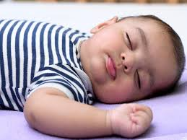
Safe Sleep and SIDS

Slide 2
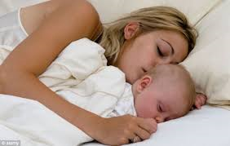
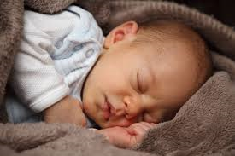
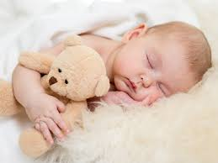
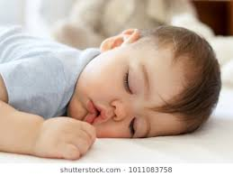
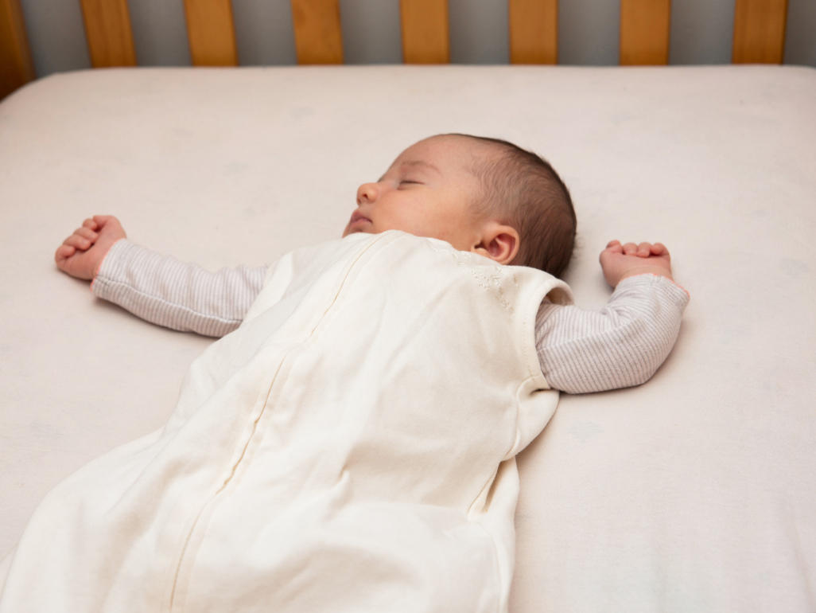
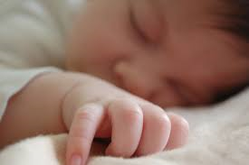
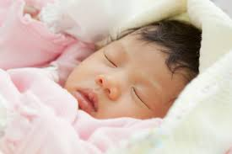
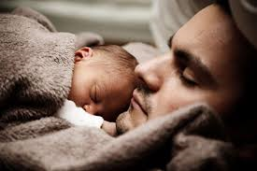
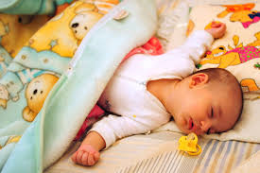
Which Baby is Sleeping the Safest?

Slide 3
Definition of SIDS
Sudden death which occurs before 1 year of age, usually in a previously healthy infant.
Cause of death unexplained after thorough investigation; including complete autopsy, death scene investigation, and review of child’s health history
A diagnosis of exclusion
SIDS is not predictable

Slide 4
Sleep-Related Deaths
Sudden and unexpected infant death (SUID)
a.k.a. Sudden and unexpected death in infancy (SUDI)
Most occur during sleep
Suffocation, strangulation, entrapment
Undetermined
SIDS

Slide 5
SIDS Facts
In 2016, there were about 1,500 deaths due to SIDS, 1,200 deaths due to unknown causes, and about 900 deaths due to accidental suffocation and strangulation.
It is the leading cause of death for babies from 1 to 12 months of age
Highest risk is at 2 to 4 months; 91% occur between 1 and 6 months of age
Seasonal trend: there are more SIDS deaths in winter months
More male babies die of SIDS
Unaccustomed tummy sleeping increases risk as much as 18 times.

Slide 6
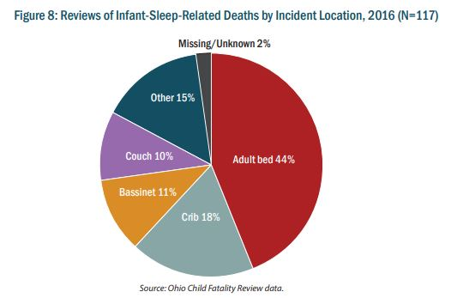
Sleep Deaths by Location

Slide 7
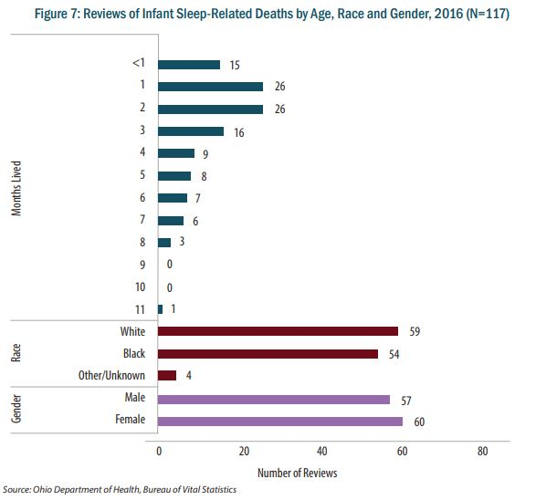
Sleep Deaths by Age, Race, Gender

Slide 8
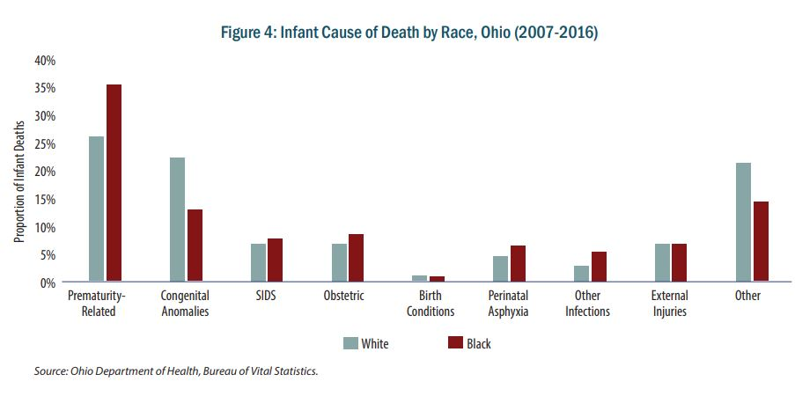
Other Infant Deaths by Race

Slide 9
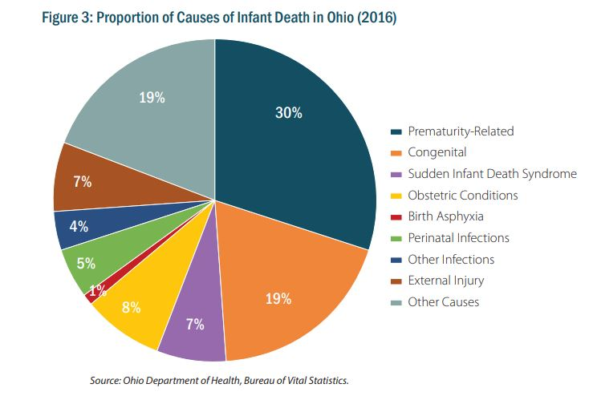
Causes of Infant Deaths in Ohio

Slide 10
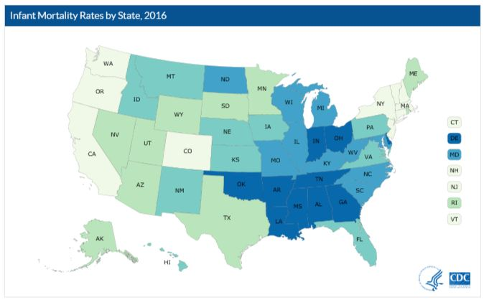
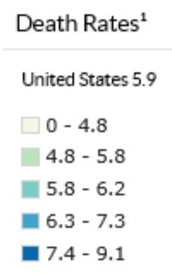
Infant Death Rates by State in the US

Slide 11
Triple Risk Model
Brainstem dysfunction, arousal defect, gene polymorphism
Highest risk at 2-4 months
Prone sleep position, smoke exposure, soft bedding

Slide 12
Established Risk Factors
Prone/side sleep position
Maternal smoking during pregnancy
Environmental tobacco smoke
Overheating
Soft sleep surface
Soft objects in crib
Late or no prenatal care
Young maternal age
Prematurity and/or LBW
Male sex
African American
American Indian

Slide 13
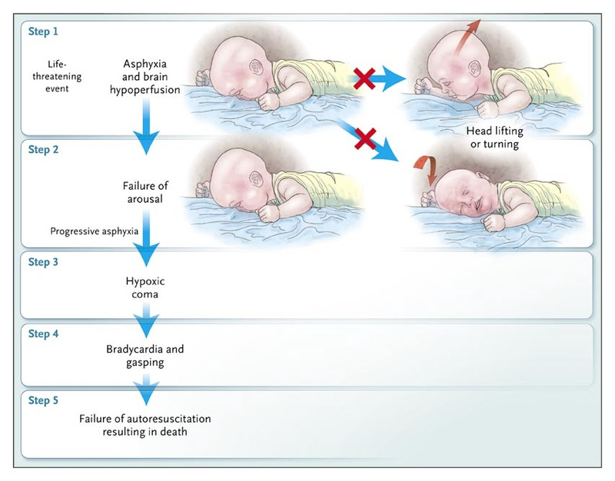
Rebreathing Theory
Infants in certain sleep environments are more likely to trap exhaled CO₂ around the face
Lie prone and near-face-down/ face-down
Soft bedding
Tobacco smoke exposure
Infants rebreathe exhaled CO₂
Infants die if they cannot arouse/ respond appropriately

Slide 14
Brain Dysfunction
Kinney et al have found abnormalities in autonomic control in the brainstem
Decreased neurotransmitter (serotonin) binding
Network dysfunction
Infants may not be able to sense and respond to hypercarbia or hypoxia
Weese-Mayer and others have found polymorphisms in serotonin transporter protein gene

Slide 15
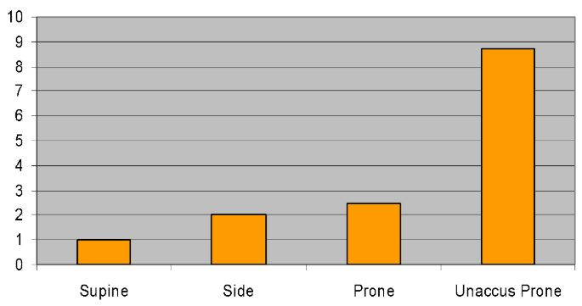
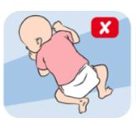
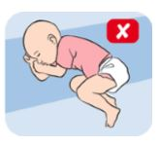
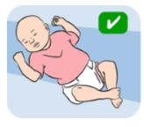
SIDS vs. Sleep Position
Unaccustomed Prone
Non-parental caregivers may use tummy sleeping
Increases risk of SIDS (as much as 18 times)
Less ability to lift head in tummy position
Need later development of upper body strength

Slide 16
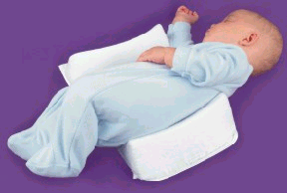
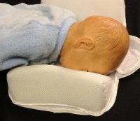
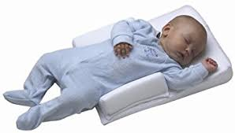
Wedges and Positioners
Not Recommended

Slide 17
But What About Choking?
Supine does not increase the risk of choking and aspiration in infants, even those with GE reflux
Protective airway mechanisms
Infants with GE reflux should be placed supine
RARE exception: infants for whom the risk of death from complications of GE reflux is greater than the risk of SIDS (i.e., those with upper airway disorders, for whom airway protective mechanisms are impaired)
Examples: infants with anatomic abnormalities (e.g., type 3 or 4 laryngeal clefts, who have not undergone anti-reflux surgery)
Elevating the head of the infant’s crib while the infant is supine is not recommended
Ineffective in reducing GE reflux
Infant may slide to the foot of the crib - may compromise

Slide 18
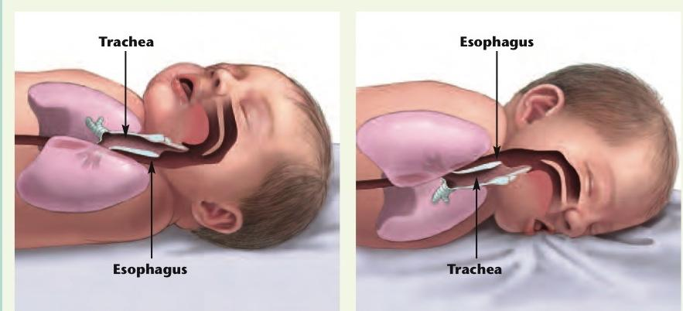
Remember the anatomy!

Slide 19
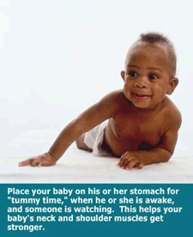
Avoidance of Plagiocephaly
Also known as “flat head syndrome”
Affects nearly one in every two infants.
Flat spot on the back or side of head.
Due to baby’s skull being very soft
Pressure from everyday surfaces (beds, car seats)
Encourage “tummy time” when infant is awake and observed. This will also enhance motor development.

Slide 20
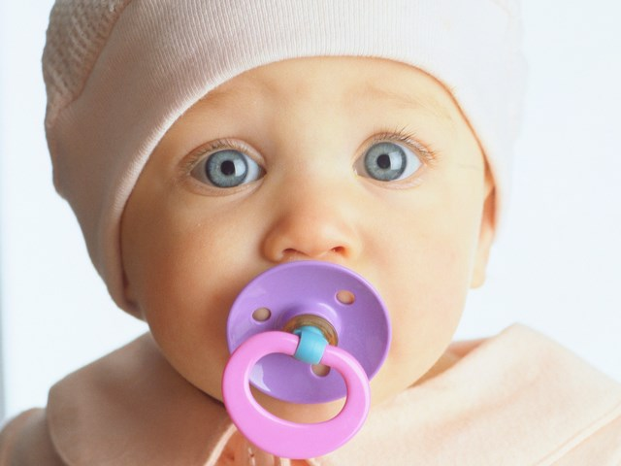
Pacifiers AAP Recommendation:
Studies consistently demonstrate a protective effect of pacifiers on SIDS
Consider using pacifier for bedtimes and naps.

Slide 21
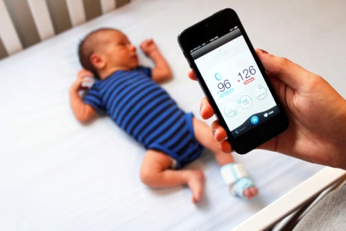
Home Monitors
Research finds SIDS monitors to be ineffective and should not be used to reduce the risk of SIDS.

Slide 22
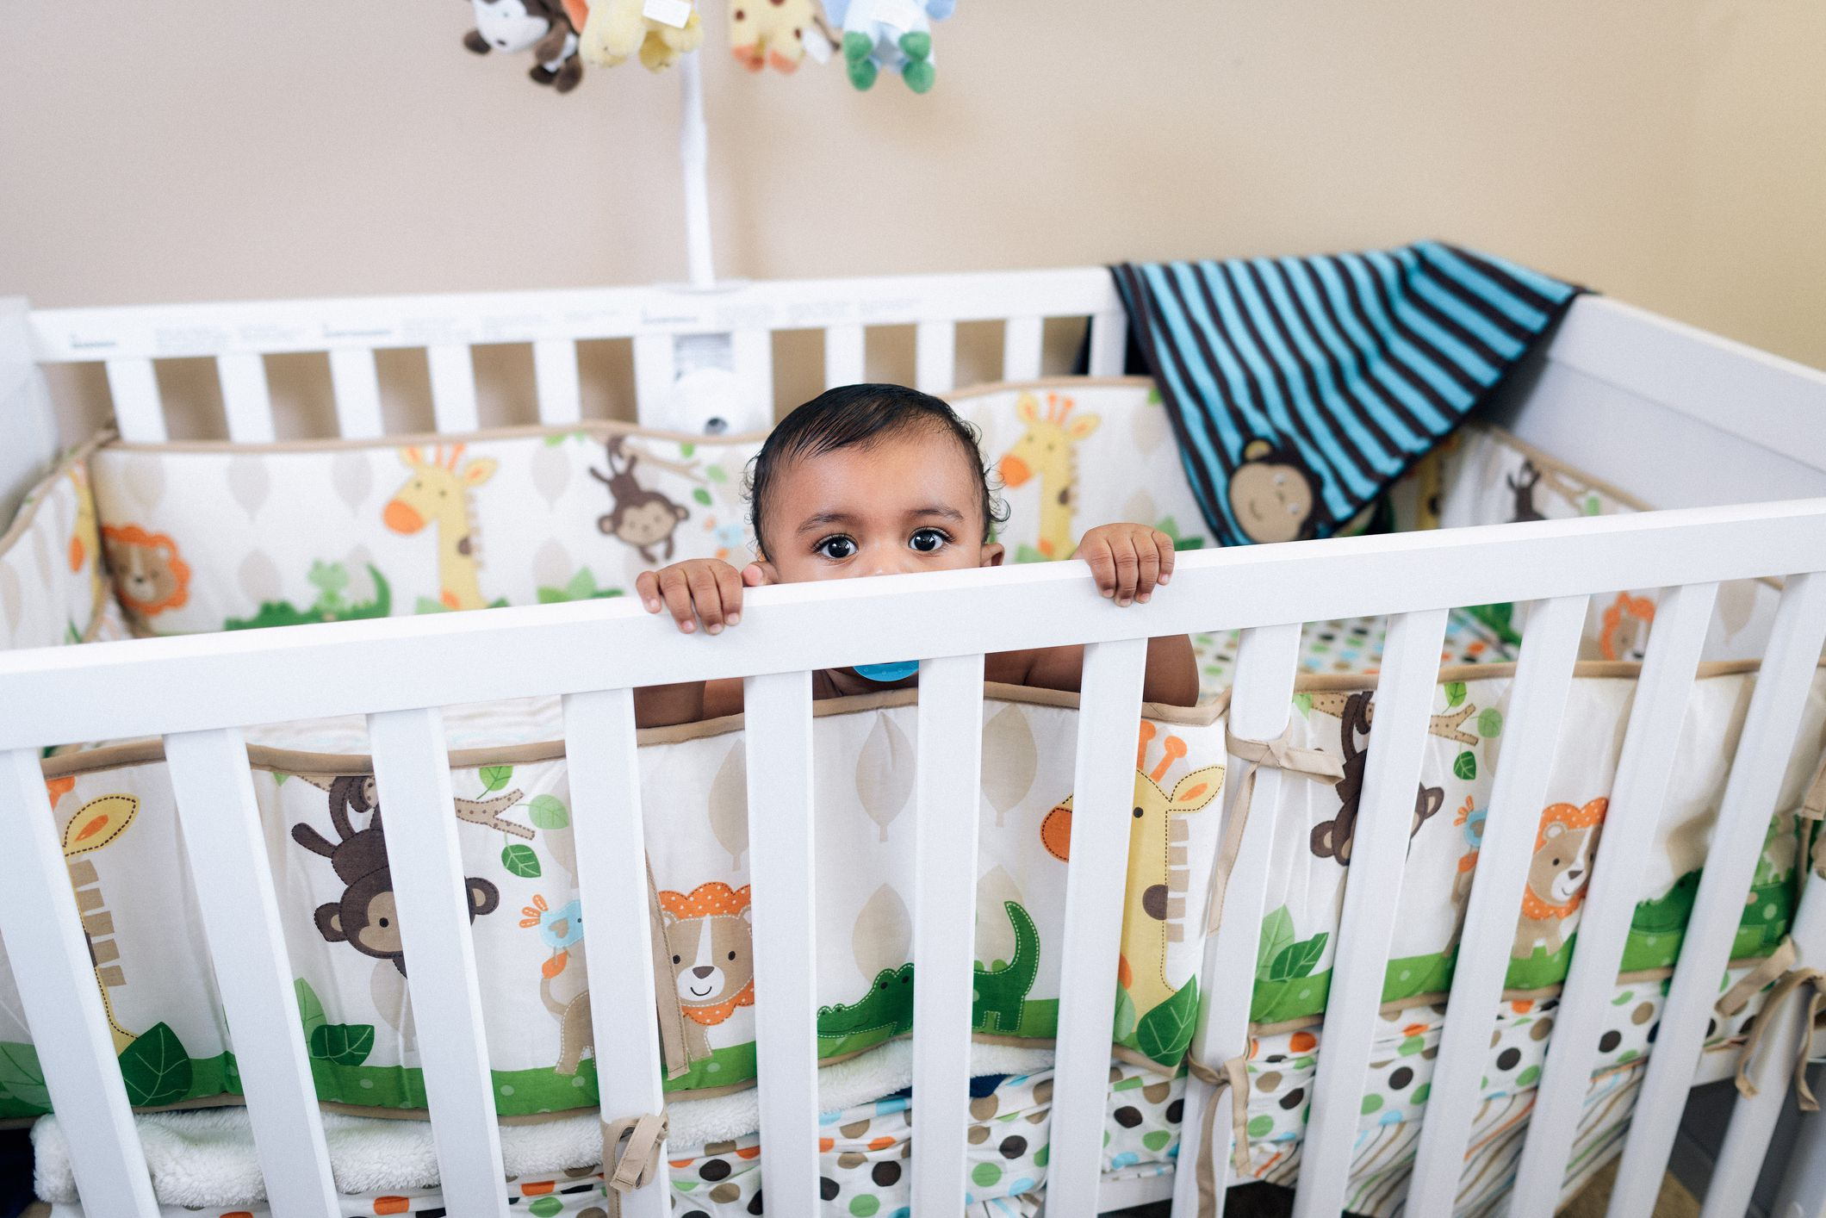
Dangers of Soft Bedding

Slide 23
Dangers of Soft Bedding
Infants dying from SIDS are more likely to have:
used a pillow or soft mattress
been found with nose and mouth completely covered by bedding
assumed face-down posture
Soft bedding increases risk of SIDS 5x, independent of prone position
Soft bedding + prone = OR 21.0 (Hauck, 2003)
Also increases risk of suffocation, strangulation, and entrapment

Slide 24
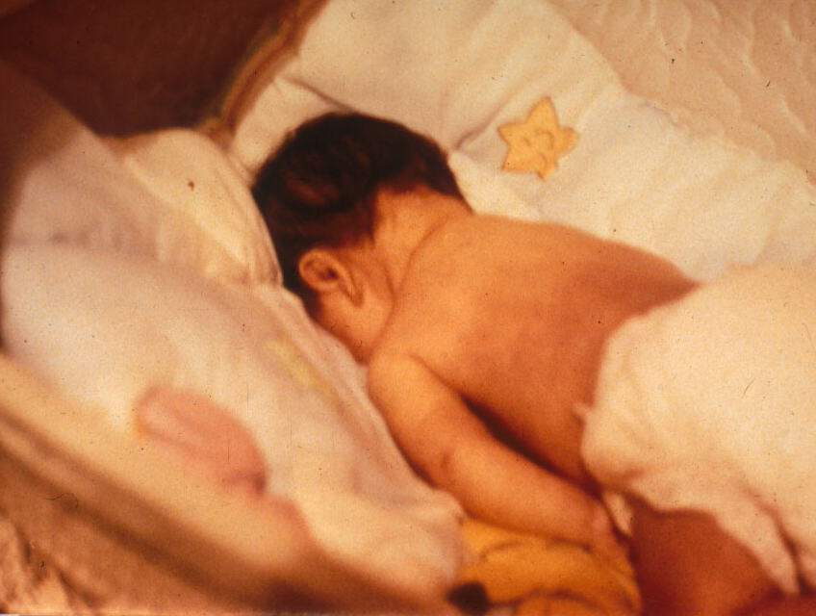
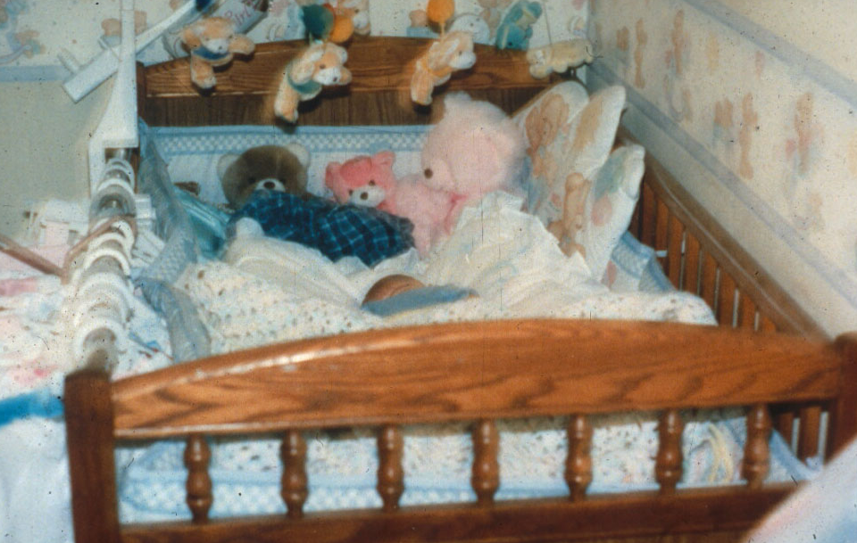
Result of Soft Bedding (CPSC Files)

Slide 25
Use a Firm Sleep Surface
To reduce SIDS and suffocation
Firm crib mattress, covered by fitted sheet
A crib, bassinet, portable crib, or play yard that conforms to CPSC safety standards
Check for recalls
Do not use cribs with missing hardware; don’t try to fix broken cribs
Use mattress designed for specific product
Mattress should be firm and maintain shape even when fitted sheet is used
No pillows or blankets in addition to or instead of mattress under the infant
No adult beds – risk of entrapment and suffocation

Slide 26
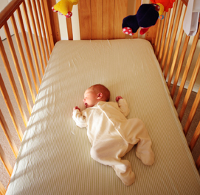
What can be in the crib?
Just the BABY!
Keep soft objects, toys and loose bedding out of sleep area
Don’t use
Pillows
Blankets
Quilts
Sheepskins
Crib bumpers

Slide 27
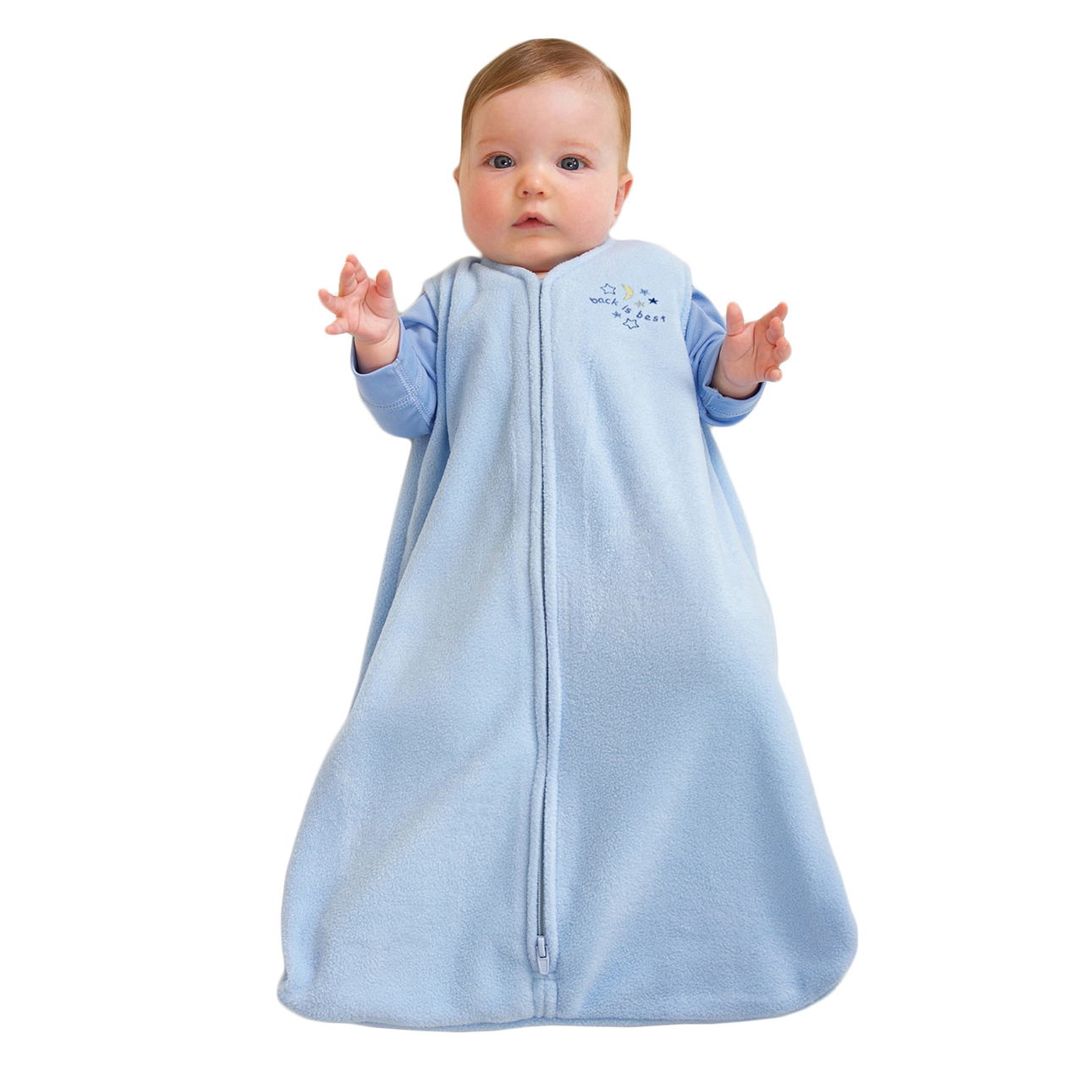
Sleep Clothing
One piece sleeper can be an alternative to blankets
Avoid Overheating
Dress infants appropriately for the environment, with no greater than 1 layer more than an adult would wear to be comfortable
Don't turn up the heat in baby’s room.

Slide 28
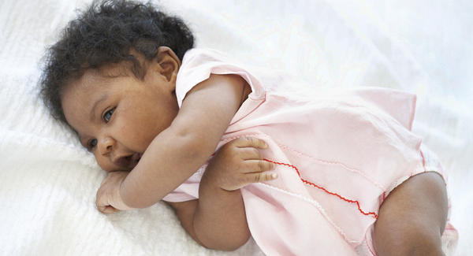
What About Rolling Over?
No data about when it is safe for infants to sleep in the prone or side position
Studies all include infants up to 1 year of age
Infants should continue to be placed supine until 1 year of age
Once an infant can roll from supine to prone and from prone to supine, the infant can be allowed to remain in the sleep position that he or she assumes

Slide 29
Remember the A, B, C’s

Slide 30
Christina Hickman, MA Edu, 2018

