Slide 1
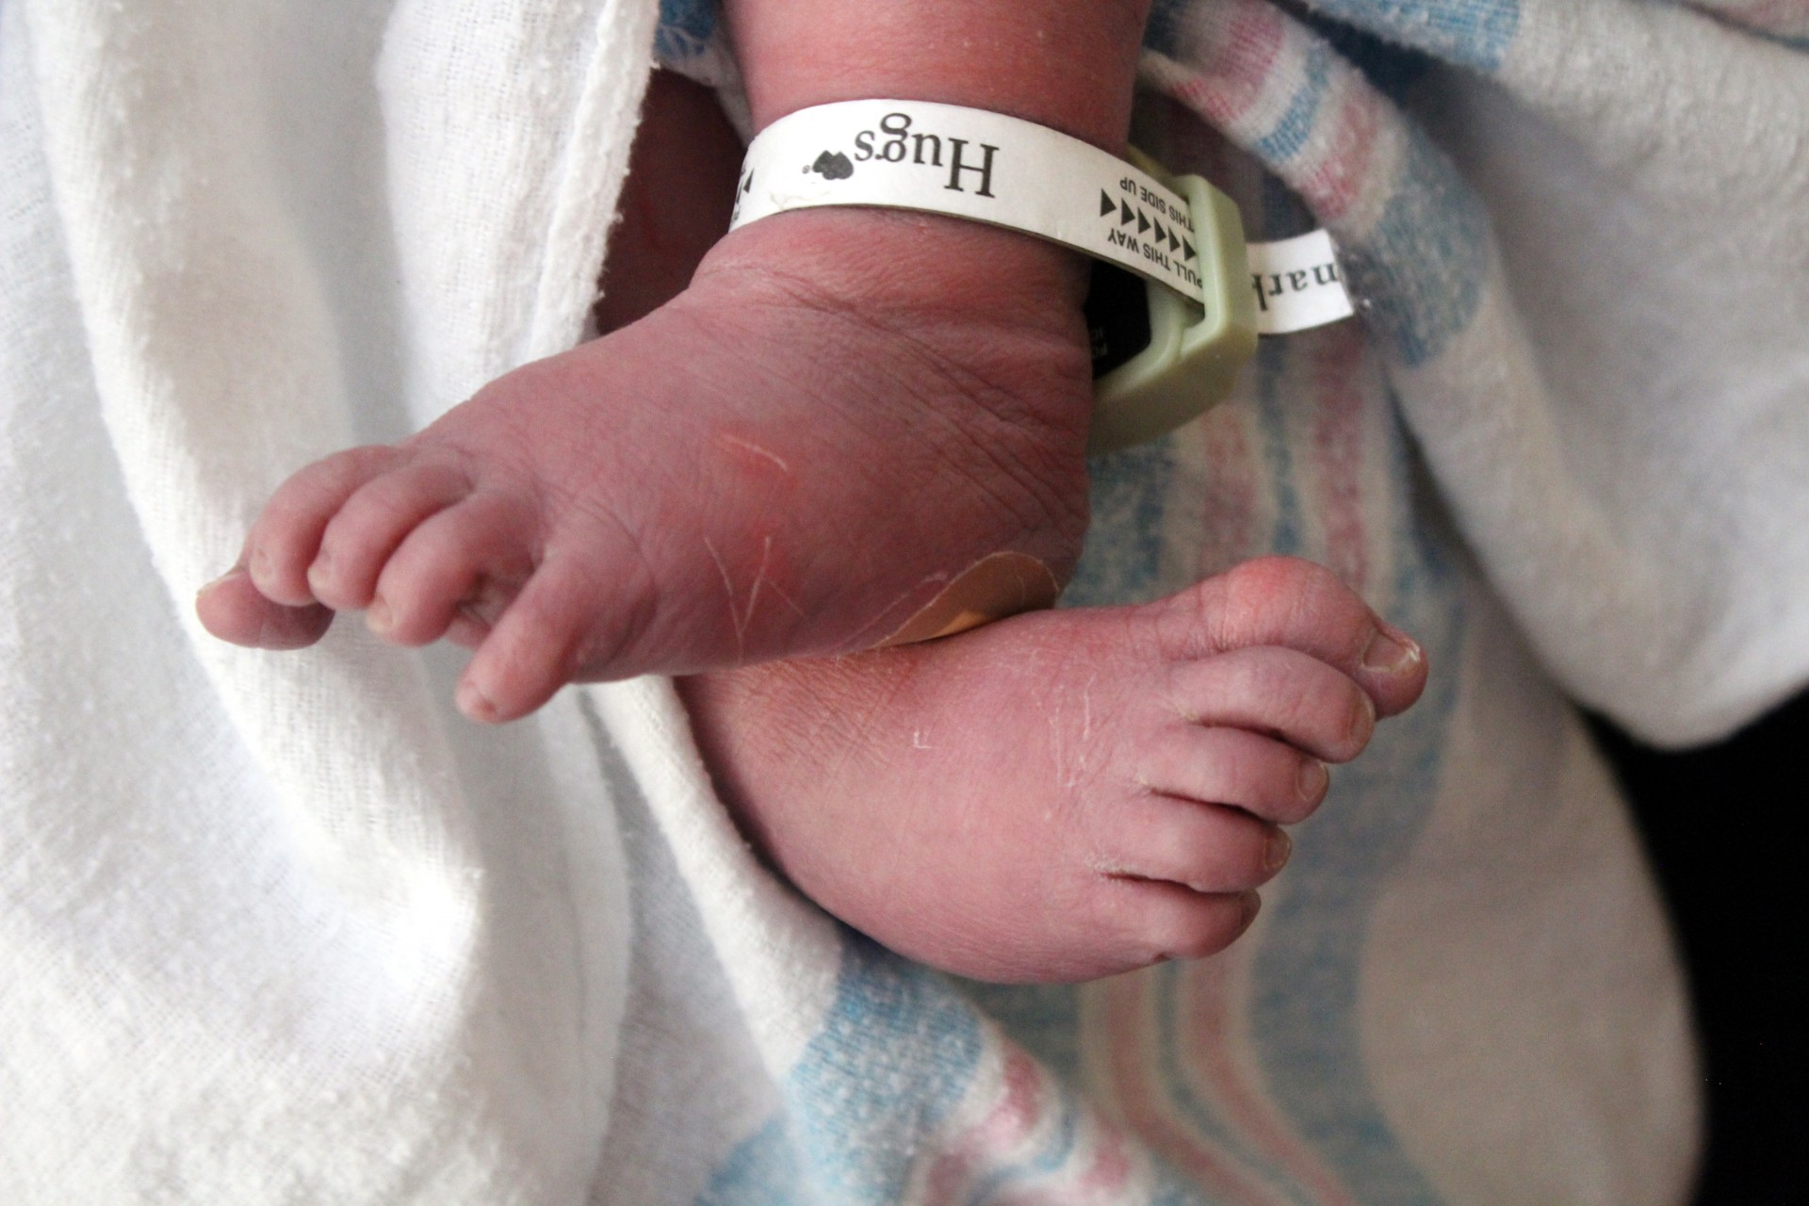
Newborn Care from A to Z
Your life will change from this moment on
Notes:
Amazing Newborn
When you get to hold your baby for the first time it will be a magical moment. You will count the tiny fingers and toes. Rub your hand over the soft tufts of hair and gaze into his or her eyes. From the moment of birth, newborns have amazing abilities. They can see, hear, smell, taste and feel.
Sight – baby will blink at bright lights and follow a moving target. They can focus on objects about 8 inches away but will fully develop their eyesight by age 2.
Hearing – baby has been able to hear your voice as a fetus at 5 months. Baby can locate the source of a sound, discriminate between mother’s voice and others.
Smell – baby can discriminate between mother’s breast.
Taste – baby can tell the difference between salty and sweet (they prefer sweet).
Touch – Newborns respond to touch, especially on the hands and mouth.

Slide 2
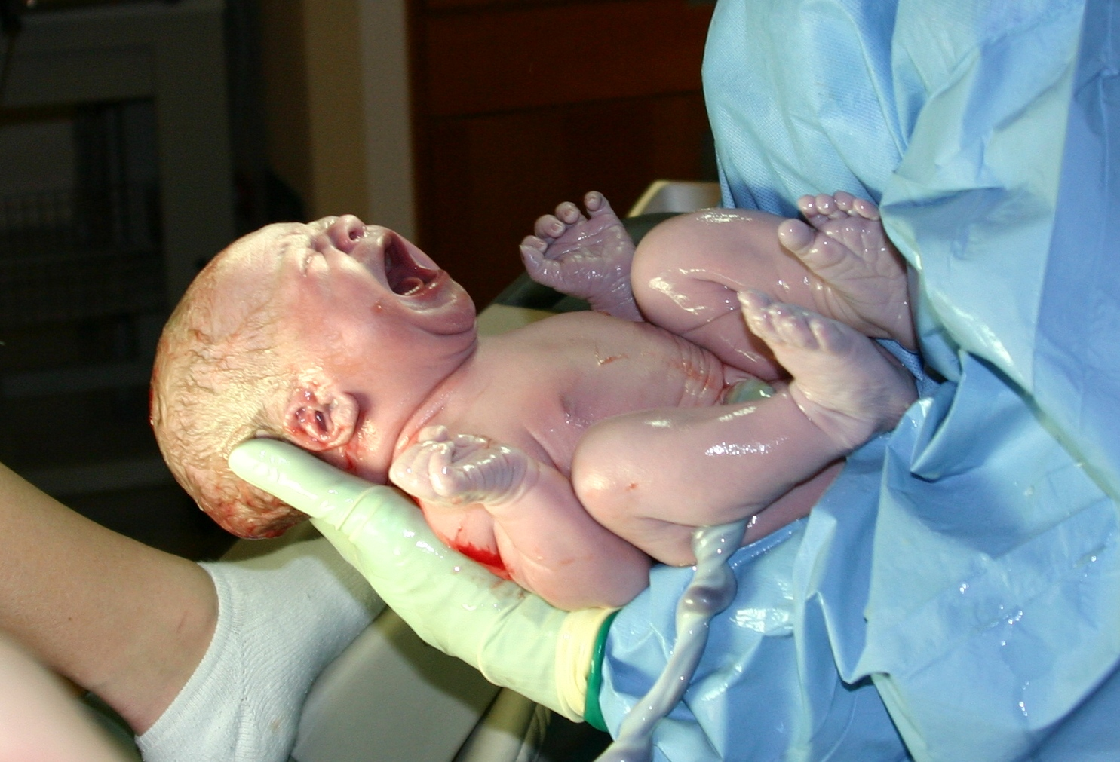
APGAR Scale
A system of rating the physical condition of the newborn at 1 and 5 minutes old.
Five Factors:
Heart Rate
Breathing
Muscle Tone
Response to Stimulation (crying)
Skin Color
Rating for each factor 0 to 2
7 or higher indicating a healthy newborn.
weteachfacs.com
Notes:
When you get to hold your baby for the first time it will be a magical moment. Bonding means falling in love but it’s not going to be like any other love you’ve felt before. You will count the tiny fingers and toes. Rub your hand over the soft tufts of hair and gaze into his or her eyes. Your life will change from that moment on.

Slide 3
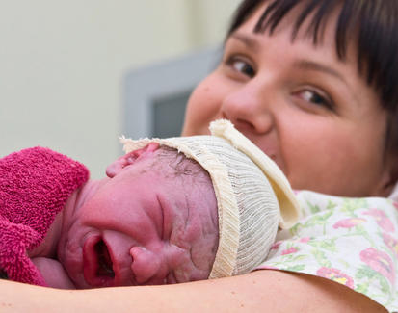
Bundle of Joy
You may notice:
The head is large, about one quarter of the total body length
Head may be misshapen, molded in the birth canal
Eyes are dark blue and may seem cross-eyed
Nose is small and flat
Skin is pinkish - purple
Face is puffy and swollen
Both boys and girls have swollen breast and genitals
You can nurse your baby right away if you choose
weteachfacs.com
Notes:
Bathing Your Baby
Your baby will get a sponge bath until the umbilical cord falls off in the first 2-3 weeks. Caution: Never place a cotton swab inside a baby’s ears or nose. Use a new cotton ball dipped in warm water, no soap, for each part: Eyes - wipe from inner eye to outer. Ears - Clean behind and around the outer ears. Nose – wipe around each nostril. Neck - Wipe gently under baby’s chin and folds of neck.
Supplies needed:
Baby tub
Baby soap
Tearless shampoo
Soft wash cloths
Two large soft towels
Baby clothes & diaper
Lotion and diaper cream
Getting ready:
The room should be warm, no breeze
Have all above supplies on hand
Check with water temperature
Bathing baby
Undress baby and wrap in large towel
Wet and wring out wash cloth. Wipe baby’s eyes and face.
Fold washcloth over finger and gently wash the outside and behind babies ears. NEVER PUT ANYTHING IN BABY’S EARS
Unwrap baby and lower into the tub.
Enjoy this time with baby, talk, sing and gently play.
Do not let baby become chilled

Slide 4
Caring for Newborn
Limit Visitors & going out for the first 2- 3 weeks
immune system can’t fight germs yet.
Everyone wash hands before handling baby.
Hold your baby often- don’t worry about spoiling your newborn.
weteachfacs.com
Notes:
Care for newborn
How do you cut an infants nails?
Visiting and going out - Keep baby inside and away from strangers for the first 2- 3 weeks. Your baby’s immune system can’t fight germs yet.
Everyone wash hands before handling baby. Especially before and after changing diaper.
Hold your baby often- don’t worry about spoiling your newborn.
Nails – Do this while baby is sleeping or when someone else can help hold baby. Use special scissors and emery boards for babies.
Bowel movements- the first BMs are called “meconium” which are thick and greenish. Breastfed babies have a yellowish color and formula fed babies have a tan BM. Color will change as diet changes.
Temperature could mean your baby is fighting and infection. Check with your doctor about their “fever policy”.
Care for umbilical cord until it falls off. Using a cotton swab with warm water and soap, wipe around the sides and the skin around the stump. Gently pat dry.

Slide 5
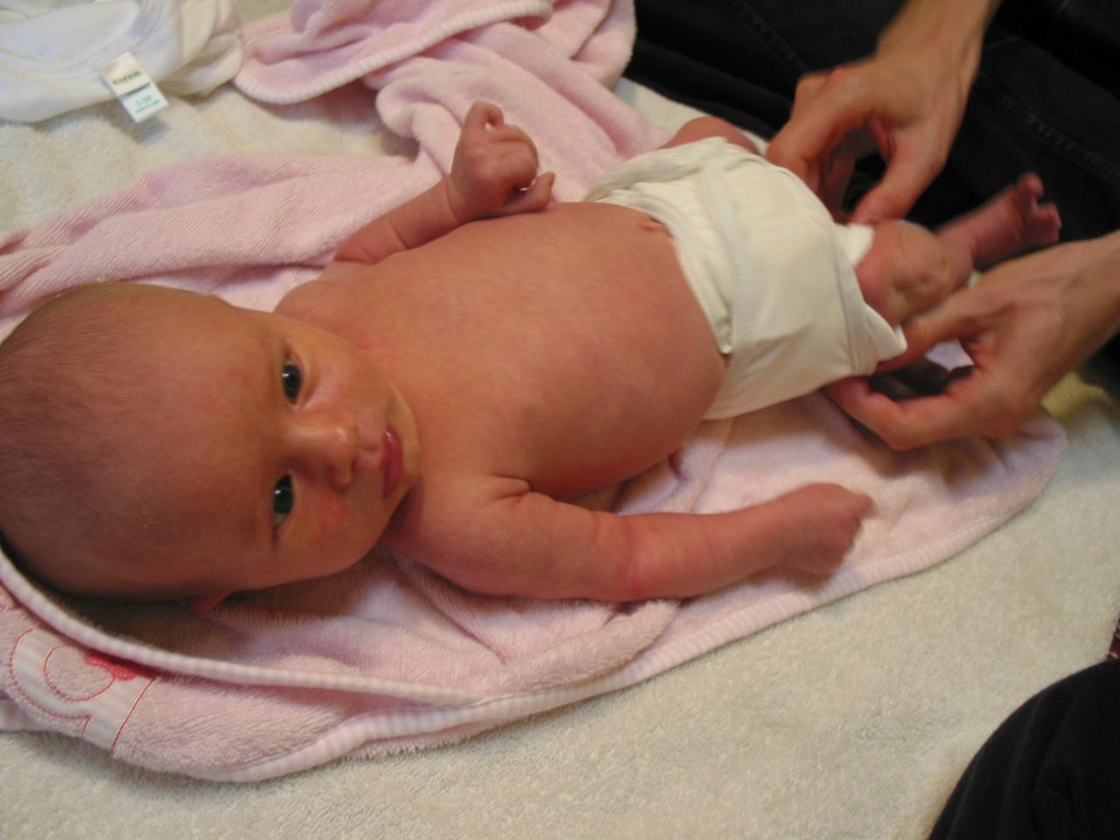
Diaper Duty
Newborns will wet 8 - 12 per day.
Wash hands before and after changing diaper.
Keep all supplies handy
Cover surface with waterproof pad
Apply cream with tissue.
Never use baby powder - talcum particles can cause lung damage
weteachfacs.com

Slide 6
Equipment for Baby
What are the differences between Needs Vs. Wants?
Babies are small but the equipment can take up a lot of room. Determine space for baby
There are a few things to consider when getting your home ready for baby’s arrival.
Where will baby sleep?
Where will you store baby clothing?
Where will you change baby’s diaper?
Where will you bathe baby?
weteachfacs.com
Notes:
Equipment for Baby
Babies are small but the equipment can take up a lot of room. Determine space for baby
There are a few things to consider when getting your home ready for baby’s arrival.
Where will baby sleep?
Where will you store baby clothing?
Where will you change baby’s diaper?
Where will you bathe baby?
Which of the following are needs and which are wants?
Children’s books
Photo albums
Homecoming outfit
Sleepers
Onesies
Socks
Shoes
Burp cloths
Hooded bath towels
Baby gym
Thank you notes
Clothing hangers
Convertible car seat
Bottles and nipples
Bottle brush
Rattles
Diaper bag
Wipes
Disposable diapers
Cloth diapers
Receiving blankets
Waterproof crib pads
Baby blankets
Baby monitor
Safety gate
Breast pump
Bottle warmer
Baby mittens
Pacifier
Thermometer
Diaper pail
Baby bathtub
Body wash
Infant car seat
Car seat toys
Jogging stroller
Bouncer/
Rocking chair
Play yard
High chair
Spat mat
Bassinet
Portable crib
Changing table
Fitted crib sheets
Crib bumper pads

Slide 7
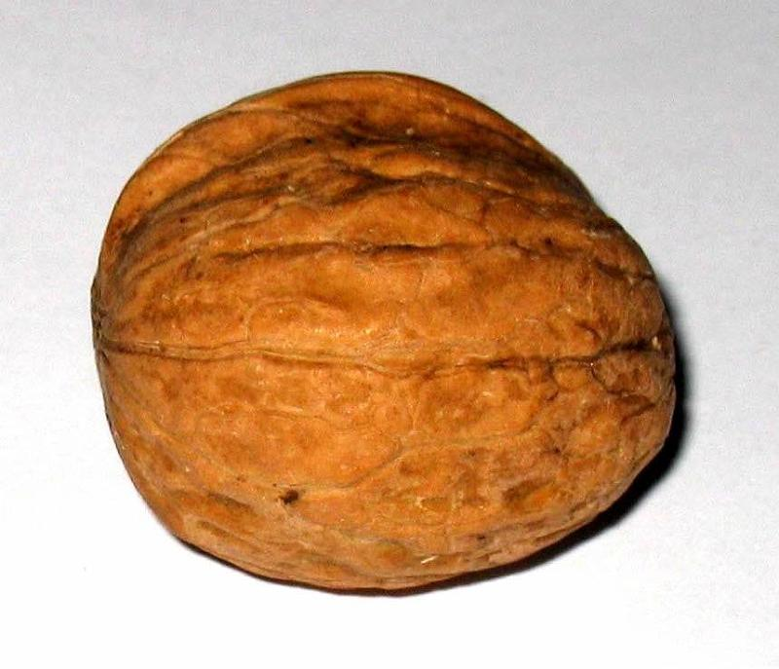
Feeding Baby
A newborn’s stomach cannot hold very much so it’s important that caretakers don’t overfeed babies. But they are also growing quickly and will be hungry every 2 – 3 hours. You will quickly recognize when your baby communicates that he or she is hungry.
1 day old
1-1/4 tsp
3 days old
.75 oz
1 month old
2.5 – 5 oz
weteachfacs.com
Notes:
Feeding Baby
A newborn’s stomach cannot hold very much so it’s important that caretakers don’t over feed babies. But they are also growing quickly and will be hungry every 2 – 3 hours.
The first day of life your baby’s stomach is the size of a large marble. By the third day the tummy is the size of a golf ball and by the tenth day it’s the size of a plastic Easter egg.
You will quickly recognize when your baby communicates that he or she is hungry.

Slide 8
Get Fathers Involved
Dad can do practically everything mom can do if he has the desire to bond with his newborn.
Carry baby and walk around the house.
Take baby on a stroller ride.
Try massaging your baby
Read to your baby
Give baby a bath
Change or dress baby
Take baby to appointments
Talk and sing to your baby
Play with your baby
Feed your baby.
Burp baby
weteachfacs.com
Notes:
Get Father Involved
Dads find themselves at a loss for what to do after baby arrives. Dad can do practically everything mom can do if he has the desire to bond with his newborn.
Here are some ideas
Carry baby and walk around the house.
Take baby on a stroller ride.
Try massaging your baby
Read to your baby
Give baby a bath
Change or dress baby
Take baby to appointments
Talk and sing to your baby
Play with your baby
Feed your baby.
Burp baby

Slide 9
Health and Wellness
Be a good role model by making healthy choices
Keep baby away from crowds during cold and flu season
Take your child for medical and dental check-ups
Provide exercise and stimulating activities
Feeding appropriate healthful foods at appropriate ages
Teach good hand washing practices
Protect your child from abuse
weteachfacs.com
Notes:
Health & wellness
There are several reason children will go see their doctor. Well-baby visits to check development, perform tests, and receive immunizations. The doctor will keep a record of your child’s health history; illnesses, injuries or infections.
Tips to keep your baby healthy:
Get your baby on a sleep and feeding routine to make things consistent.
Keep baby away from crowds during cold and flu season
Massage your baby
Take your child for medical and dental check-ups
Provide exercise and stimulating activities
Feeding appropriate healthful foods at appropriate ages
Provide vitamins if doctor recommends
Protect your home environment from dangerous cleaning chemicals, yard fertilizers, pesticides, cigarette smoke, pet dander and litter, lead and radon.
Keep your home safe from all accidental injuries
Use natural cleaning products that are safe on surfaces baby will touch
Teach good hand washing practices
Protect your child from abuse
Be a good role-model by making healthy choices

Slide 10
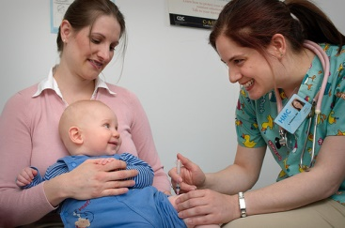
Immunize
Well-baby visits allow the doctor to check your child’s growth, perform tests, ask about daily habits and immunize against diseases like Hepatitis A, Influenza, Meningitis, Polio, RSV or whooping cough just to name a few.
After shots your child may have discomfort and will need plenty of TLC:
Use acetaminophen or ibuprofen
Never give aspirin to a child
Provide plenty of fluid
Dress in comfortable clothing
Beware of tenderness at shot site
Call your doctor if child is
Less active
Shaking,
Crying nonstop
Has a temperature which concerns you.
weteachfacs.com
Notes:
Immunize
Well-baby visits allow the doctor to check your child’s growth, perform tests, ask about daily habits and immunize against diseases like Hepatitis A, Influenza, Meningitis, Polio, RSV or whooping cough just to name a few. These shots will become a part of your child’s “Immunization Record”.
After Shots your child may have discomfort and will need plenty of TLC
Use acetaminophen or ibuprofen
Never give aspirin to a child
Provide plenty of fluid
Dress in comfortable clothing
Beware of tenderness at shot site
Call your doctor if child is
Less active
Shaking,
Crying nonstop
Has a temperature which concerns you.
Be Wise, Immunize

Slide 11
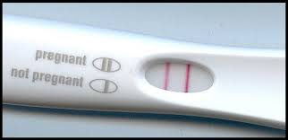
Just In Case
Even though having sex after the birth of your baby is the furthest thing from your mind you should plan ahead, just in case. There are many different methods of birth control to investigate. talk to your healthcare provider about the options that are best for you.
Here are some important and surprising facts about postpartum birth control:
1. A new mom can get pregnant before she's even gotten her period. Since ovulation occurs two weeks before menstruation, a new mom should not wait until she's gotten her period again to begin using birth control.
2. Just because a woman is breastfeeding does not mean she can't get pregnant. There are certain criteria that a new mom's breastfeeding patterns must meet before she can rely on breastfeeding as a form of birth control.
Some forms of birth control require several weeks to be effective. This, combined with the fact that a woman may begin ovulating as early as 25 days after giving birth, indicates that a new mom should begin thinking about birth control methods as soon as possible after having the baby -- or ideally, during pregnancy.
Source: American College of Obstetricians and Gynecologists
Reviewed 11/02 by Elizabeth Stein, CNM
weteachfacs.com

Slide 12
Keep Your Home Safe
Protect your home environment from dangerous cleaning chemicals, yard fertilizers, pesticides, cigarette smoke, pet dander and litter, lead and radon.
Keep your home safe from all accidental injuries
Use natural cleaning products that are safe on surfaces baby will touch
weteachfacs.com
Notes:
Keep your goals in focus.
Remember, you need to get your education because your baby is depending on you now. Finishing school is the most important step in providing a good future for you and your child.
One of the best suggestions is to utilize a good time management system with a planner or on a device.
Be sure to seek help from your school administrators, guidance counselors and teachers. They want you to succeed and will help you stay on top of requirements.
If you are getting behind see if there is an online course you can take to catch up.
Ask for peer tutoring if you fall behind.
Ask your family to watch your baby for designated times of the day or evening so you can study and complete work.
Stay organized

Slide 13
Learning to Communicate
You can’t spoil a baby with too much love!
So hug and cuddle often!
Can you imagine what it would be like if you needed something but couldn’t speak? A newborn can only cry to get your attention. You will learn what baby needs by the type of cry:
When a parent or caregiver responds to an infant’s cry it is a vital part of how the baby will learn to trust and bond with those around him.
the HUNGRY Cry- Rhythmical rise & fall - demanding not desperate
the CRY of PAIN - Loud gasp - shrieks
the BORED or GRUMBLING CRY - Low pitched - not demanding - increases when ignored
the ANGRY CRY - Loud - demanding - not a type of cry until about 6 months of age
When baby cries It’s okay to walk away and count to 10
weteachfacs.com
Notes:
Learning to Communicate
Can you imagine what it would be like if you needed something but couldn’t speak? A newborn can only cry to get your attention. You will learn what baby needs by the type of cry:
the HUNGRY Cry
Rhythmical rise & fall - demanding not desperate
the CRY of PAIN
Loud gasp - shrieks
the BORED or GRUMBLING CRY
Low pitched - not demanding - increases when ignored
the ANGRY CRY
Loud - demanding - not a type of cry until about 6 months of age
When a parent or caregiver responds to an infant’s cry it is a vital part of how the baby will learn to trust and bond with those around him.
You can’t spoil a baby with too much love!
So hug and cuddle often!

Slide 14
Massage Your Baby
Promotes bonding
Helps baby sleep
Relieves gas
Reduces crying
Boosts immune system
Relieves teething pain
Massage Techniques: go online to find video demonstrations
weteachfacs.com
Notes:
Massage Your Baby
Your baby will benefit from receiving your gentle touch and will communicate a strong message of love. Studies show that touch and massage can improve all aspects of your baby’s development. Infant massage can also promote bonding, help parents relax, help baby sleep better, and relieve symptoms of gas. Massage can reduce crying, boost the immune system, enhance body awareness, relieve nasal congestion and teething discomfort. Best to begin after baby is 4 weeks old.
Massage Tips:
Choose a time when your baby is awake and not hungry.
Have all of your supplies ready – oil, towel, diaper clothes
Provide a safe, warm environment for the massage.
Wash your hands and remove jewelry.
Play soft music in background.
Always ask permission to begin the massage.
Massage Techniques: go online to find video demonstrations
Head & Face - Giggle & Grin, Smoothing, Peek-a-Boo, Thumbs Up, Gentle Circles, Sweetheart Stroke.
Arms & Hands – Indian Milking, Squeeze and Twist, Finger & hand Massage, Rolling.
Chest - Valentine, Open Book, Butterfly
Stomach – Water Wheel, Navel Stroke, Finger Walking, Sun Moon, I Love You
Arms: Milking – move your hands in opposite directions from wrist up to shoulders
Legs: Leg Roll, Swedish Milking, Indian Milking, Squeeze and Twist, Foot Massage
Back - Back & Forth, Swooping Strokes, Back Massage, Combing,
Exercises – Arm Cross, Wrist & Ankle Cross, Leg Cross, Leg Stretch,

Slide 15
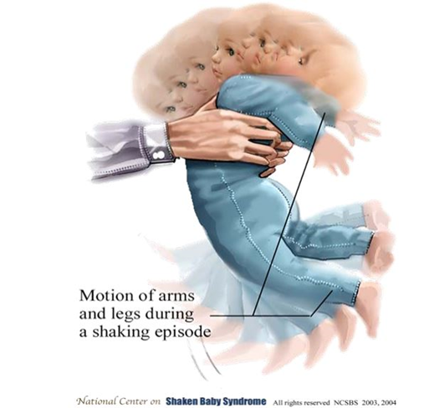
Never Shake Your Baby
) Baby’s brain bangs against skull.
2) Small blood vessels are torn - bleeding
3) Blood clots press on brain.
4) Vertebrae crush the spinal cord
Results:
BRAIN DAMAGE
RETARDATION
LEARNING DISABILITIES
PHYSICAL DISABILITIES
PARALYSIS
BLINDNESS
DEATH
weteachfacs.com
Notes:
Never Shake Your Baby
Newborns can cry anywhere from 30 minutes to 6 hours per day! That can un-nerve even the most patient caretaker. But some people can lose control and shake a baby just to quiet them with deadly results.
1) Baby’s brain bangs against skull.
2) Small blood vessels are torn - bleeding
3) Blood clots press on brain.
4) Vertebrae crush the spinal cord
Results:
BRAIN DAMAGE
RETARDATION
LEARNING DISABILITIES
PHYSICAL DISABILITIES
PARALYSIS
BLINDNESS
DEATH
It’s okay to walk away and count to 10

Slide 16
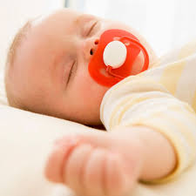
Offer a Pacifier
According to AAP pacifiers
Lowers the risk of SIDS if used during sleep.
do not reinsert if it falls out.
Doesn’t affect breastfeeding
Will not cause dental problems
don’t tie onto clothing
use one-piece pacifiers only
weteachfacs.com
Notes:
Offer a Pacifier
AAP – American Academy of Pediatricians say consider offering a pacifier at nap time and bedtime.
It has been shown that the pacifier lowers the risk of SIDS if used during sleep. Using a pacifier does not affect breastfeeding, and does not cause later dental problems. The task force recommends use of a pacifier until one year of age according to the following procedures:
Use the pacifier when placing the infant down for sleep, and do not reinsert once the infant falls asleep. If the infant refuses the pacifier, he or she should not be forced to take it.
Pacifiers should not be coated in any sweet solution.
Pacifiers should be cleaned often and replaced regularly.
For breastfed infants, do not start using the pacifier until 1 month of age to ensure that breastfeeding is firmly established.
Don’t tie it on to clothing.
Check with Consumer Products Safety Commission for pacifier recalls
Use one-piece pacifiers only
Don’t buy too many pacifiers before baby arrives

Slide 17
Play with Baby
Interacting with baby affects his growth
and
endorphins will make you feel happy!
weteachfacs.com
Notes:
Play with baby
Interacting with your baby will directly affect his growth and development. It will release endorphins in you that will make you feel happy and calm.
Begin talking to your baby
Read to your baby
Ask him how he’s doing today.
Stroke and pat your tummy.
Play with him by poking your tummy
Sing to him
Listen to soft music
Dance with him
Tell him you love him and you can’t wait to hold him.

Slide 18
Quiet & Calm Baby
Newborns can cry anywhere from 30 minutes to 6 hours per day!
Dr Karp developed the five S’s calming method
Swaddling
Side position
Shushing
Swaying
Sucking
weteachfacs.com
Notes:
Quiet & calm your baby
Comfort your baby by feeding, swaddling, rocking, singing and offering a pacifier.
Using cross-cultural techniques combined with his own research, Dr. Karp has developed the "five S's system". Some babies will need all five, others just a few to help induce what he calls the "calming reflex."
Swaddling - Tight swaddling provides the continuous touching and support the fetus experienced while still in Mom's womb.
Side/stomach position - You place your baby, while holding her, either on her left side to assist in digestion, or on her stomach to provide reassuring support. Once your baby is happily asleep, you can safely put her in her crib, on her back.
Shushing Sounds - These sounds imitate the continual whooshing sound made by the blood flowing through arteries near the womb. This white noise can be in the form of a vacuum cleaner, a hair dryer, a fan or from an app on your device.
Swinging - Newborns are used to the swinging motions that were present when they were still in the womb. Every step you took, every movement caused a swinging motion for your baby. After your baby is born, this calming motion, which was so comforting and familiar, is abruptly taken away. Your baby misses the motion and has a difficult time getting used to it not being there.
Sucking - "Sucking has its effects deep within the nervous system," notes Karp, "and triggers the calming reflex and releases natural chemicals within the brain." This "S" can be accomplished with breast, bottle, pacifier or even a finger.

Slide 19
Reflexes of Infants
All babies are born with a set of reflexes which are automatic physical responses to specific stimuli
Rooting – when touched on the cheek baby will turn head toward the touch and search for something to suck.
Moro – also known as the startle reflex, when baby hears a sudden loud noise both arms are thrown outward and back is arched.
Babinsky – when you stroke the bottom of baby’s feet he fans out the toes and then curls them.
Grasp – when there is something in baby’s hand he will grasp it by curling his fingers around
Stepping – If you hold a baby up to that her feet barely touch the ground, she will make walking movements with legs.
weteachfacs.com
Notes:
Reflexes of Infants
All babies are born with a set of reflexes which are automatic physical responses to specific stimuli
Rooting – when touched on the cheek baby will turn head toward the touch and search for something to suck.
Moro – also known as the startle reflex, when baby hears a sudden loud noise both arms are thrown outward and back is arched.
Babinsky – when you stroke the bottom of baby’s feet he fans out the toes and then curls them.
Grasp – when there is something in baby’s hand he will grasp it by curling his fingers around
Stepping – If you hold a baby up to that her feet barely touch the ground, she will make walking movements with legs.

Slide 20
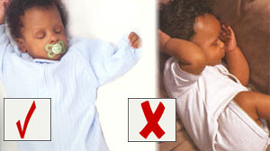
Safe Sleep
SIDS is the leading cause of death from 1 to 12 months
Back to Bed
Never sleep on side or stomach
weteachfacs.com
Notes:
Safe Sleep
Provide safe sleep by placing your baby on his back.
Remove all pillows, stuffed animals and crib padding.

Slide 21
Temperament of Baby
For a calm baby begin creating a routine for everyday activities
weteachfacs.com
Notes:
Temperament
You over slept, missed the bus, were late for school. What happens to your day when your routine is changed? Does it offset your whold day or do you just shrug it off? What kind of temperament do you have?
For a calm baby begin creating a routine for
playing
reading
bathing
sleeping
waking
eating
dressing
napping
Try to eliminate stress and tension around baby

Slide 22
Using a Car Seat
Never accept a USED Car Seat always use the car seat facing the rear.
Did you know that it’s estimated that 80% of car seats are installed incorrectly? That’s why it’s important to visit a certified child passenger safety technician to double check.
Never accept a USED Car Seat
Always use the car seat facing the rear.
Check the Consumer Reports Safety Commission before purchasing a car seat.
Always check the label on the car seat to make sure it’s correct for your child’s age, weight and height.
weteachfacs.com
Notes:
Using a Car Seat
Never accept a USED Car Seat
Always use the car seat facing the rear.

Slide 23
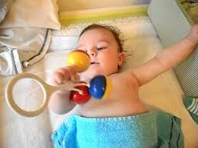
Vision Development
Infants like high contrasting colors and can only focus on something 7 – 10 inches from her face.Between 2 – 4 months she can see 12 – 18 inches in front of her. She will enjoy looking at her own hands.
At 6 months her eye movements are coordinated and smooth. She can see as far as 6 feet.
By age 2 her vision is 20/20.
weteachfacs.com
Notes:
Vision Development
Vision development occurs in the first few months after birth. If infants have vision problems then brain connections will not be made because she’s not seeing and learning about her environment.
Infants are attracted to high contrasting colors like black and white or red. Between birth and 2 months she can only focus on something 7 – 10 inches from her face.
Between 2 – 4 months she can see 12 – 18 inches in front of her. She will enjoy looking at her own hands.
At 6 months her eye movements are coordinated and smooth. She can see as far as 6 feet.
By age 2 her vision is 20/20.

Slide 24
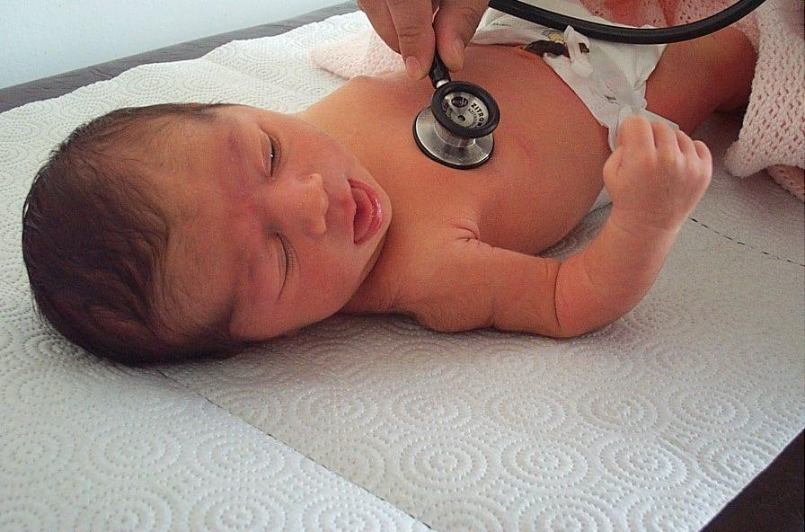
When to Call Your Doctor
One of the hardest thing for a parent is caring for their sick child. Don’t forget to take care of yourself by asking another adult to help out.
Go to Urgent Care for non-life-threatening problems.
Go to Emergency Rooms for serious problems like convulsions, severe burns, severe bleeding and unconsciousness.
Call 911 for life threatening illness or injuries
weteachfacs.com
Notes:
When to Call Doctor
One of the hardest thing for a parent is to care for a sick child. It takes hours, sometimes day, before there is any improvement. Things like fevers, vomiting or diarrhea, sore throats and ear infections can be handled at home with Tylenol, Pedialyte and a nasal syringe. Don’t forget to take care of yourself by asking another adult to help out.
Some symptoms may require a doctor's attention:
Changes in weight or eating habits
Changes in behavior or sleep patterns
Temperature over 102 degrees Fahrenheit that persists or recurs (fevers are not harmful as they fight infections)
Frequent vomiting or diarrhea over a period of days
Inability to hold down liquids
Signs of skin infection
Severe sore throat
Persistent cough
Localized pain, such as an ear infection
Nasal fluid that is discolored, bad-smelling or bloody
Go to Urgent Care for non-life-threatening problems.
Go to Emergency Rooms for serious problems like convulsions, severe burns, severe bleeding and unconsciousness.
Call 911 for life threatening illness or injuries

Slide 25
Extended Family
The African Proverb, “it takes a whole village to raise a child” should encourage you to find support from your family, friends, and community.
weteachfacs.com
Notes:
Extended Family
After your family adjusts to the news of your pregnancy they will be very supportive.
Go to them for guidance. You are still their child and they would still be as worried about you and your pregnancy even if you were 25 years old.
This is their grandbaby, the one they’ve always dreamed about having one day. When the baby is here they will love it and spoil it!

Slide 26
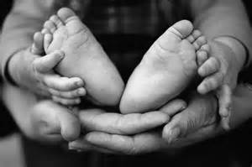
Your New Role
Raising a child is one of the most exhausting yet gratifying accomplishments you will ever do!
Feeding (8 – 12 per day)
Prepare formula, cleaning bottles
Changing diapers – 10 – 12 per day
Changing baby’s clothes
Bathing baby
Laundry
Activities with baby
Holding & rocking baby
weteachfacs.com
Notes:
Your new role
Welcome to Parenthood! You are now responsible for another human being! There are so many daily chores involved in caring for newborns and you will find yourself wondering if you will ever feel rested again!
Feeding (8 – 12 per day)
Prepare formula, cleaning bottles
Changing diapers – 10 – 12 per day
Changing baby’s clothes
Bathing baby
Laundry
Activities with baby
Holding & rocking baby
Raising a child is one of the most exhausting yet gratifying accomplishments you will ever do!

Slide 27
Zzzzz’s For Baby
Newborns spend 80% of their time SLEEPING!
And in an Alert State about 10-15% (2-4 hours) per day
When baby is alert, this is the best time to play and interact.
When baby is in Active or Crying state he can be soothed by touching, movement and warmth.
Being able to identify your baby’s state of consciousness you will be able to respond to his needs.
weteachfacs.com
Notes:
Zzzz’s for Baby
Newborn babies will be in various states of consciousness throughout the day.
Deep sleep – very little movement with regular breathing
Light Sleep – some body movements, eye movements with eyes closed
Drowsy – semi-dozing with eyes closed or open
Alert – Bright eyes, muscles activity, very responsive.
Active – considerable movement, often fussy
Crying – vigorous activity and loud crying
During the first week of life, a newborn spends 80% of their time in the Deep Sleep, Light Sleep or Drowsy State.
And in an Alert State about 10-15% (2-4 hours) per day
When baby is alert, this is the best time to play and interact.
When baby is in Active or Crying state he can be soothed by touching, movement and warmth.
Being able to identify your baby’s state of consciousness you will be able to respond to his needs.

Slide 28
Christina Hickman, MA. Ed 2018
weteachfacs.com

