Slide 1
Nature vs. Nurture
which is the result of parenting?

Slide 2
What do you think?
Do you think what happens to you in early childhood impacts you later in life?
Explain

Slide 3
Heredity (nature)
Development is a result of the child’s innate biological makeup. Growth and development becomes a process of waiting and watching as the child follows his/her biological programming.

Slide 4
Environment (nurture)
Development is a result of environmental influences on the child. The child comes into the world waiting for experience to influence what he or she will become.

Slide 5
Interactional (nature & nurture)
Development is influenced both by biological heredity and environment as well as by the dynamic interaction between the two.

Slide 6
Early Childhood Scenarios
Number your paper from 1 - 10.
I will read different situations or scenarios about each child.
You will discuss and predict how the child will turn out as an adult.
Write down your prediction for each.

Slide 7
Vincent is the eighth child in a family of ten children. His biological Father fathered him and two of the girls in his family. The rest of the children were fathered by various other men. His mother is raising all ten children on her own. The family lives in the lower social economic. They have a three room house with no indoor plumbing and only two beds. Most of the children sleep on the floor. Vincent is known to be a bully who throws rocks at cars, and at children’s heads. He also beat up his female cousin with a baseball bat. He has aimed loaded guns at people. His mother beats and whips him regularly, trying to get him to stop his negative behavior.
What will happen to Vincent? Discuss as a group and write your response.

Slide 8
2. Tonya is an only child. Her parents got a divorce when she was very young. Her mother, who Tonya lives with, has to work outside of the home to support the family. Her mother often beats her and emotionally abuses her. Her mother often tells Tonya that she is not good.
What will happen to Tonya? Discuss as a group and write your response down.

Slide 9
3. Jeff lives in a traditional family with a younger brother and his parents. His family is very religious. His parents are very supportive and loving. They strive to provide a nurturing atmosphere in their home. Occasionally Jeff’s parents argue. For the most part, Jeff’s family fits the profile of a typical, traditional family.
What will happen to Jeff? Discuss as a group and write your response down.

Slide 10
4. Charlie’s mom was 15 and unmarried when he was born. Because she was so young and unprepared for the responsibilities of raising a child, Charlie spent most of his early childhood in foster homes with many different substitute parents. Charlie is now 12 years old and his mother has given him to social services to find a home for him.
What will happen to Charlie? Write your response down.

Slide 11
Review answers to scenarios
Let’s see what became of these children when they grew up.
Is it
Nature or Nurture?

Slide 12
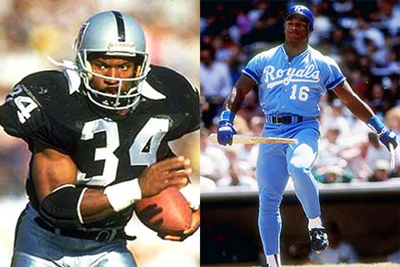
Vincent Bo Jackson
He overcame the abuse and hardship of his childhood and is one of the only athletes to have ever played two professional sports (football and baseball)

Slide 13
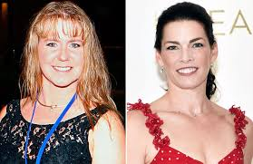
2. Tonya Harding
She was the 1994 US National figure skating champion and also represented the USA in the 1994 Winter Olympics in Lillehammer, Norway. She was involved in a scandal in which figure skater Nancy Kerrigan, her rival, was attacked

Slide 14
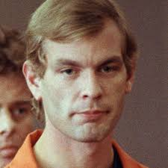
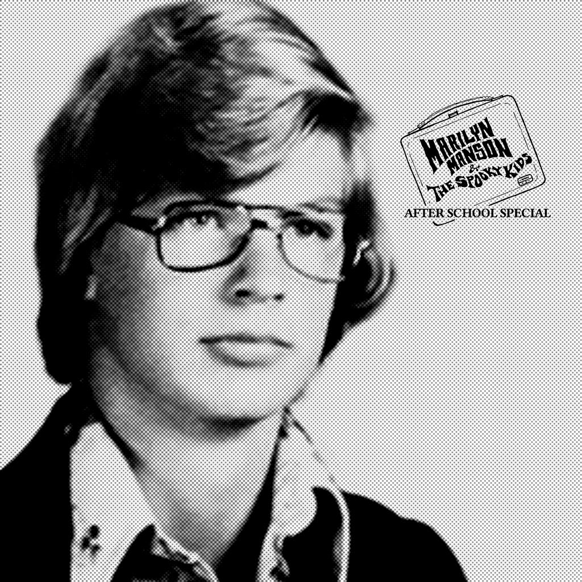
3. Jeffrey Dahmer
He confessed to brutally killing 17 men and keeping some of their body parts in his freezer for months as well as eating some of their flesh. He was one of the most horrific serial killers known in the US

Slide 15
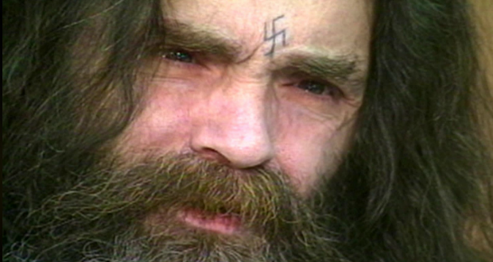
4. Charles Manson
He was the mastermind of Helter-Skelter, going on a two day killing spree in which 7 people were left mutilated and dead.

Slide 16
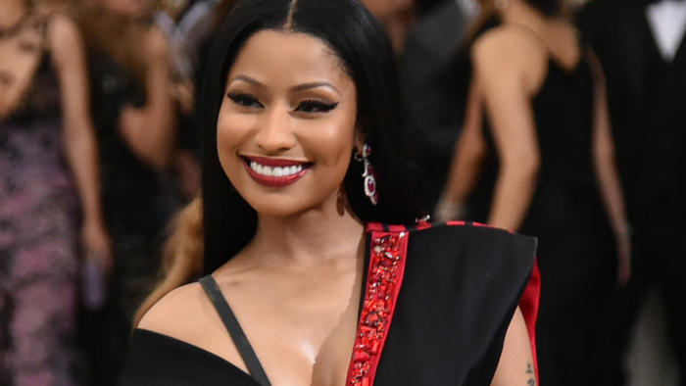
5. Nicki Minaj
Search online - What was her childhood like?

Slide 17
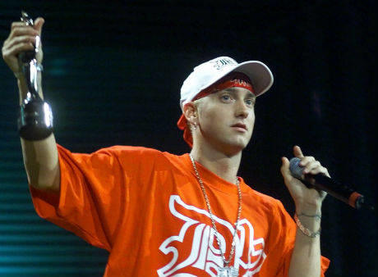
6. Eminem
Search online - What was his childhood like?

Slide 18
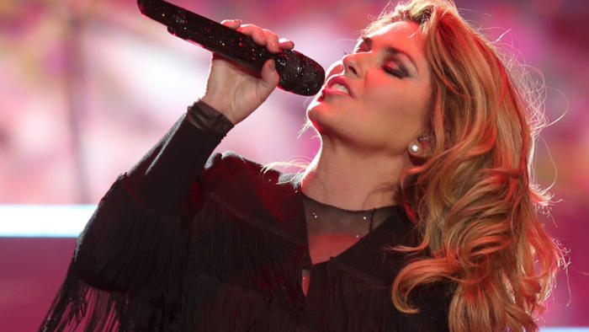
7. Shania Twain
Search online - What was her childhood like?

Slide 19
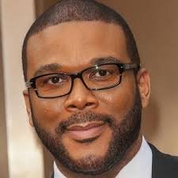
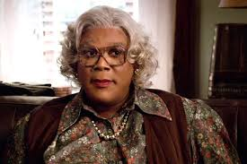
8. Tyler Perry
Search online - What was his childhood like?

Slide 20
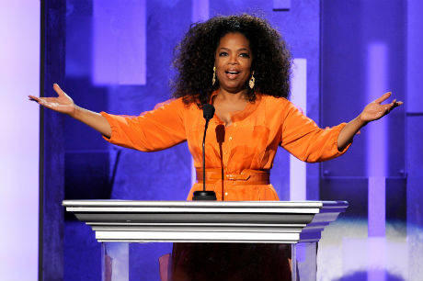
9. Oprah Winfrey
Search online - What was her childhood like?

Slide 21
10. Review answers to scenarios
Discussion: What can we learn from this activity?
Is the end result of parenting Nature or Nurture?

