Slide 1
Coping With Stress

Slide 2
weteachfacs.com

Slide 3
weteachfacs.com

Slide 4
What is stress?
weteachfacs.com
Notes:
anything that scares, threatens, thrills, prods or worries us.
Stress is the body’s response to any demand placed on it
Stress cannot be avoided
Your stress level can never be zero
Stress provides the energy necessary to sustain life
Humans are naturally seeking stress and even thrive on it.
Discussion: What are some examples of things that scares, thrills, prods you? What kind of stress do people naturally seek?

Slide 5
Types of Stress
weteachfacs.com
Notes:
Eustress is fun & exciting; positive
Acute stress is short-term from positive or negative events.
Chronic Distress is extreme, severe and out of our control
The body’s physiological response is the same
Discussion: What are some positive events that can cause stress?

Slide 6
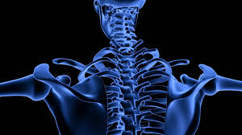
Acute and Chronic Distress
weteachfacs.com
Notes:
Will affect a person’s entire body:
Depletes nutrient resources
protein from muscles and lean tissue
calcium from bones
vitamins and minerals from every cell of the body

Slide 7
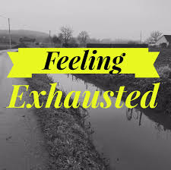
Stages of Stress
Alarm Resistance Exhaustion
weteachfacs.com

Slide 8
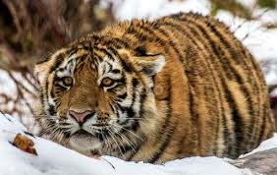
Stage 1 Alarm = Fight or Flight
weteachfacs.com
Notes:
Body tenses for readiness just like this tiger.
rapid pulse - increased perspiration - pounding heart - tightened muscles - shortness of breath - gritting teeth - clenching jaw - racing thoughts - excessive gripping emotions - pupils dilate - decreased digestion -

Slide 9
Stage 2 Resistance
weteachfacs.com
Notes:
The definition of Resistance - the refusal to accept or comply with something; the attempt to prevent something by action or argument. "she put up no resistance to being led away"
synonyms: opposition to, hostility to, refusal to accept "resistance to change"
2. the ability not to be affected by something, especially adversely.
"some of us have a lower resistance to cold than others"
During stage 2
vital resources are applied to help your body resist damage
body adapts and returns to normal level
body repairs damage

Slide 10
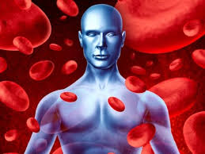
Stage 3 Exhaustion
weteachfacs.com
Notes:
The effects and diseases as a result of Stage 3
immune system is impaired (hypothyroidism, MS, lupus, psoriasis )
stress illnesses develop (ulcers, cancer, hypertension, heart disease)
energy gone
body breaks down

Slide 11
Anatomy of Stress
weteachfacs.com

Slide 12
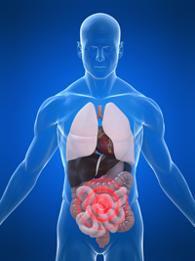
Hormones During stress
If the GI function is disrupted what might be the physical symptoms?
weteachfacs.com
Notes:
epinephrine (adrenaline) is released, changes in hypothalamus
Catecholamines increase cardiac output, blood flow, sodium retention, increase glucose, reduce intestinal mobility
cortisol activation of the pituitary promoting survival.
Discussion: If the GI function is disrupted what might be the physical symptoms?

Slide 13
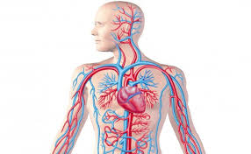
High Cortisol Levels
Learning
Memory
High blood pressure
Reduces bone
density
Immune function
Increases weight
gain
weteachfacs.com
Notes:
High Cortisol Levels
impacts memory and learning
lowers immune function
reduces bone density
causes increase weight gain
raises blood pressure
Blamed for metabolic syndrome, diabetes, cardiovascular conditions, mental health issues, including anxiety and depression and shortened life spans

Slide 14
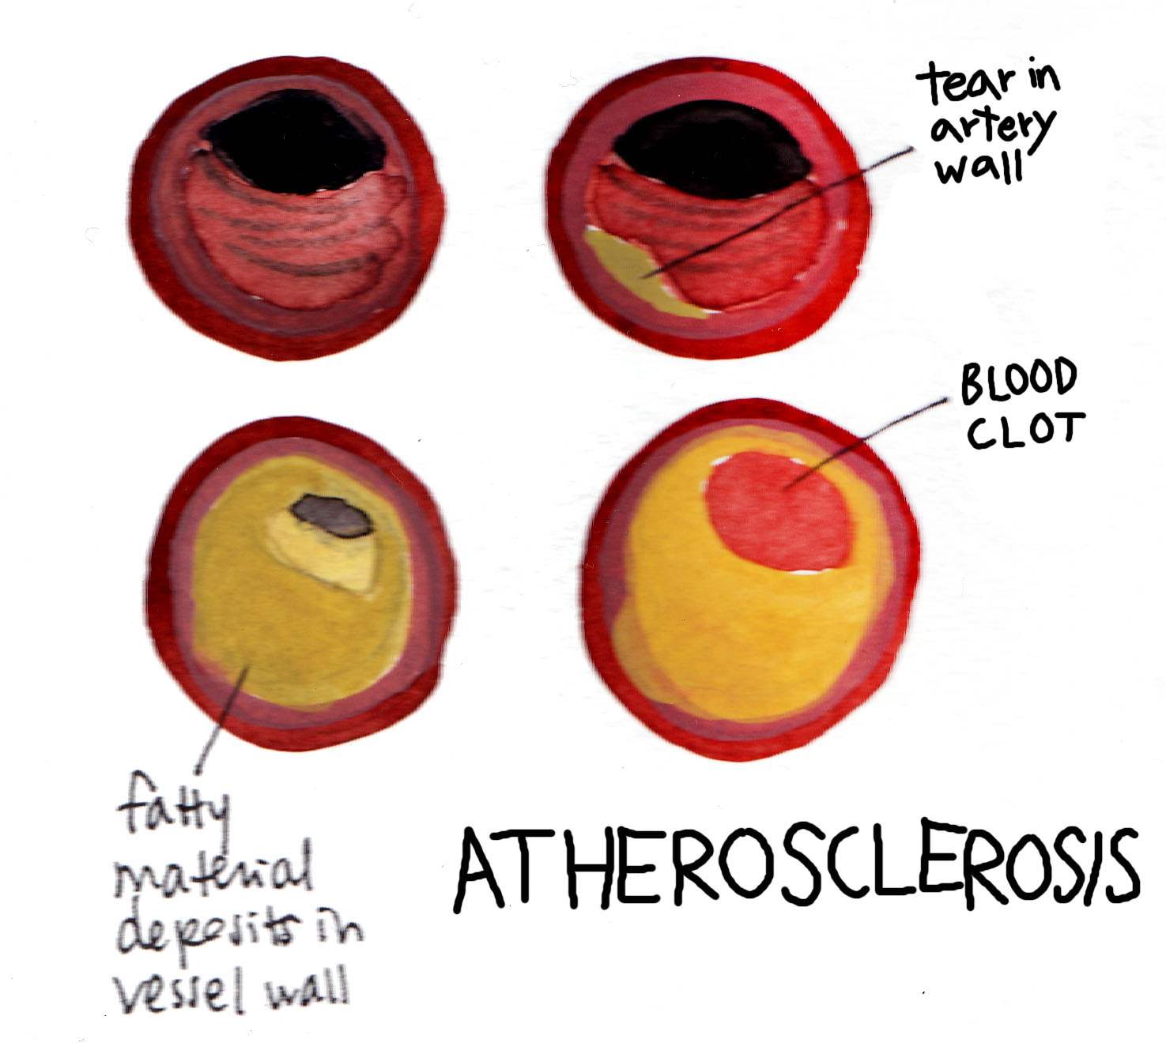
Long-term effects of Cortisol
weteachfacs.com
Notes:
Cortisol causes damage to artery walls by poking holes. Micro-tears from cortisol are repaired by the release of fatty deposits, sort of like a bandage. This accumulation of plaque buildup will result in clogged arteries.

Slide 15
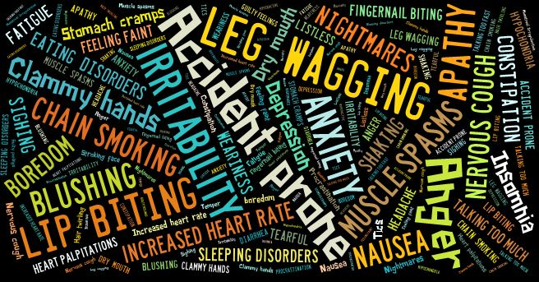
Symptoms of Stress
weteachfacs.com

Slide 16
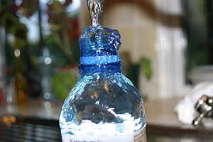
How much stress is too much?
weteachfacs.com
Notes:
It depends… Stress tolerance varies according to a person’s
age
maturity
type of stress
prior experience
adaptability

Slide 17
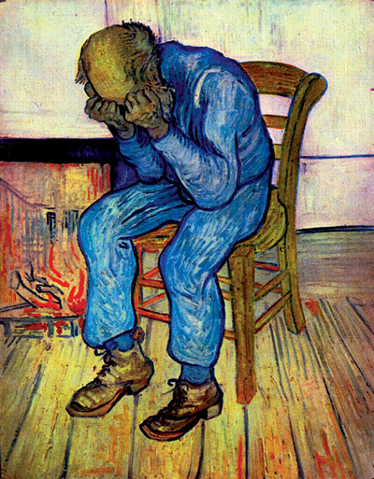
Stages of Coping With Crisis
Denial - feeling shock and numbness
Anger - feeling resentment, striking out
Bargaining - feeling hopeful
Depression - feeling sad, empty, hopeless
Acceptance - feeling calm, dealing with it
weteachfacs.com

Slide 18
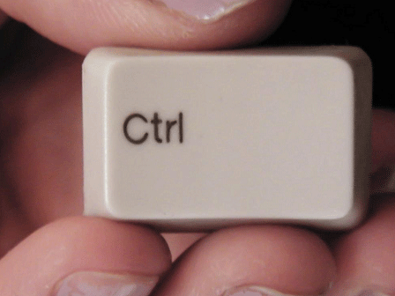
Adapt to Stressor
weteachfacs.com
Notes:
What are some ways you can adapt to stressors?
Identify the Stressor
Identify your control over the Stressor
Identify whether you can eliminate the stressor; if you can, do so
If you cannot eliminate the stress, then build you skills to deal with it.

Slide 19
Stress Prone Diet & Lifestyle
weteachfacs.com
Notes:
High Glycemic load
Saturated & trans fatty acids
Caffeine
Alcohol in excess
Sedentary lifestyle
Smoking or Drugs
Less Sleep

Slide 20
Improved Diet & Lifestyle
weteachfacs.com
Notes:
Lower glycemic load diet
Eliminate trans fats, reduce saturated fats
Reduce caffeine
Alcohol in moderation
Boost consumption of whole plant foods
Eliminate cigarettes & drugs
Regular exercise
Probiotics

Slide 21
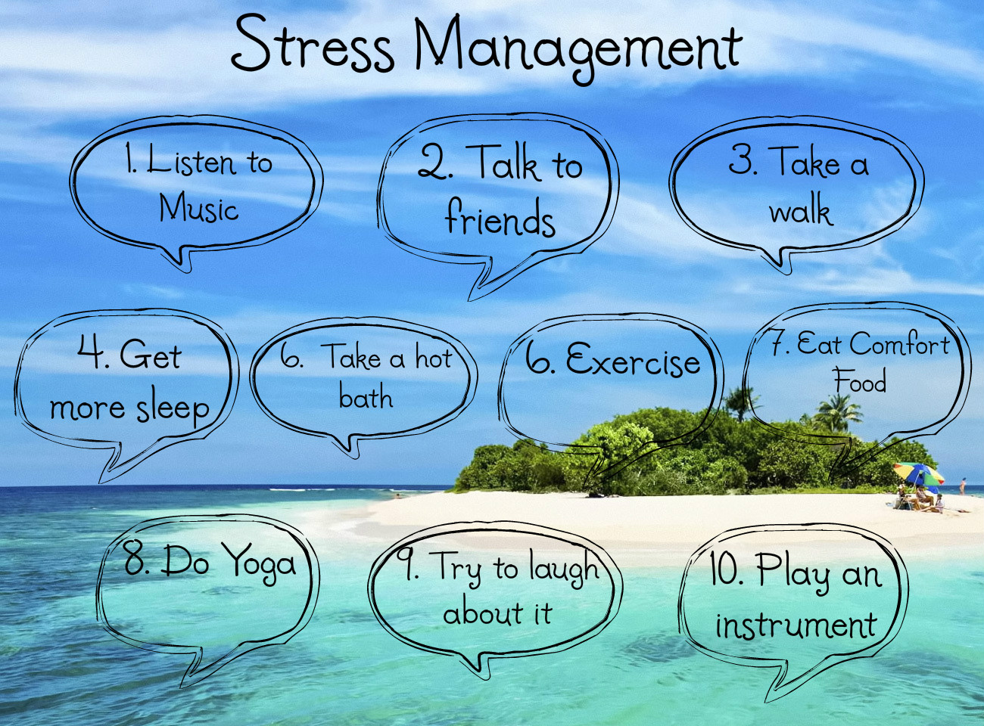
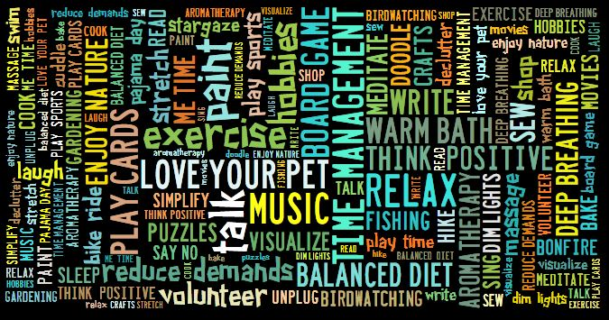
Stress Busters
weteachfacs.com

Slide 22
Stress Busters
weteachfacs.com

Slide 23
Laughter is the Best Medicine
weteachfacs.com
Notes:
Produces feel-good chemicals
Exercises heart and lungs
Stimulates immune system
Releases natural pain killers
Relieves tension
Enhances creativity
Increases positive attitude
Stimulates mental functioning

Slide 24
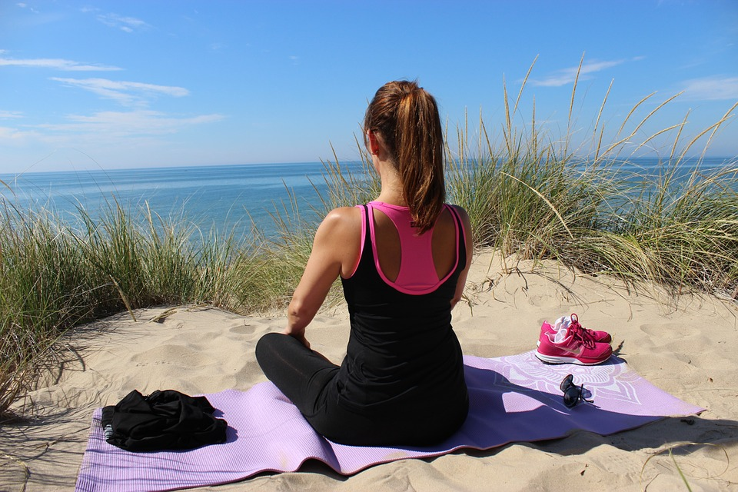
Alternative Therapeutic Methods
weteachfacs.com
Notes:
Guided imagery
Massage
Reiki
Deep Breathing
Mindfulness Meditation
Progressive muscle relaxation

Slide 25
Serenity Prayer
weteachfacs.com
Notes:
Discussion:
What are some things people worry about that can be changed and things that cannot?

Slide 26
Mandalas: The Sacred Circle
weteachfacs.com
Notes:
Facilitates meditation to center the body and mind.
Used as healing tool
Boosts immune system
Reduces stress
Combat depression
Reduces pain
Lowers blood pressures
Promotes restful sleep
Don’t think about your color choice. Let your instincts guide you.

Slide 27
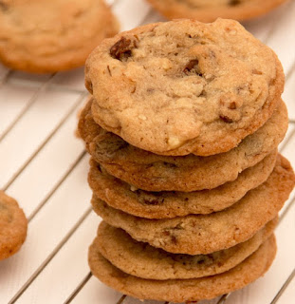
Stress Baking Therapy
The greatest gift you can give a friend is to cook for them!
~ Ina Garten
weteachfacs.com
Notes:
Cooking is meditative
calming
focus on recipe
eases negative thoughts
aroma stimulates senses
increases good endorphins
creativity brings happiness
personally rewarding
boosts confidence

Slide 28
Stress Can Be Puzzling
Start by looking at the BIG PICTURE
Clear a SPACE to work uninterrupted
Dump everything out and TURN EACH PIECE RIGHT-SIDE UP
Find the EDGES and CORNERS first
Work on SMALL SECTIONS at a time
Don’t get exhausted - PACE YOURSELF
GET HELP if the puzzle is too big
weteachfacs.com

Slide 29
Christina Hickman, MA. Ed 2016
weteachfacs.com

