Slide 1
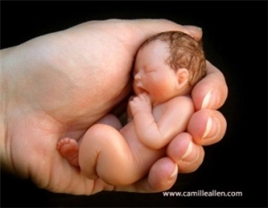
Human Reproduction

Slide 2
5.5 Analyze the impact of sexuality on health and wellness
Child Development class
5.5.1 Differentiate between the male and female reproductive system, structures and functions
5.5.2 Describe the decisions and responsibilities associated with sexual relationships
5.5.3 Identify types, effects and preventions of STI's
5.5.4 Evaluate family planning techniques for the different lifecycle stages.
GRADS Class
3.4.1 Set standards for making sexual decisions
3.4.2 Evaluate consequences of being sexually active
3.4.3 Evaluate birth control options

Slide 3
Female Reproductive System
Fallopian Tubes
Ovaries
Fimbriae
Uterus
Cervix
Vagina

Slide 4
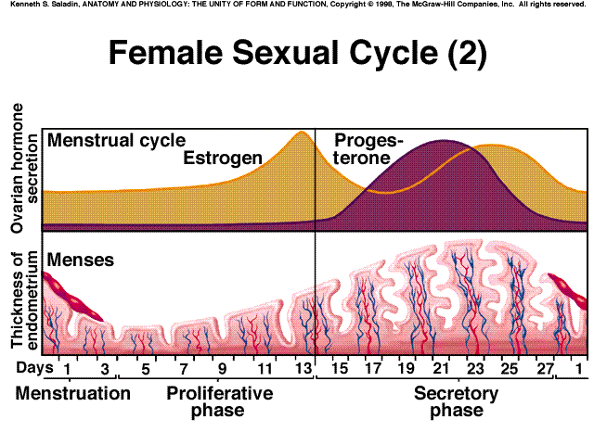
Hormone Levels and Endometrium Thickness

Slide 5
The Menstrual Cycle
The menstrual cycle typically lasts 28 days; approximately 1 month.
One cycle is the amount of time from the beginning of one period to the beginning of the next period.
The beginning of a period is marked by the release of the blood and lining from the inside of the uterus.
This flow of blood typically lasts 3-7 days and is called menstruation.

Slide 6
Average Days of Menstrual Cycle

Slide 7
Ovaries
1) produce oocyte (oogenesis)
Two solid egg-shaped structures
They are attached to the uterus by ligaments.
They are the counterpart of the male testicles.

Slide 8
Two Functions of Ovaries
1) produce oocyte (oogenesis)
#1-store and release the ova or female egg cell. Some of the ova disappear; others are dormant until each is ripened and released after puberty.
#2-produce female sex hormones ESTROGEN and PROGESTERONE

Slide 9
Ovulation
After menstruation, the ovaries release hormones that tell the uterus to grow a new lining and prepare to receive a new egg.
As the uterus prepares a new lining, one of the ovaries releases an egg. This is called ovulation.
Ovulation occurs about halfway through a woman’s cycle.
The egg travels through the Fallopian tube. If it is not fertilized it breaks down and is released with the lining and blood of the uterus.

Slide 10
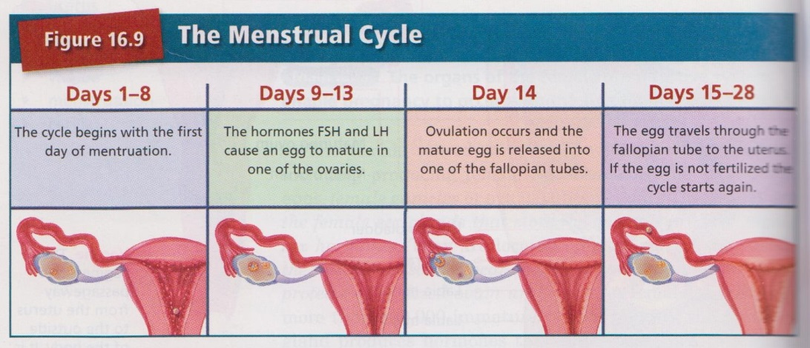

Slide 11
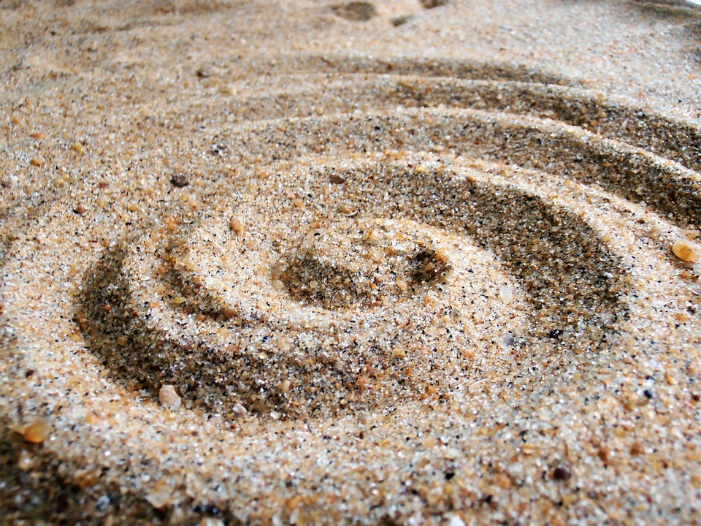
Ovulation
1) produce oocyte (oogenesis)
Born with about 400,000 or 200,000 in each ovary
They are the largest cells in the female body.
(about the size of a grain of sand.)
About 400-500 ova mature and are released over a lifetime

Slide 12
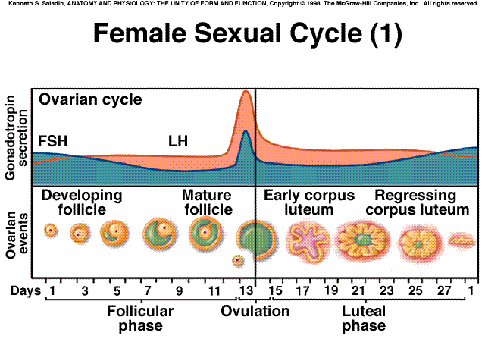
Ovarian Events

Slide 13
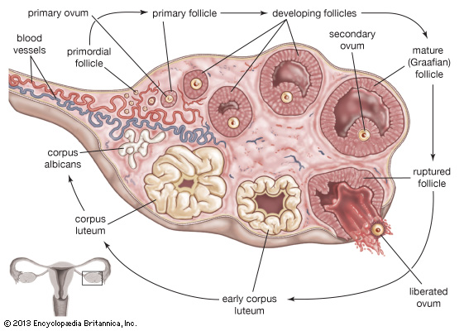
Ovulation inside the Ovaries
1) produce oocyte (oogenesis)

Slide 14
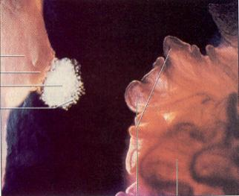
Ovulation of a Human Egg
Fallopian Tubes
Pair of muscular tubes with fingerlike projections that draw in the ovum
pathway for egg
Hair-like structures called cilia carries the egg to uterus
fertilization must take place within 24 hours while the egg is still viable
Ovum
Fimbriae
viewed by Endoscopy

Slide 15
Swimming For Your life
A sperm is a tiny package with a big responsibility;
to fertilize the egg and create a human life.
That tiny package is loaded with “gear” for its important journey.
A few facts:
Daily sperm production by a healthily man:
10 million to 50 million
Contents of an average ejaculation:
50 million sperm, 25 million moving, 20 million deformed.
Maturation:
72 days
Average swimming speed of a sperm:
8 inches per hour
Survival time in a woman:
2 to 7 days

Slide 16
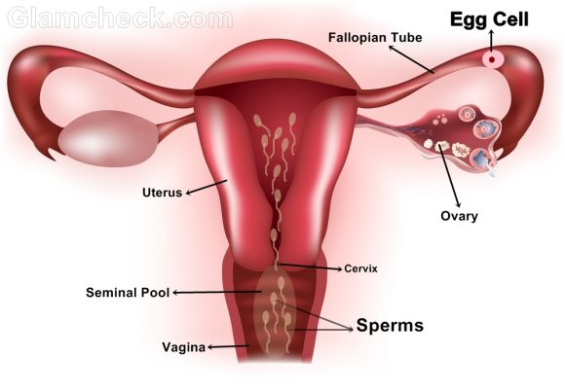
Journey of the Sperm
4) Half of the remaining will turn to the wrong way
3) In one hour about 6000 sperm will reach the top of the uterus
2) Half die in acidic condition of vagina. The remainder will pass through the cervix
1) 400,000 are ejaculated

Slide 17
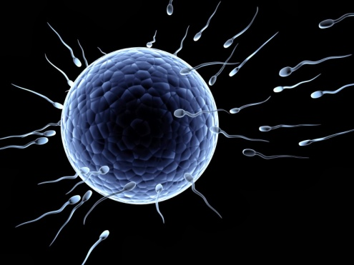
Journey of the Sperm
5. Only a few hundred sperm will reach the egg
6. One sperm will penetrate the ovum.
7. Immediately, the cell wall hardens, preventing other sperm from entering.
8. Sperm can survive for up to 72 hours, hang out and wait for an egg to be released!

Slide 18
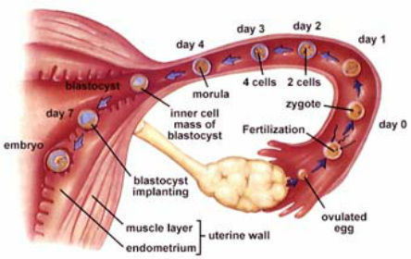
Journey of an egg

Slide 19
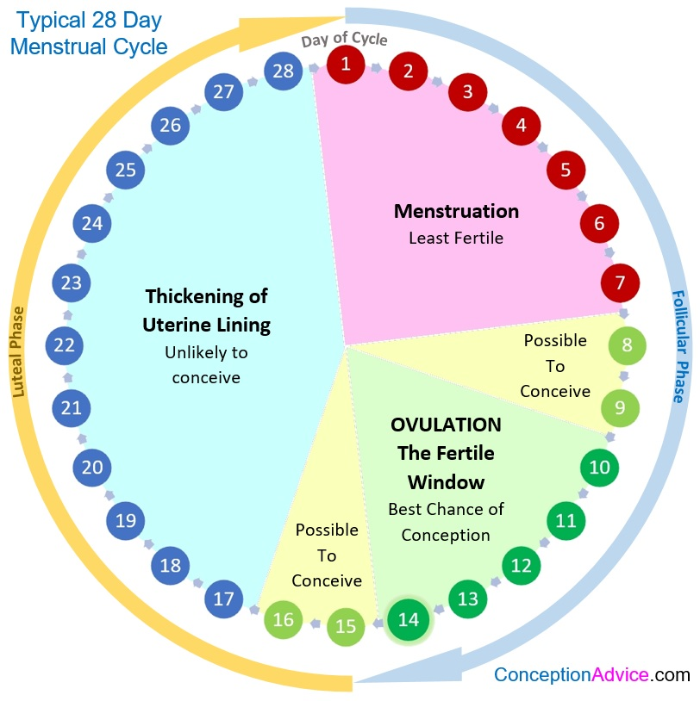
The Fertile Window

Slide 20
The role of the uterus
If the egg is fertilized by a sperm cell, the egg will implant in the lining of the uterus and begin to develop.
The Uterus harbors the embryo, provides nutrients, then expels the fetus at the end of its development

Slide 21
The Stages After Fertilization
Zygote: The first cells of a new organism; the time from
fertilization to implantation (7 days)
Embryo: The zygote is now called an embryo after implanted in the uterus until 8 weeks.
Fetus: After 8 weeks of development, the embryo is now called a fetus until birth at 40 weeks.

Slide 22
Implantation inside Fallopian tube called tubal pregnancy
1 in 50 pregnancies is ectopic
Ectopic Pregnancy

Slide 23
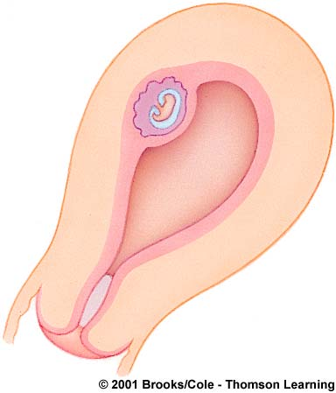
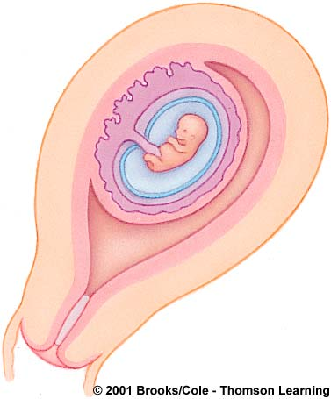
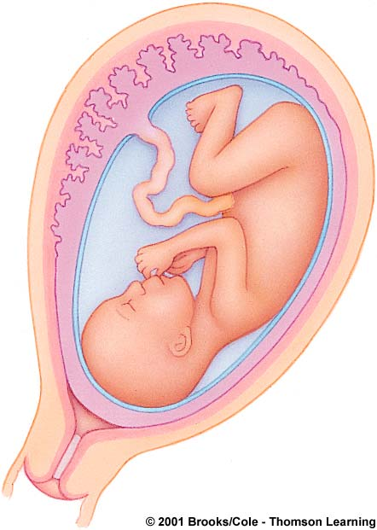
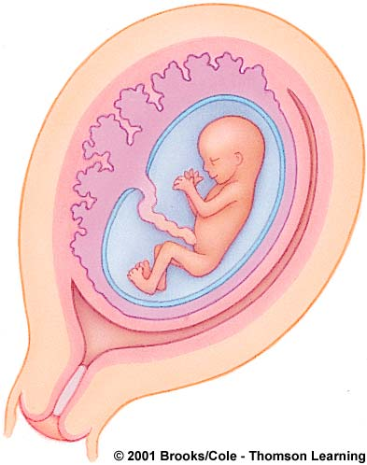
Takes 40 weeks to full term
4 weeks
8 weeks
12 weeks
Appearance of the placenta at full term

Slide 24
Period of the Zygote

Slide 25
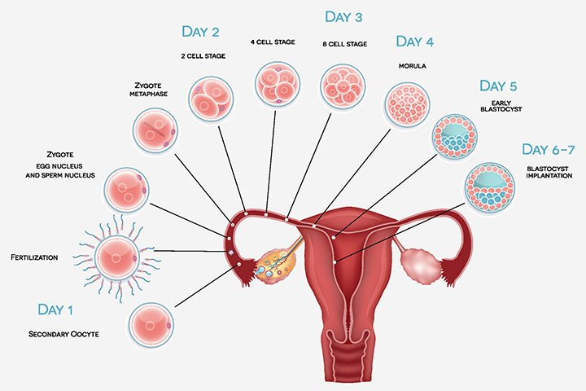
Counting the Days

Slide 26
Christina Hickman, MA Edu, 2018

Slide 27
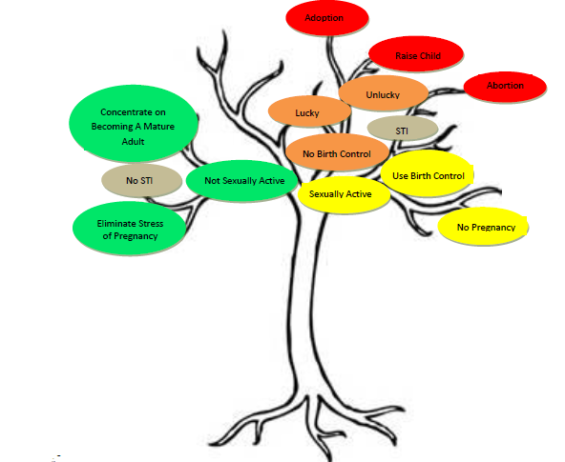
Your Sexual Decision Tree

