Slide 1
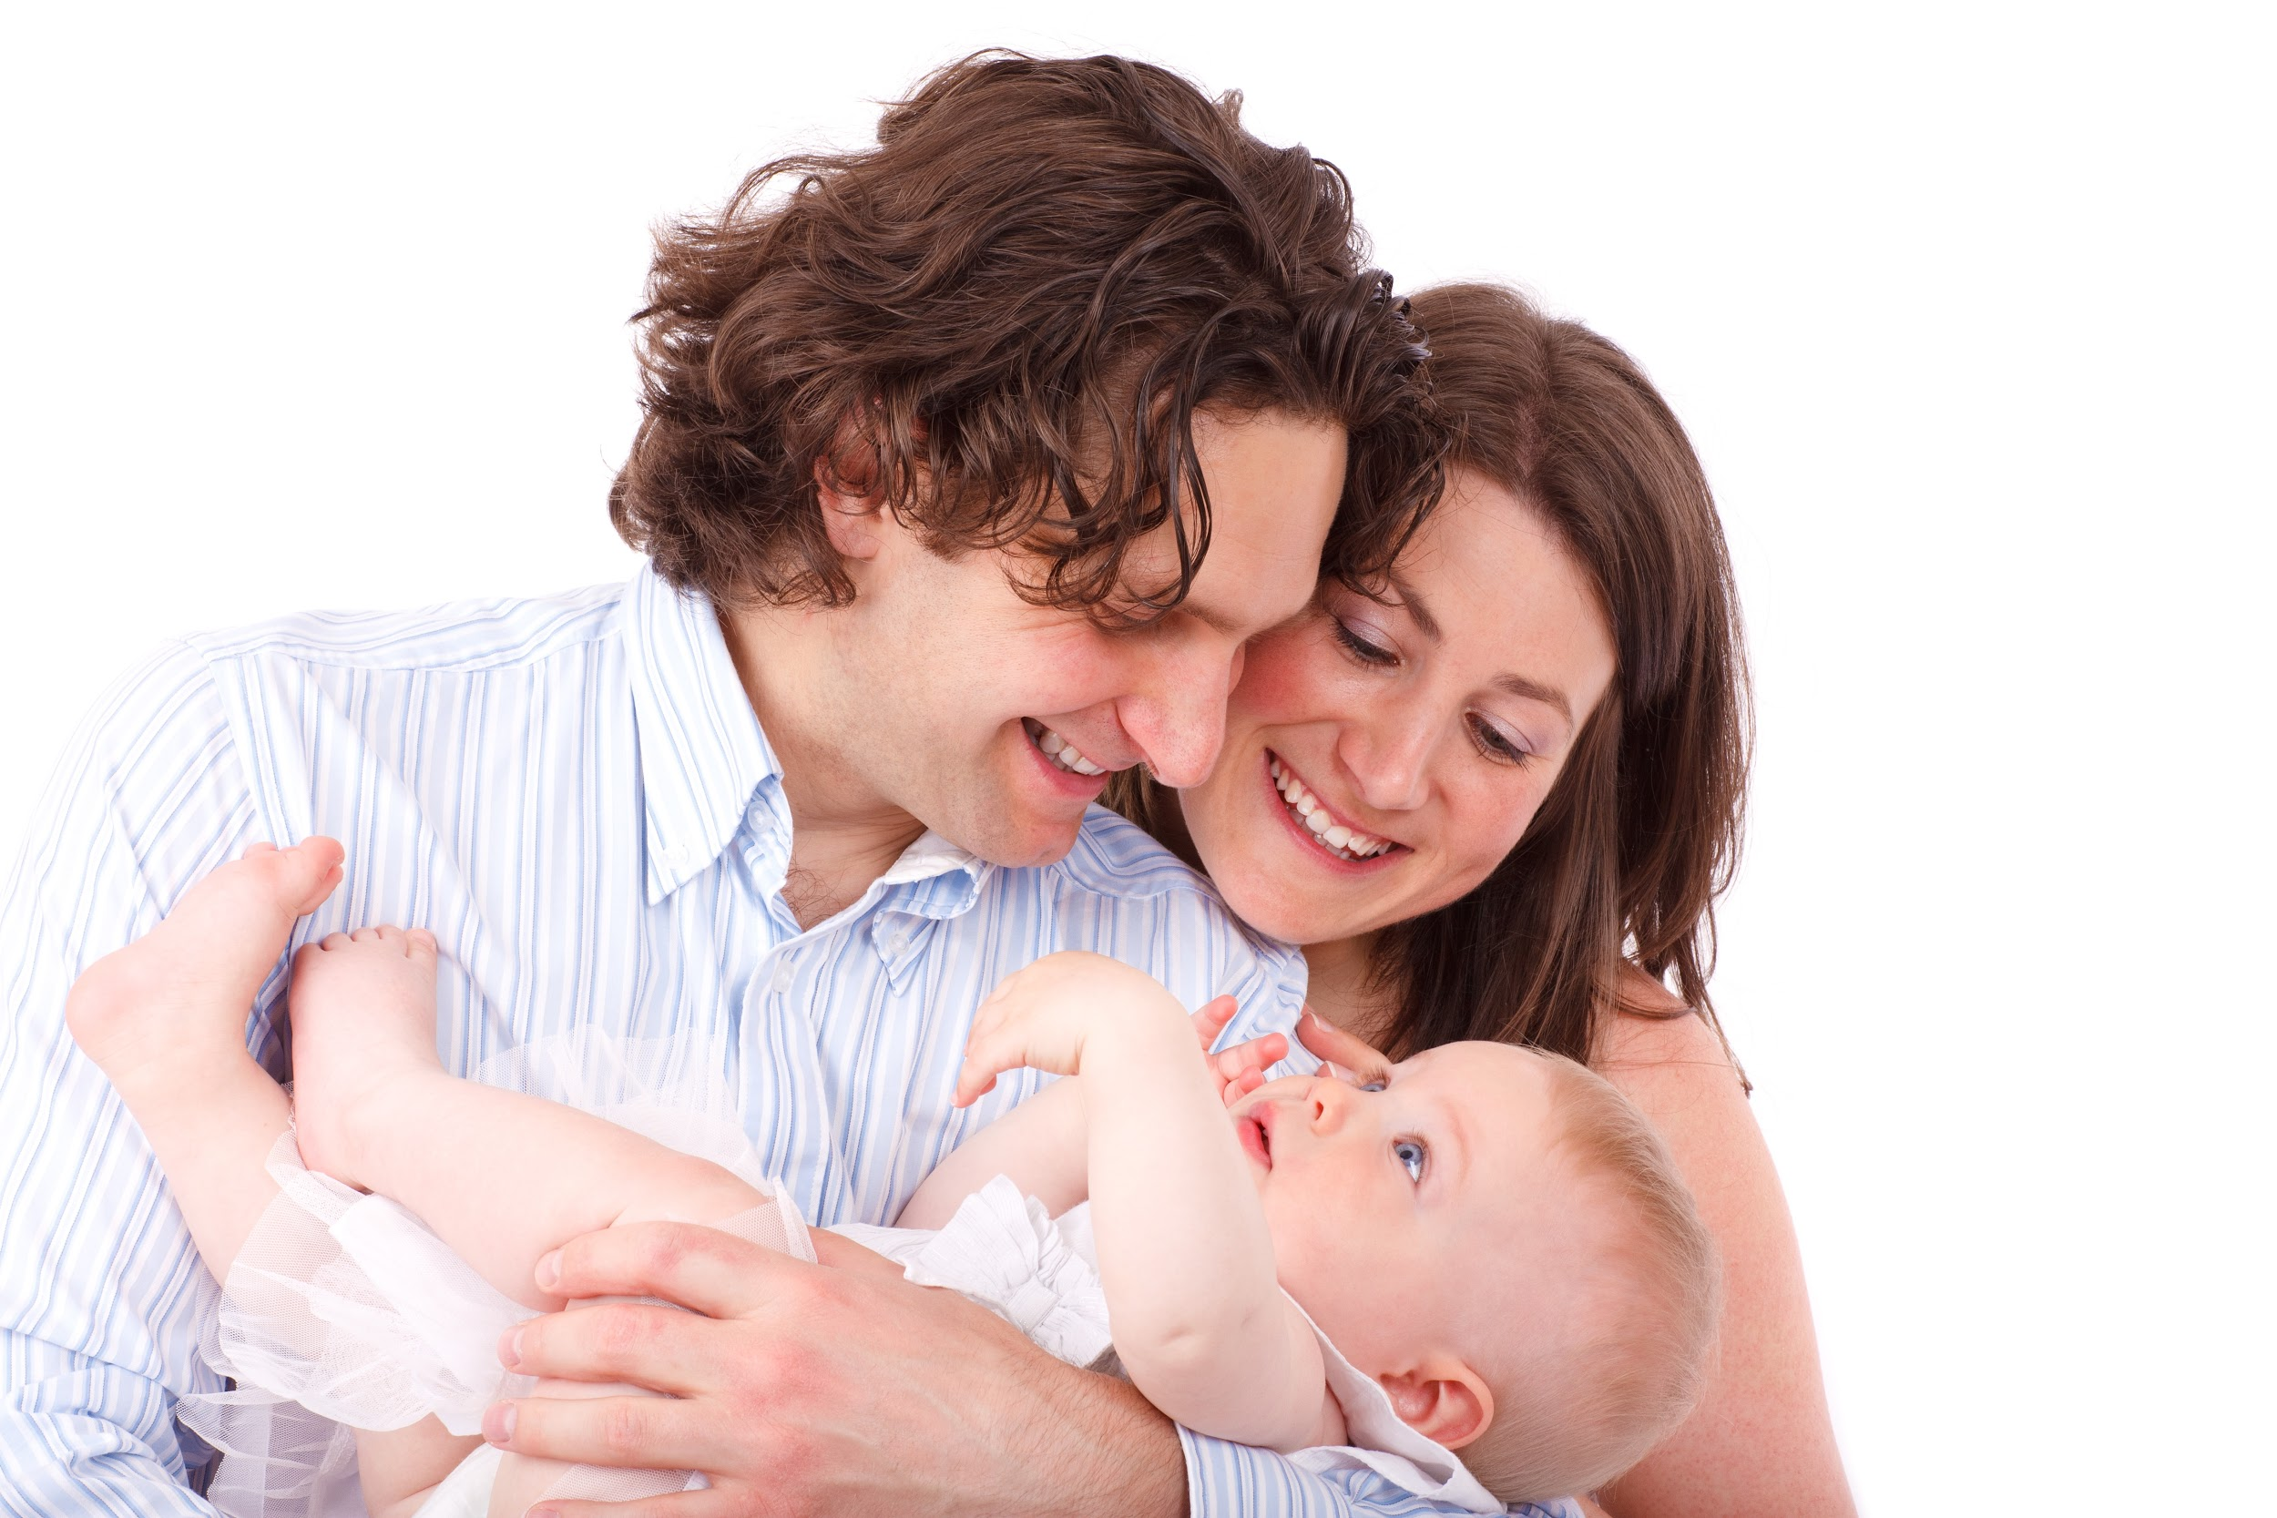
Nurturing Overall
Development

Slide 2
New Career Opportunity

Slide 3
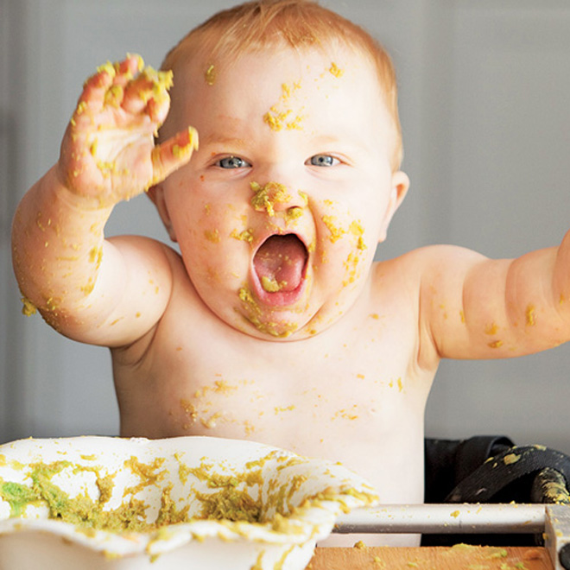
Parenting Responsibilities
transportation
medical care
entertaining
play with them
cooking, cleaning
disciplining
teaching
referee
finances
psychologists

Slide 4
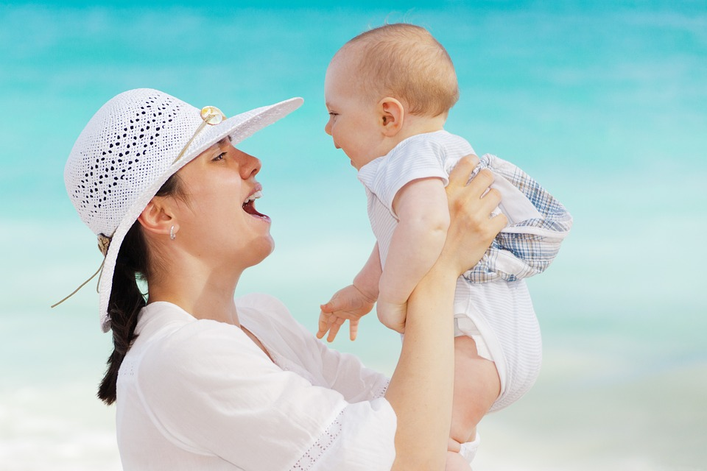
Rewards of Parenting
Provides a lot of personal growth
a fulfilling role
Influences the future
gives direction in life
emotional satisfaction
fun to watch child grow and develop

Slide 5
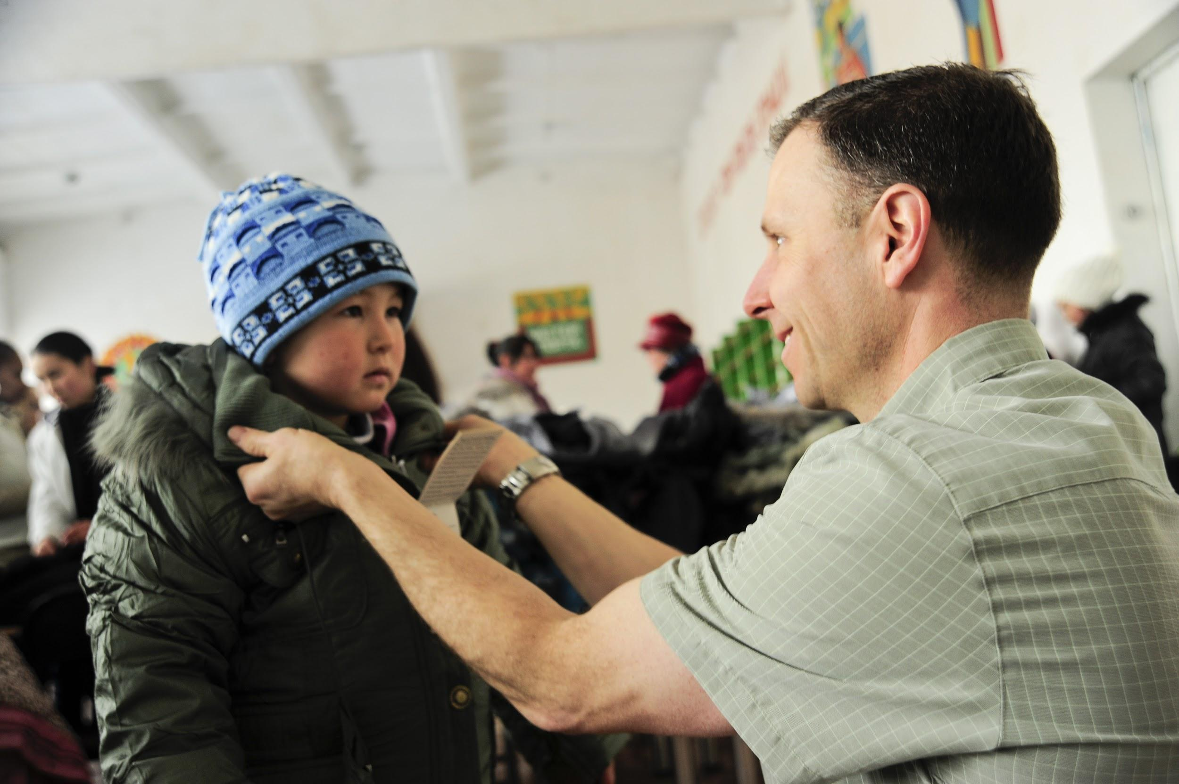
The Most Important Demand
Lifetime commitment
parent gives and child receives
providing constant nurturing environment
24 hours a day
giving love without expecting any in return
being unselfish with own time

Slide 6
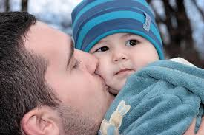
Parents must Nurture
Nurturing a child means to promote his/her development by providing
unconditional love throughout the lifespan.

Slide 7
Parents must Protect
Protection - from harmful objects, situations, words

Slide 8
Parents must provide enrichment
Stimulating Environment
Play
Literacy
Different surroundings

Slide 9
Parents must provide guidance
Set appropriate rules,
Explain reasons
Consider child’s feelings

Slide 10
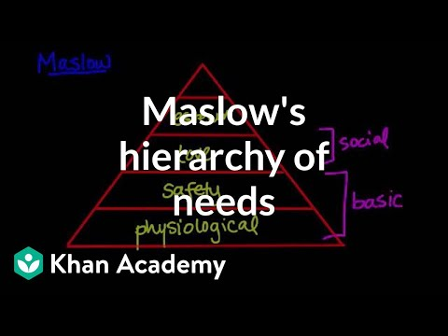
Maslow’s Hierarchy of Needs
Self-Actualization
personal growth and fulfillment
Esteem Needs
achievement, status, reputation
Belonging and Love Needs
family, affection, relationships, work group
Safety Needs
protection, security, order, law, limits, stability
Physical Needs
Food, drink, air, shelter, warmth, sleep

Slide 11
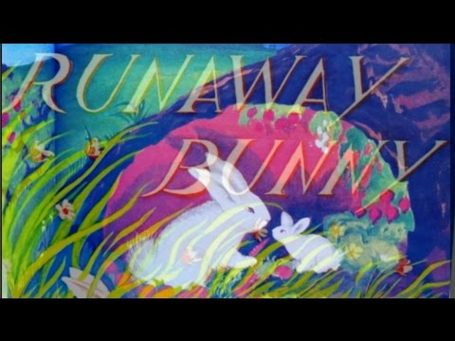
The Runaway Bunny

Slide 12
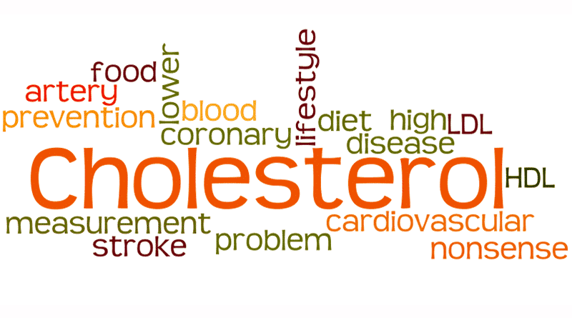
Ohio University Study
In the 1970’s, Ohio University conducted a study on rabbits. Students were assigned to feed several groups of rabbits a high-cholesterol diet each day.
Over time, all but one of the groups of rabbits began to display the hypothesized symptoms.

Slide 13
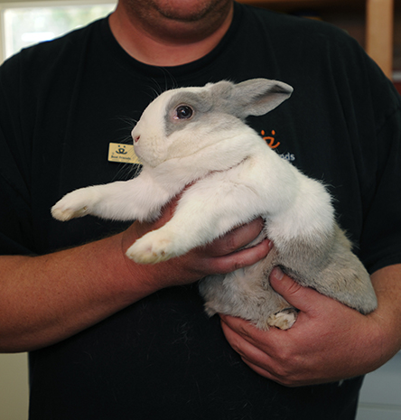
Ohio University STUDY (continued)
One student assigned to feed this “non- responding” group of rabbits would hold, talk to, and pet each of the rabbits in this group each day before he fed them.

Slide 14
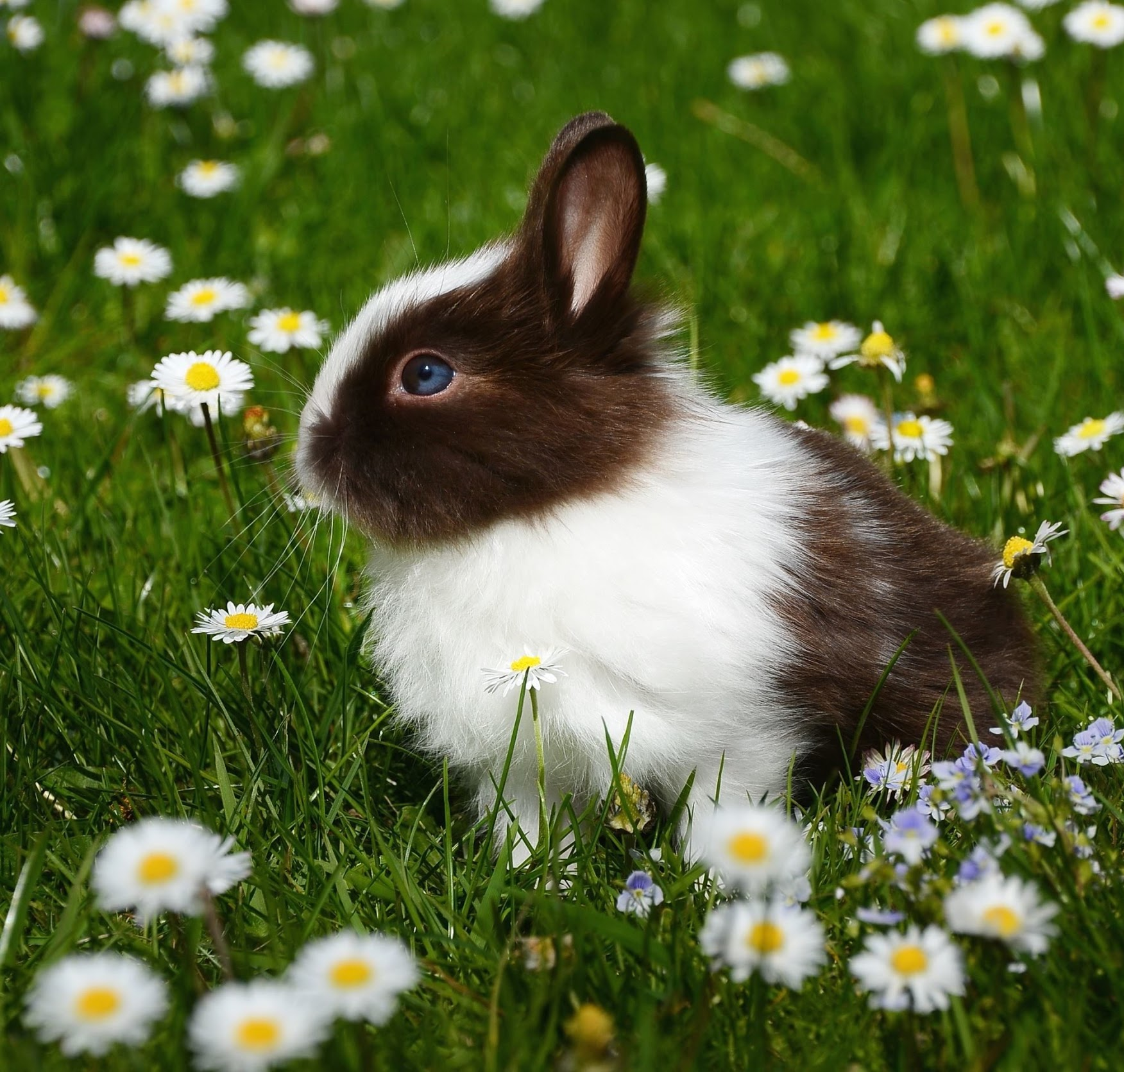
Ohio University STUDY (continued)
It was accidentally discovered that this nurturing and loving care seemed to account for the rabbits health and intolerance to the toxic diet.
Repeat studies produced similar results.

Slide 15
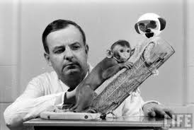
Harry Harlow Experiment
Harry Harlow did an experiment in which he isolated a group of monkeys from any human or animal contact for the first six months of life.

Slide 16
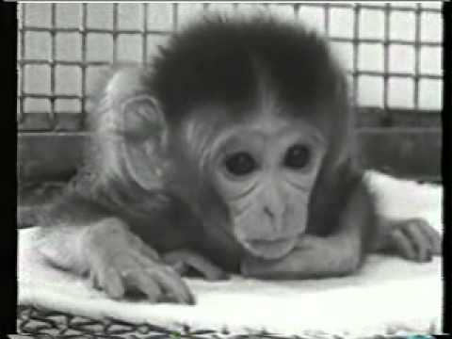
Harry Harlow Experiment (cont.)

Slide 17
STUDY - Rene Spitz
In 1946, Rene Spitz studied the effects of a lack of nurturing by comparing two institutions; a prison and an orphanage.
In the prison nursery, mothers cared for their own babies.
In the orphanage, each nurse was assigned to care for seven babies- an extremely high ration of caregiver to infants.
Spitz found that the mortality rate of the babies cared for by the nurses in the orphanage was 37% higher, even though the orphanage was noted for its excellent medical care.
The reason the infants in the orphanage dies, according to Spitz, was from a lack of love.

Slide 18
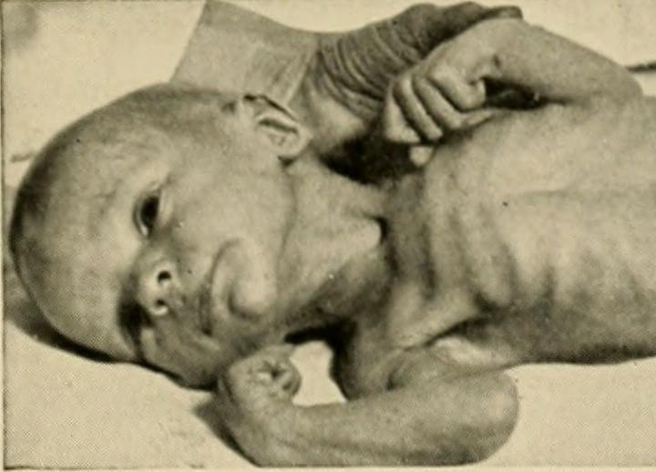
Define Failure to Thrive
A condition in which the baby does not develop and grow properly due to lack of love attention, and touch.
Assignment Article Summary: http://theconversation.com/can-a-lack-of-love-be-deadly-58659

Slide 19
Failure to Thrive
do not respond to people and objects
their cries weaken, smiles fade
become withdrawn
the lack of love and attention and cause “failure to thrive”, a condition in which babies do not grow and develop properly
caused by neglect, abuse, or another form of stress if left alone most of the time or do not receive enough physical contact.

Slide 20
Define Bonding
Forming strong emotional ties between a parent and a child.

Slide 21
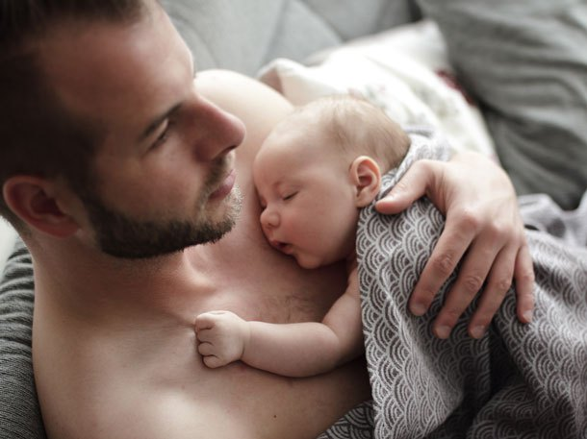
Why is Bonding important right after birth?
The child needs to know that they are loved and accepted immediately in order to thrive and begin to develop.

Slide 22
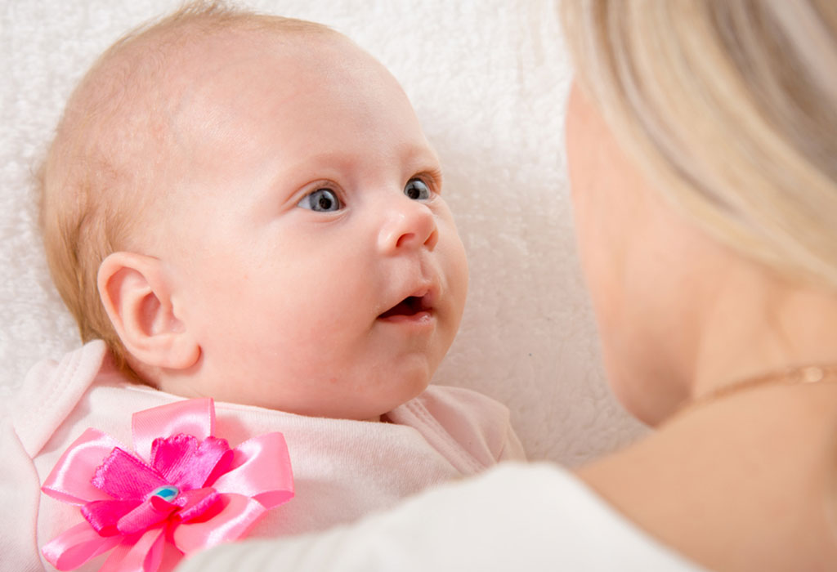
How do parents bond with their newborn?
Long loving looks, Loving touches, Animated face and voice, Consistency Responsiveness, Sensitivity and in-tune, are all ways a parent or caregiver can help develop a bond with an infant or child of any age.

Slide 23
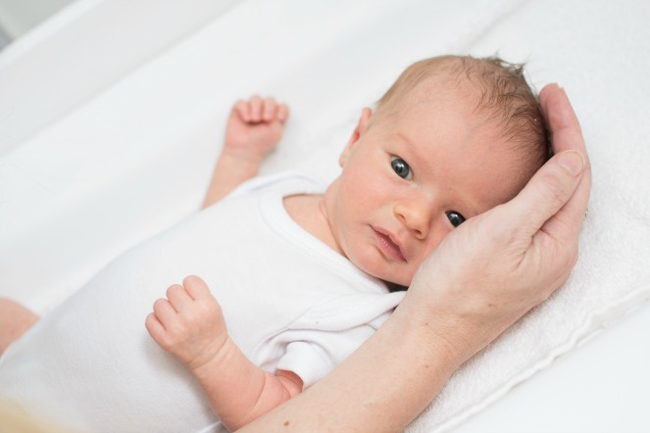
Why are bonding actions important?
They build safety, security, trust, dependence upon the caregiver, lets the child know that you have their attention, that they are special to you, builds the relationship, tells child that they are okay just the way they are, tells them that everything is going to be okay.

Slide 24
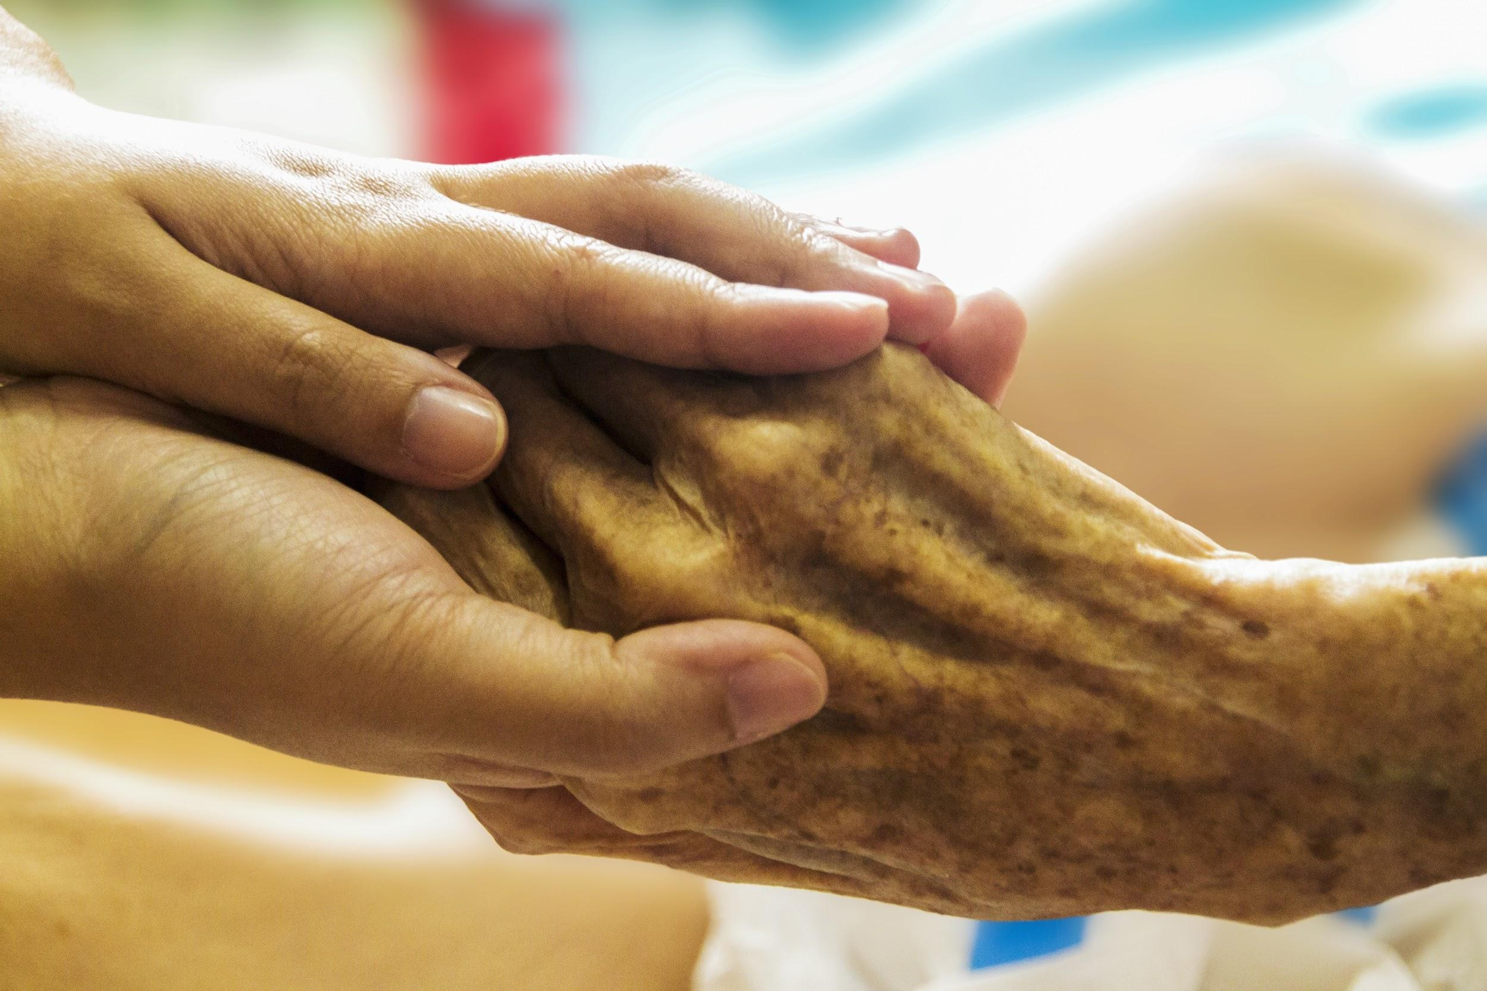
All people have a need for human contact.
Have you ever been to a nursing home?
Have you noticed how elderly people want to hold your hand and look at you while you talk to them? They never want you to leave!

Slide 25
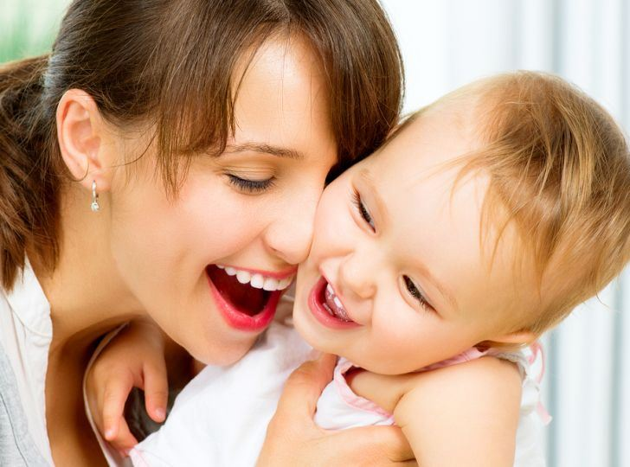
HUGS & KISSES
We need 4 hugs a day for survival
We needs 8 hugs per day for maintenance.
We needs 12 hugs per day for growth
Virginia Satir,
family therapist

Slide 26
HUGS CAN HEAL
Hugs build trust and sense of safety
Hugs boost oxytocin levels healing loneliness & anger
Extended hugs lifts serotonin levels, elevating mood & happiness
Hugs strengthen immune system
Hugs boost self-esteem
Hugs relax muscles, releases tension
Hugs teach us to be present in the moment
Hugs encourage empathy and understanding

Slide 27
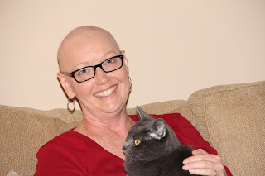
The Power of Hugs
The Power of Hugs

Slide 28
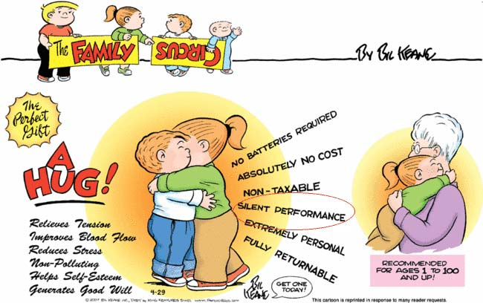
A Hug is a Perfect Gift!

Slide 29
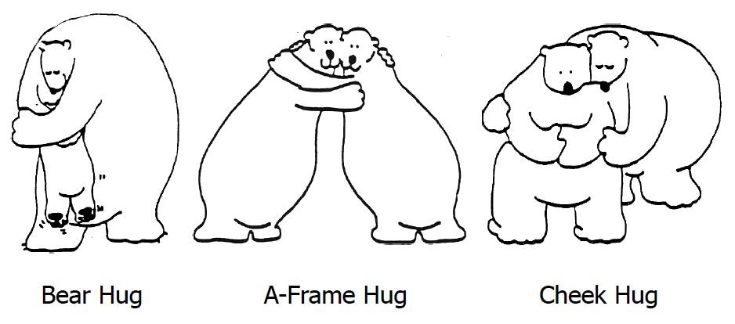
Have you given a bear hug today?

Slide 30
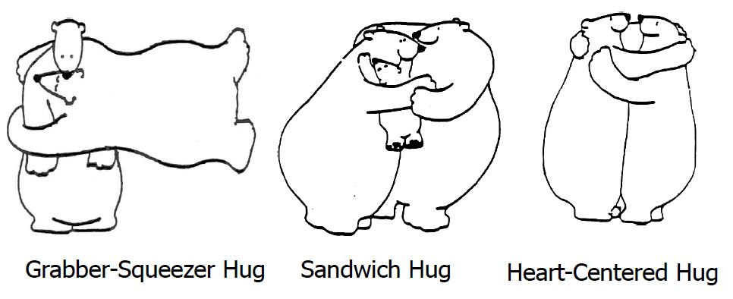
Have you received a bear hug today?

Slide 31
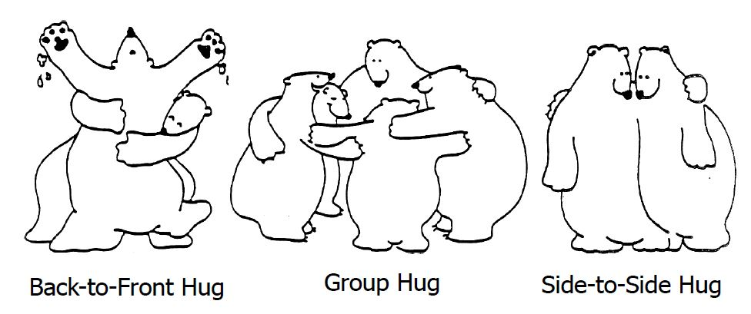
Do you need a bear hug today?

Slide 32
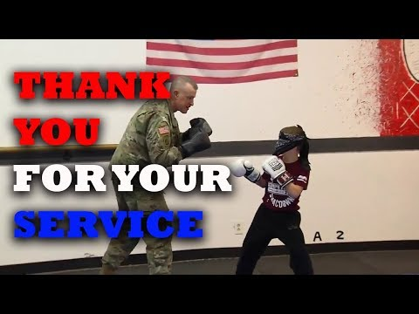

Slide 33
Summarize
Summarize the potential consequences from a lack of bonding and nurturing
Physically
Intellectually
Emotionally
Socially

Slide 34
Areas of Child Development
P. I. E.S
Emotional
Express feelings
Establish identity
Physical
Gross (large) Motor
Fine (small) Motor
Social
Interactions w/ others
Intellectual
Learning
Language

Slide 35
Assignment: Nanny Ad
Requirements:
Position- what are you looking for?
Description and Characteristics
Responsibilities/ Duties
Experience
Contact Information

Slide 36
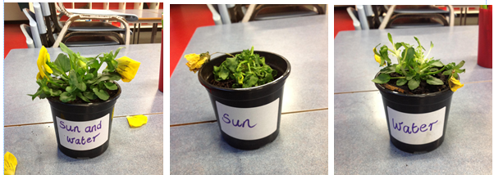
Everything Grows Better
in Sunshine and Love
If the child represents the plant,
then what does the sun and water represent?

Slide 37
Christina Hickman, MA Ed, 2019

Slide 38
How does nurture (environment) affect a child’s development?
Think in terms of socially, mentally, emotionally, and physically.
How a child is treated affects how they act, think, feel, react…. Able to talk with and get along with others.
Can process and develop information.
Stable with who they are.
Trusting towards others.
Feels safe.
Strong in all areas of development.
Physical skills are age appropriate.
Physically healthy. Bodily functions work.

Slide 41
Hugging

