Slide 1
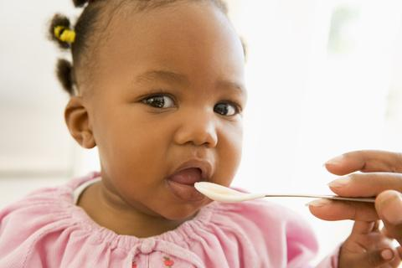
Feeding Baby

Slide 2
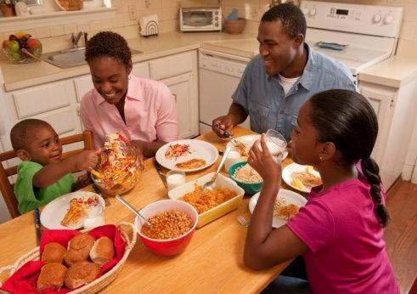
Reasons People Eat
Nutrients
Pleasure
Hungry
Routine
Reflex
Family Gathering

Slide 3
Emotional Eating
What if a baby is given a bottle every time he cries?

Slide 4
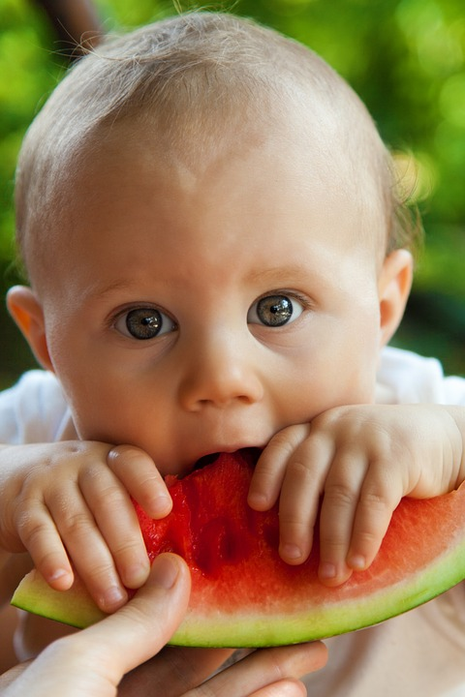
Nutrition
Proper nutrition is essential for:
Essential nutrients the body needs to grow and develop
Affects bone strength, brain development, & height.
Can be at risk for illness, delayed growth, or death if the baby does not get enough calories or nutrients.

Slide 5
Malnutrition
Dry, dull hair
Night blindness
Red swollen lips
Pale tongue
Loose skin
Brittle nails
Rickets
Muscle cramps

Slide 6
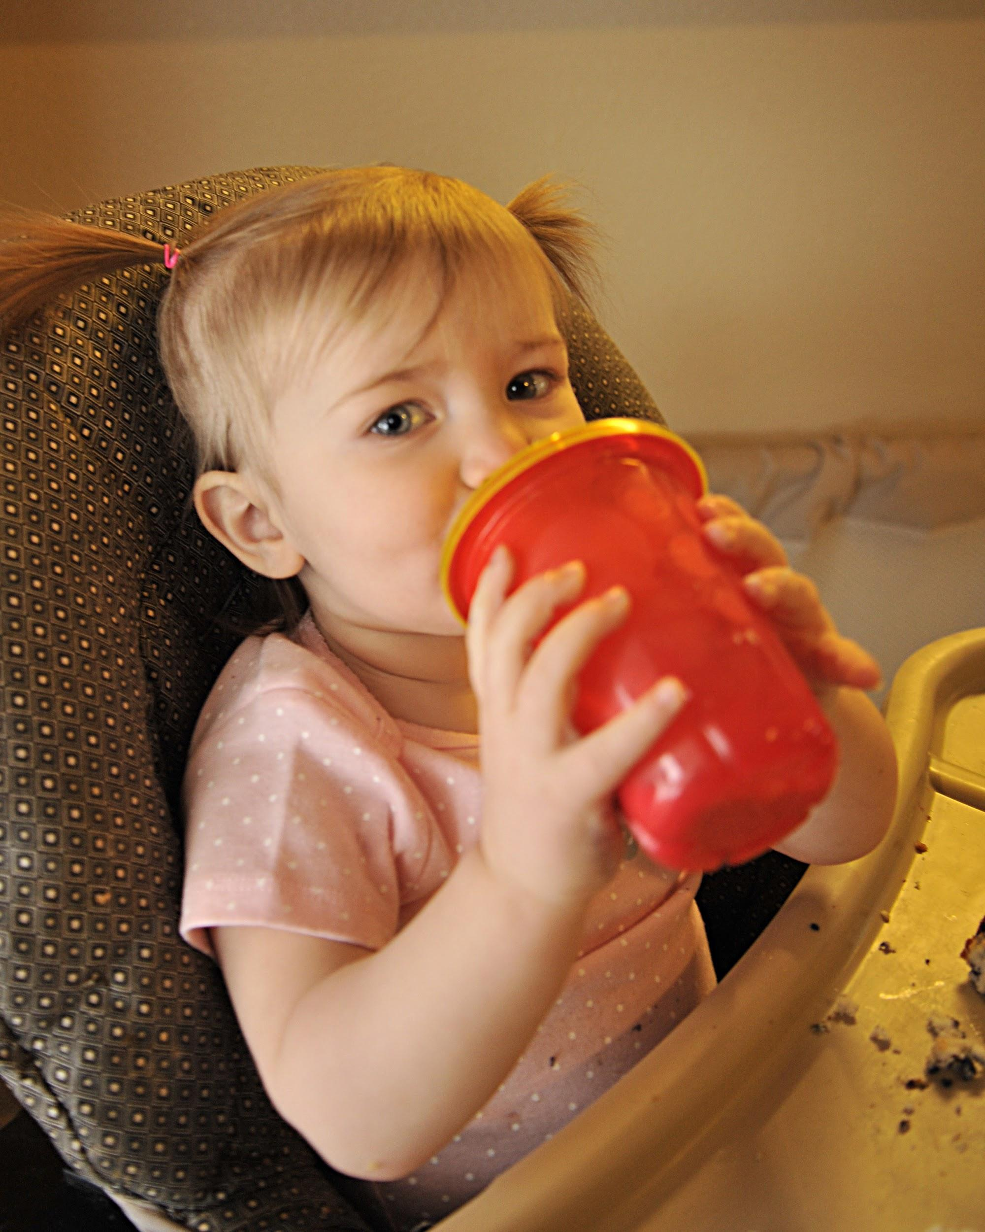
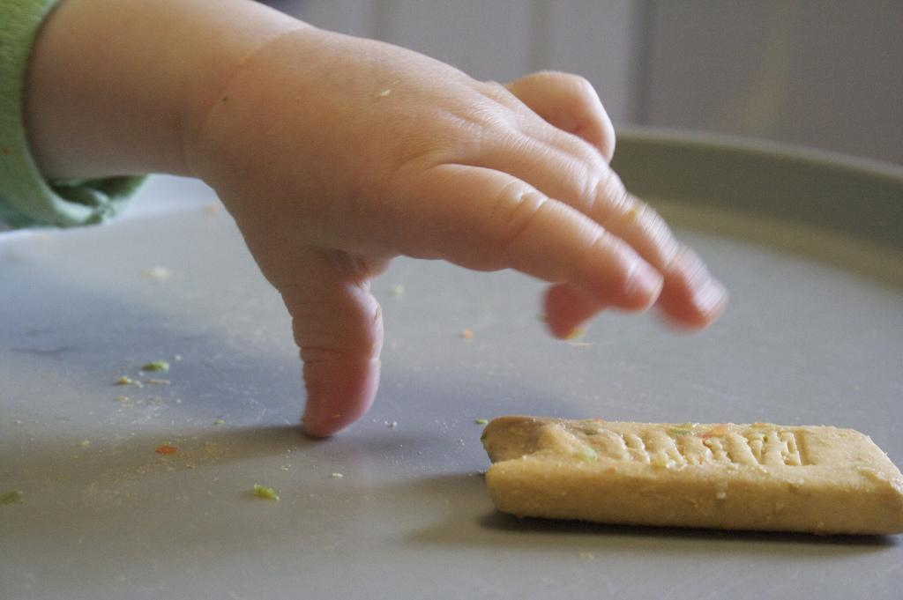
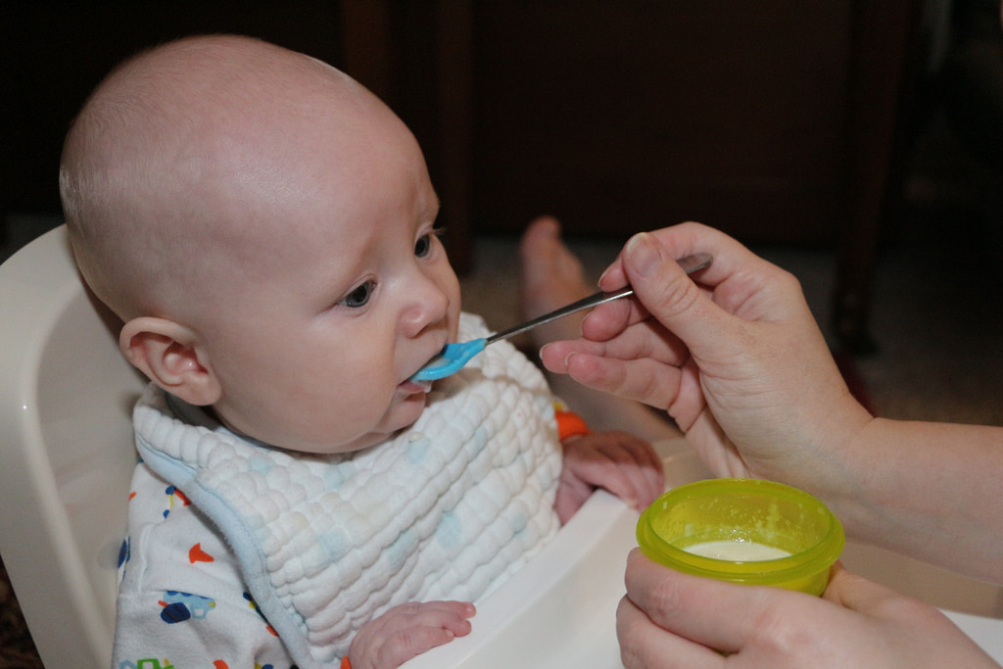
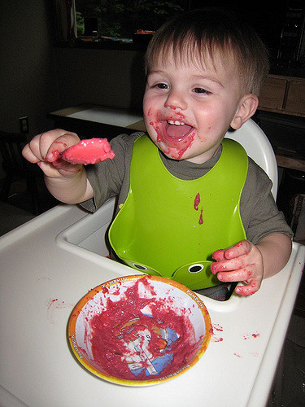
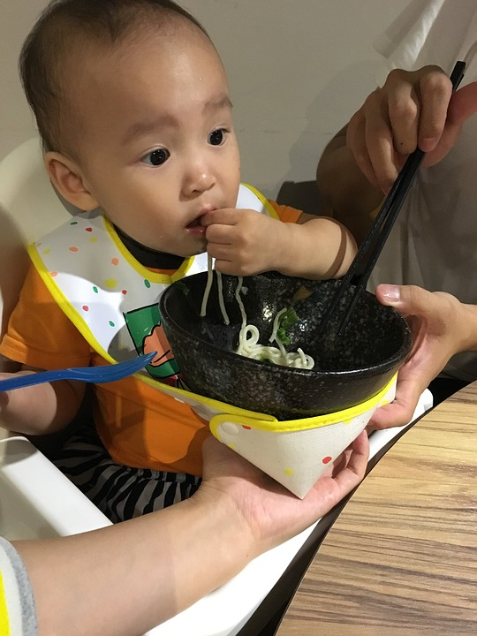
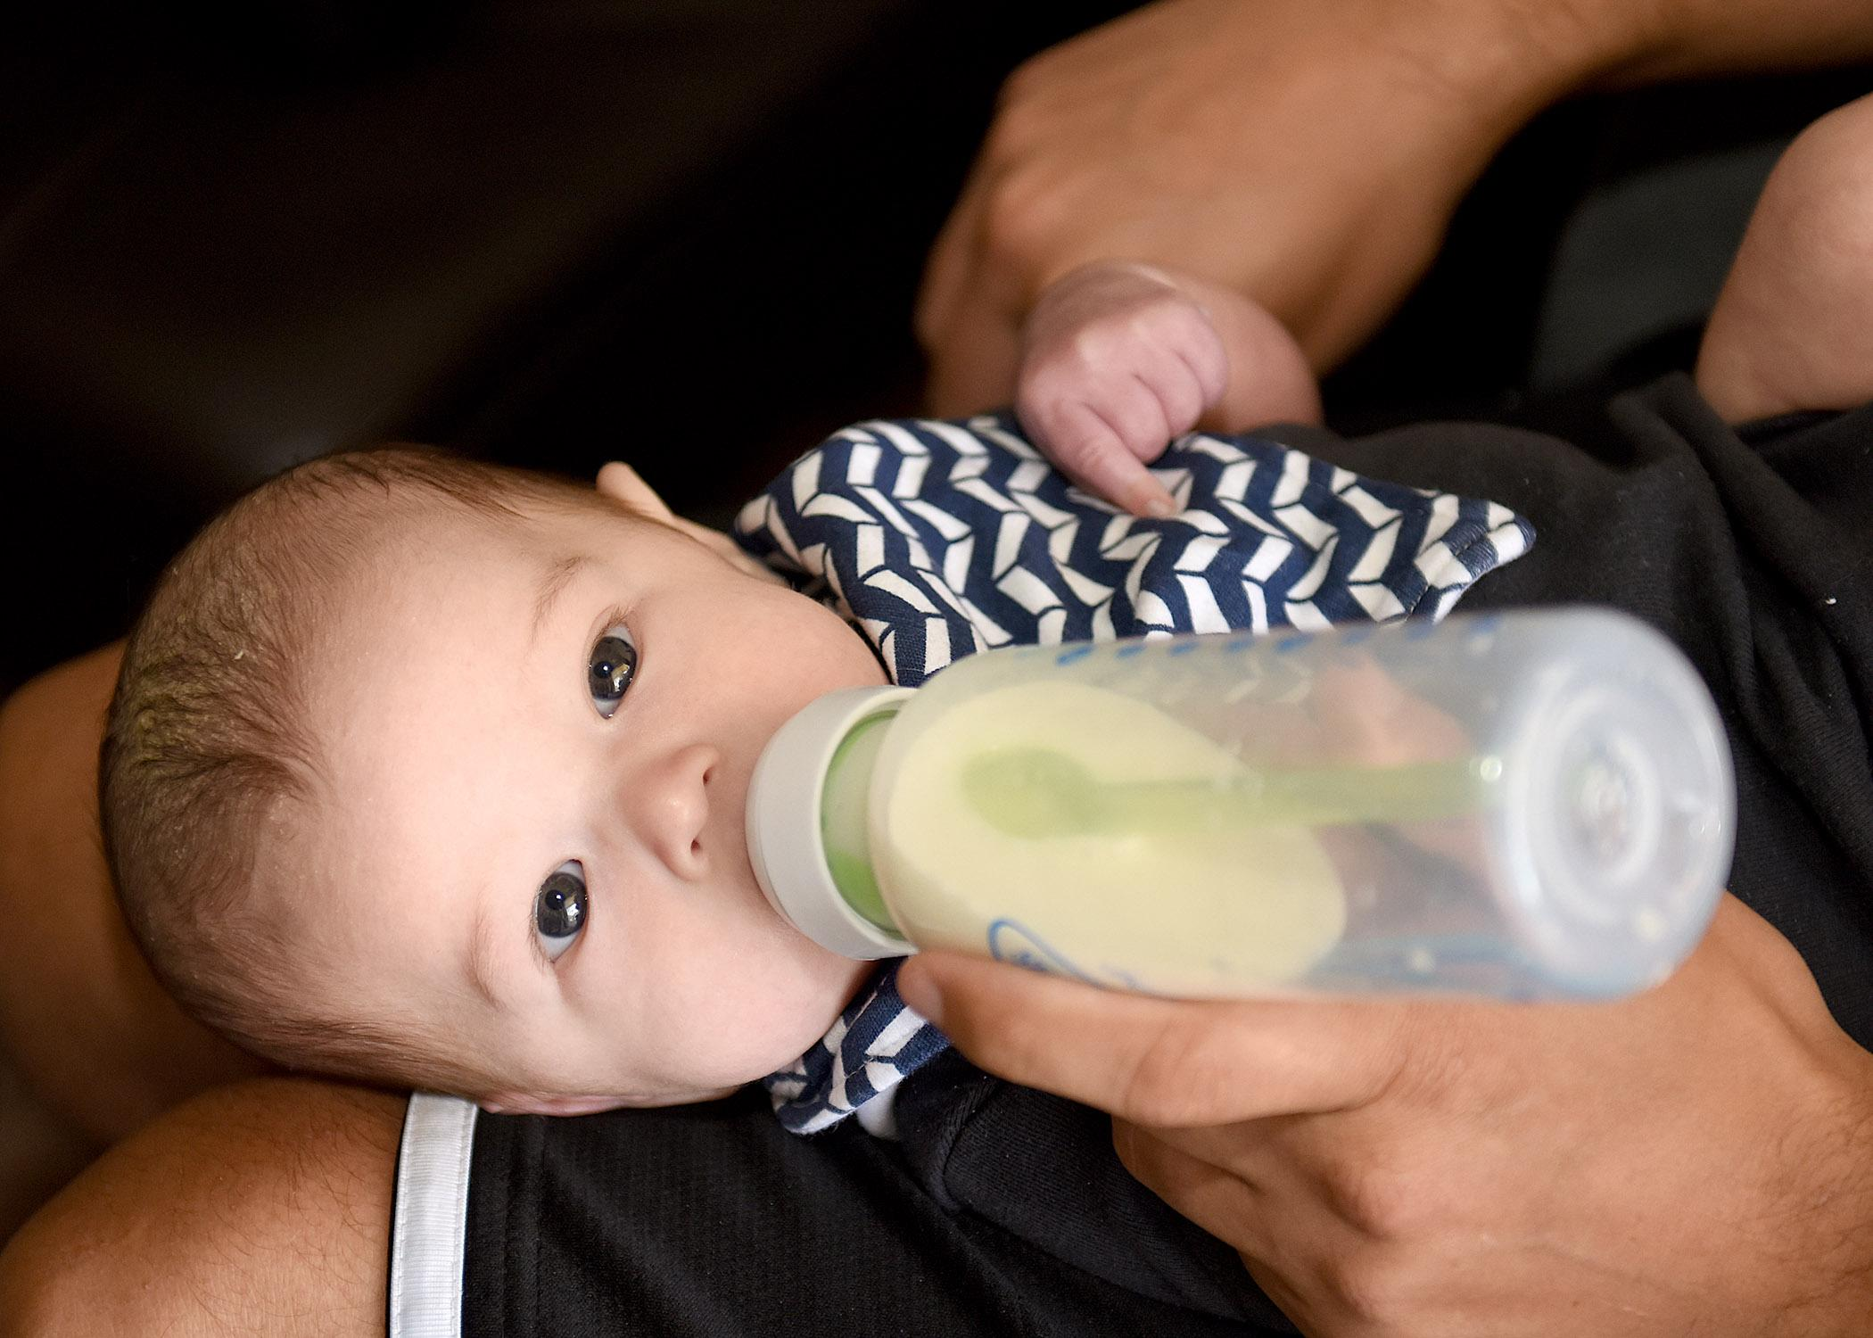
Match the Developmental Stages of Eating
Birth to 4-6
4 - 6
6-7
8 - 10
9 - 12
10 - 12

Slide 7
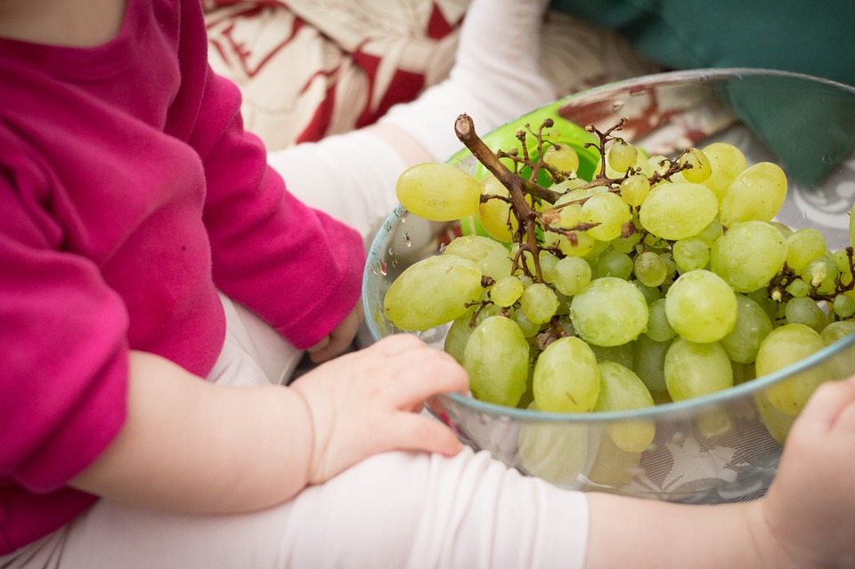
1st Year Developmental Stages of Eating
Birth to 4-6 Tongue moves from side to side,
4 - 6 Moves tongue back and forth, can move food back of throat to swallow. Starts teething.
6-7 Begins to learn to chew.
8 - 10 Grasps objects with fingers, can put in mouth
9 - 12 Drinks from a cup
10 - 12 Holds spoon and moves spoon to mouth.

Slide 8
Compare Breastfeeding vs Formula
Breast milk is the most natural form of nutrition for babies
Colostrum is a yellowish substance and is the first food a breastfeeding newborn receives
Economical
Convenient
Healthy for mom and baby
Breast Milk more easily digested
Possible reasons for using formula
Illness and stress can limit mother’s milk
Father can participate
Socially acceptable in public
Convenient
Takes longer to digest, feedings are less often
Colds & diarrhea are more common

Slide 9
How to Feed Infants
The benefits of holding a baby while feeding
Vital time for one-on-one interaction & bonding
Cradling the head in an upright angle prevents ear infections

Slide 10
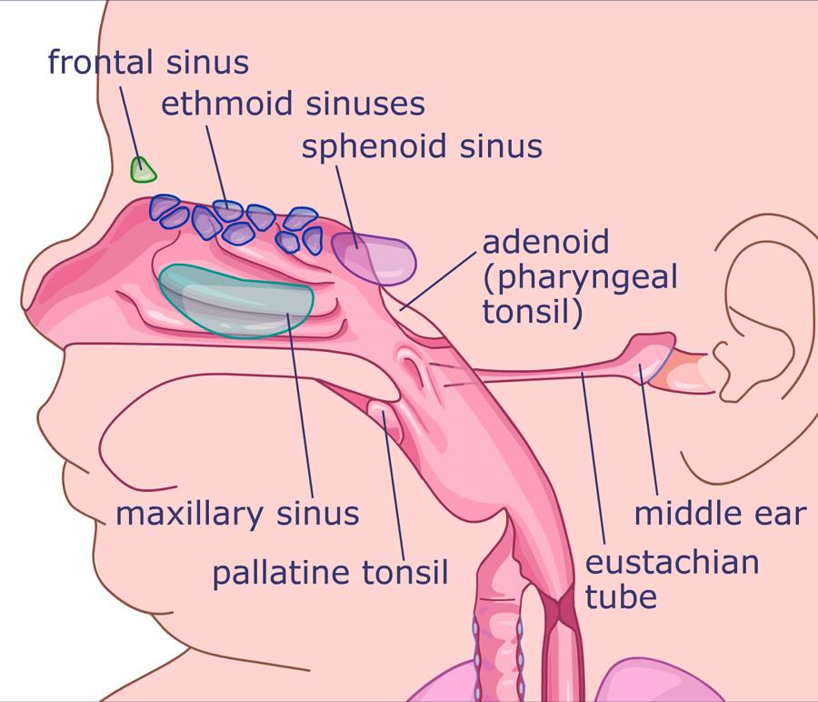
How to Feed Infants
If the baby is left alone to feed self they miss the bonding time.
If left on a flat surface the fluid will go into the eustachian tube and cause ear infections or damage hearing.

Slide 11
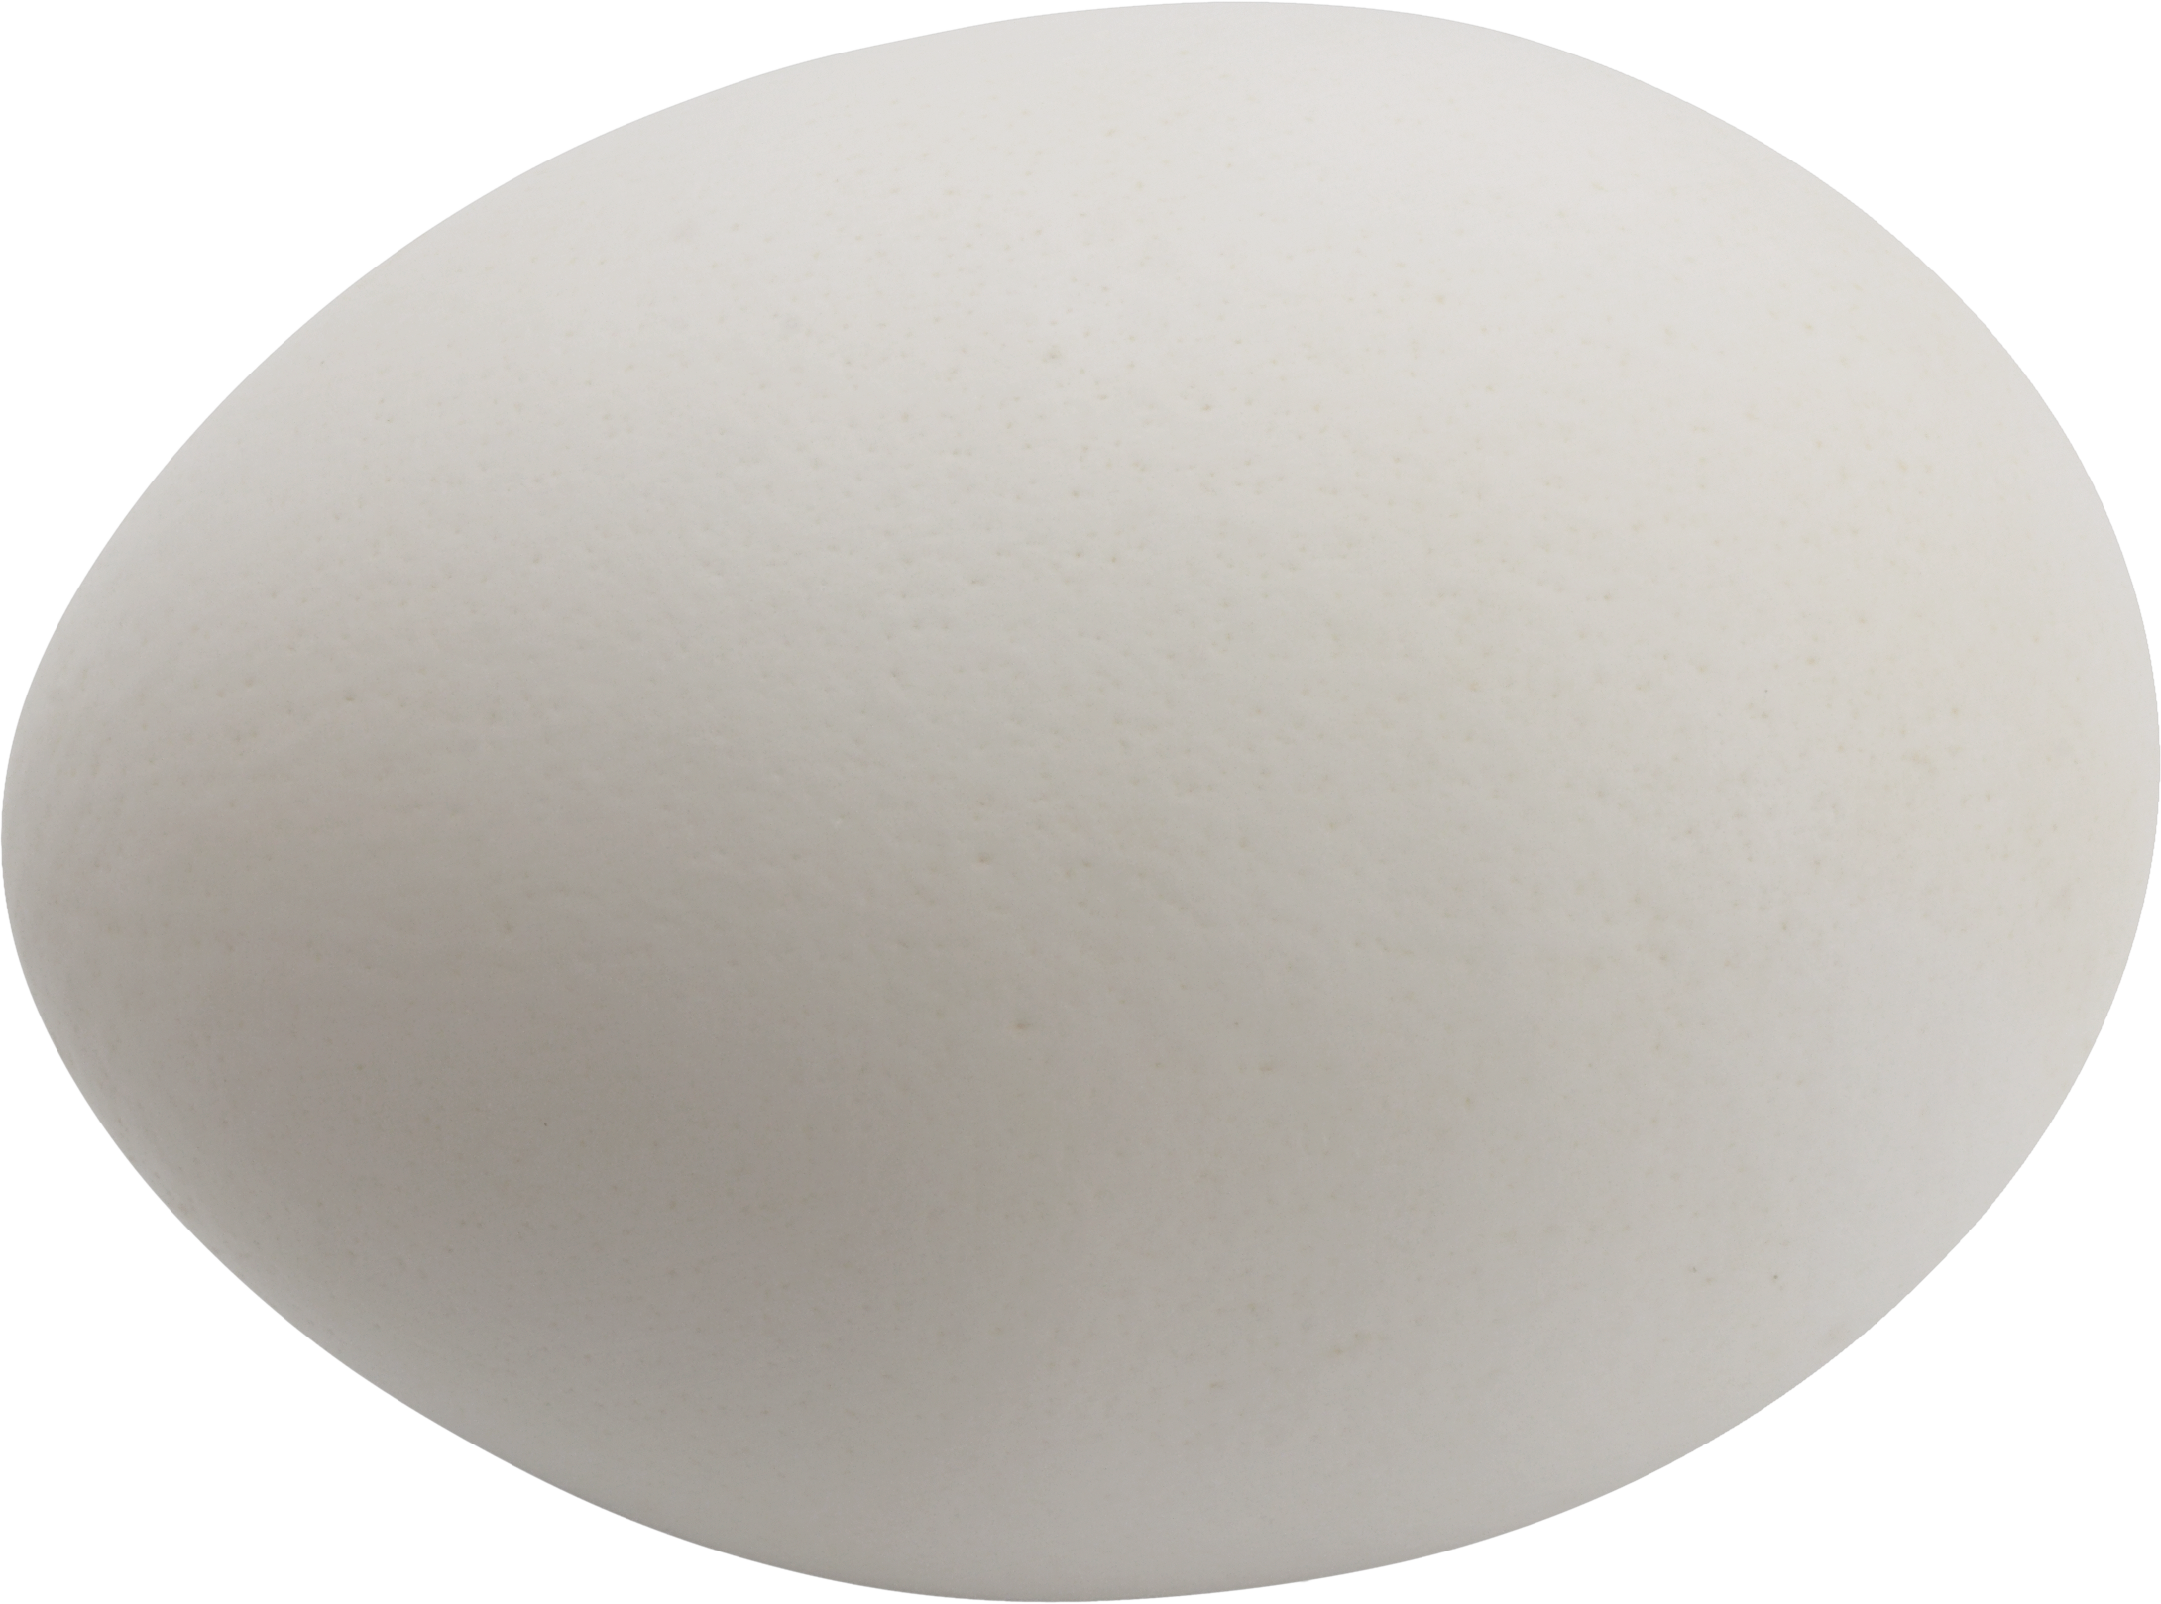
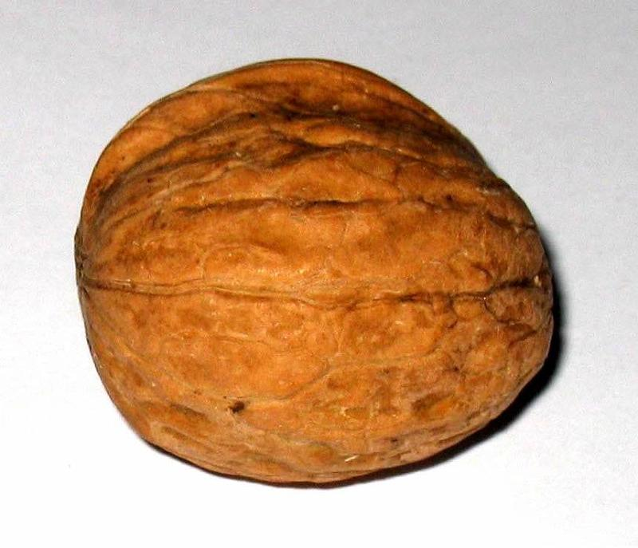
Newborn’s Stomach Capacity
Newborn’s tummy can’t hold much at each feeding
1 day old
1 ¼ teaspoon
Per feeding
3 days old
.75 ounces
Per feeding
1 month old
2 ½ - 5 ounces
Per feeding

Slide 12
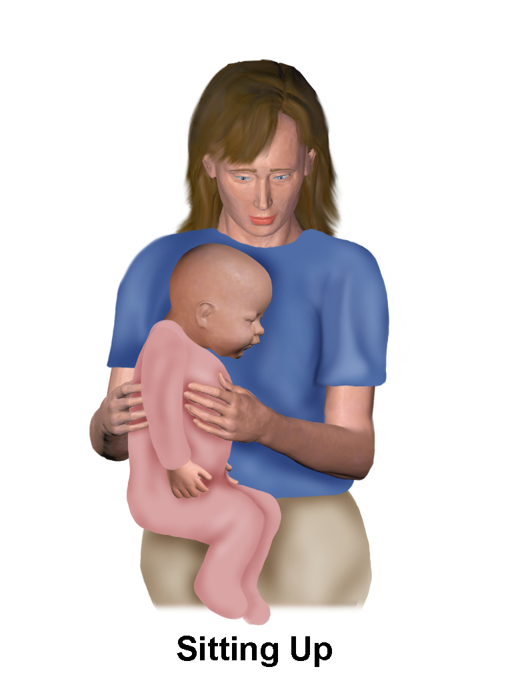
Burping the Baby
Babies swallow air as they drink
Must burp to expel air
Burp the baby at least twice throughout the feeding
Find a comfortable position to burp a baby
Gently pat baby on the back
Protect your clothing

Slide 13
Funny Babies Eating
Funny Babies Love Food

Slide 14
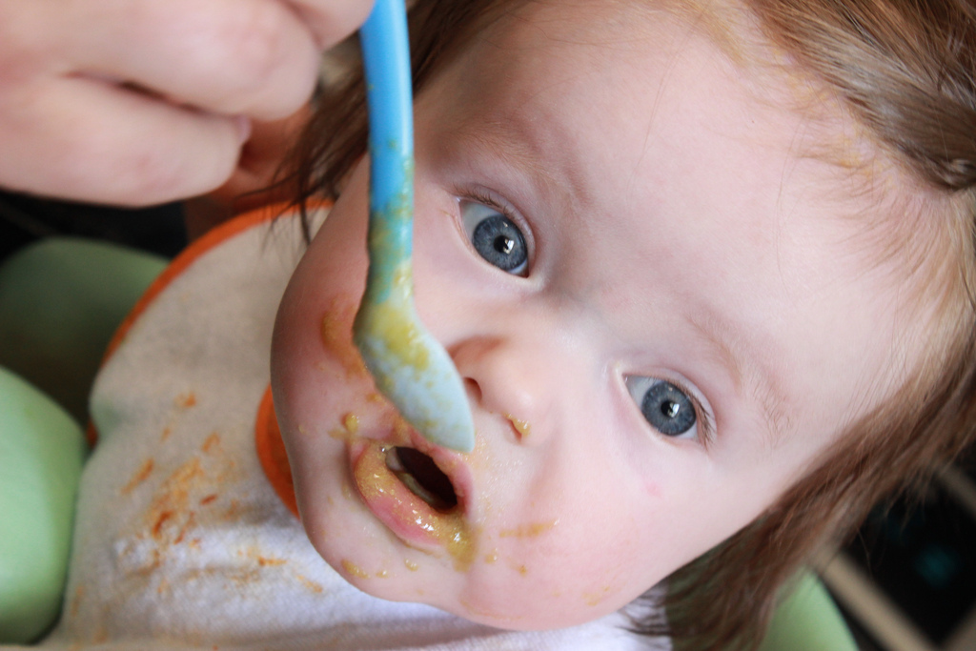
When Can Babies Start Cereal
Between 4 - 6 months babies can produce saliva, which is the key factor needed for digestion.
When birth weight has doubled and weighs at least 13 pounds
Sits with help and has control of head movement
Can put hands together
Puts toys in mouth

Slide 15
Feeding an Infant
Choose foods that are soft and easy to chew and swallow
Avoid salty foods
Foods that work well:
Watery rice cereals
Strained fruits and vegetable
Amount of solid foods consumed should increase over time

Slide 16
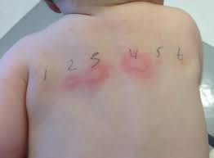
Feeding Infant
Introducing Solid Food
New foods should be introduced at least four days apart to figure out which food is the problem
Sign to look for is there is a problem with food
Rashes
Digestive trouble
Allergic reaction

Slide 17
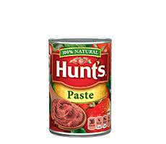
Juice for Babies
Babies under six months should not drink fruit juice
Promotes tooth decay
May curve or limit a child’s appetite
Should be water down
Infants 6 months and older should only have 4 - 6 ounces per day.
Can of tomato paste

Slide 18
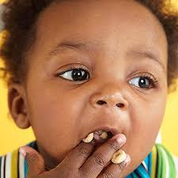
Transition to Table Food at 8 - 10 months
Babies will progress from pureed or mashed food to soft, minced or diced foods
Self-feeding
Finger foods
Small pieces of food that can easily be picked up with fingers and eaten
It can take as many as 10 tries before a child will accept a new food

Slide 19
Foods to Avoid
Round or hard foods can cause choking
Raw vegetables
Hot dogs
Nuts
Peanut butter
Whole grapes
cherries
Candy
Chips
Pretzels
Popcorn
Marshmallows

Slide 20
Weaning
Changing from drinking from the bottle or breast to a cup
Around one year in age
Signs that they are ready to be weaned
Playing or looking around while feeding
Pushing the breast or bottle away
Showing a preference for eating solids

Slide 21
Avoid
Never mix cereal in a baby’s bottle unless recommended by a health care provider for medical purposes.
Baby’s under the age of one should not be fed cow’s milk
Hard to digest
Honey -- pure or found in other foods. Can cause Infant Botulism

Slide 22
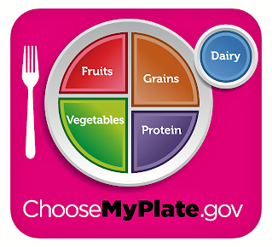
How will you serve food to toddlers?

Slide 23
Serving Sizes per Meal
Fruit = 1/4 cup
Veg = 1/2 cup
Grains = 1/2 cup
Protein = 1/4 cup
Dairy = 1/2 cup
Toddlers generally eat ¼ to ½ of an adult serving,
or one tablespoon per year of age.

Slide 24
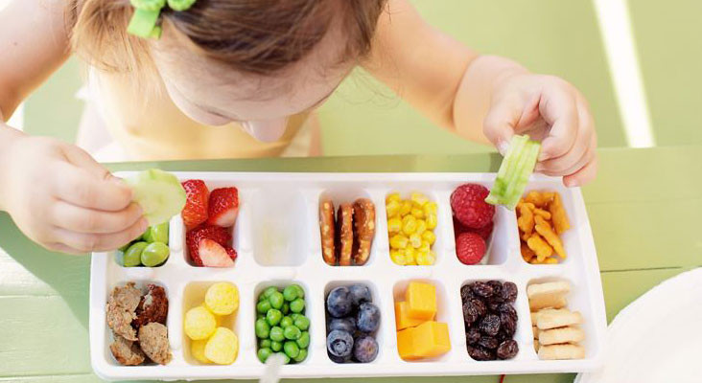
Serving Sizes

Slide 25
How Much Food Should Children Eat?
Age 1 to 3 year olds should drink 16 ounces of whole milk per day
Do not switch to 2% or reduced fat milk until the age of 2
Toddler needs 3 meals per day plus healthy snacks.
Young child have small stomachs and high energy levels, requires calories throughout the day
Parent is responsible for what is offered to the child
Child is responsible for how much he or she eats
If a child is having a growth spurt he or she may require more food

Slide 26
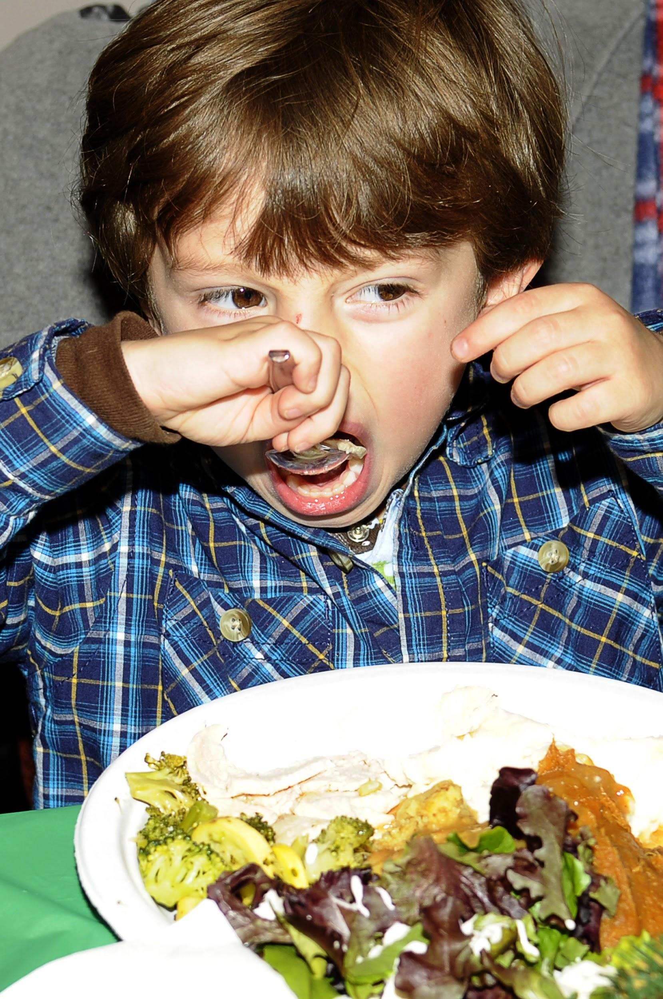
Helping Child Eat Well
Serve meals and snacks in a quiet, pleasant and safe environment
Avoid food battles and don’t pressure children to eat
Offer a variety of nutrition food from each food group
Introduce new foods with a familiar food
Provide small portions and allow your child to ask for second helpings
Do not use sweets or desserts as a reward for finishing a meal.
Respect your child’s individual food preferences
Eat with your child to set a good example
Turn the TV off and don’t allow devices at the table
Supervise your child at all times during meals and snacks

Slide 27
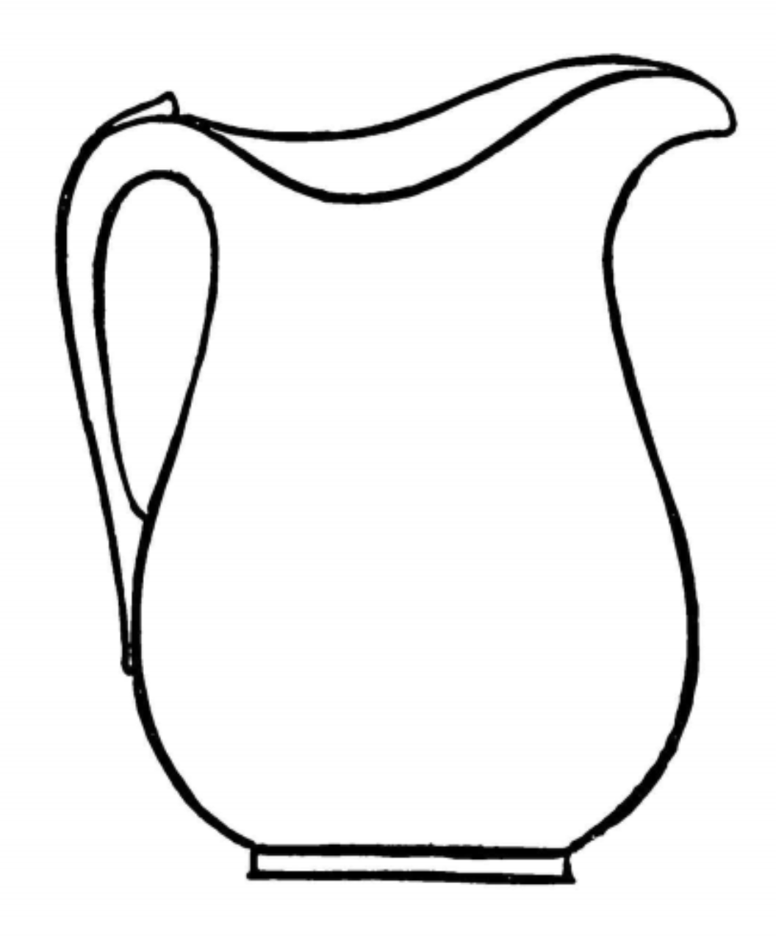
Rank Most to Least Amount of Sugar in Beverages 1 - 6
Chocolate Milk ______ Milk_________ Fruit Juice _______
Formula ______ Kool Aid_________ Soda Pop _______

Slide 28
Rank Most to Least Amount of Sugar in Beverages 1 - 6
Soda Pop #1 = 30 gram Fruit Juice #2 = 29.3 gram Choc Milk #3 = 25 gram
Kool Aid #4 = 24 gram Milk #5 = 22 gram Formula #6 = 18 gram

Slide 29
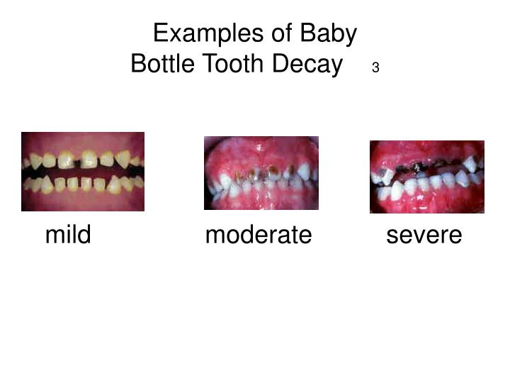
Baby Bottle Tooth Decay
BBTD is caused by prolonged contact with liquids containing sugar, which means almost all liquids other than water. Usually happens when children are put to bed with a bottle and the liquid settles in their mouths and on their teeth as they fall asleep.

Slide 30
Sugar Addict
Sugar Addict

Slide 31
Christina Hickman, MA Edu, 2018

