Slide 1
Labor & Delivery

Slide 2
Who does what?
Obstetrician – concerned with pregnancy and childbirth
OBGYN – Obstetrician/gynecologist – specializes in pregnancy, childbirth and other female concerns
Mid-Wife - provides gynecological examinations, contraceptive counseling, prescriptions, and labor and delivery care. Providing expert care during labor, delivery, and after birth is a specialty of midwives that makes them unique.
Labor and Delivery Nurse - care for women during labor and childbirth, monitoring the baby and the mother, coaching mothers and assisting doctors.

Slide 3
A Few Weeks to go
Lightening
Baby settles deep in the pelvis
Reduces pressure on the upper abdomen making it easier for mother to breathe
Mother gets anxious
Happens during the last few weeks of pregnancy for the first pregnancy.
Women who have already had a baby, may happen right before labor begins.

Slide 4
What is Labor
Labor is the energy and effort used to push the baby out of the womb.
Dilation is when the cervix dilates from 0 – 10 cm.
Effacement is the thinning of the cervix.
Average length of labor for a first baby is 12 – 20 hours.

Slide 5
False Labor
Contractions are not regular or rhythmic
Contractions do not get stronger over time
No bloody show
Membranes are intact
Contractions are up front and up high
No progression in timing or intensity
Contractions stop when you walk
No cervical changes
Braxton-Hicks can occur throughout the pregnancy as a the uterus practices contracting.

Slide 6
True Signs of Labor
The “Show” or “Bloody Show”
Few drops of blood or pinkish vaginal stain that occurs when the mucus that plugs the uterus during pregnancy dissolves.
May occur as early as a few days prior to birth.
Water Breaks
Trickle or gush of warm fluid from the vagina
This indicates that the amniotic sac has broken
Delivery should be within 24 to 48 hours
Call your doctor or midwife immediately
Contractions
Tightening and releasing of the muscles of the uterus
Purpose: to push the baby against the cervix

Slide 7
How does Labor Feel?
Emotions and feelings women experience
Excited
Afraid
Confused
Quiet
Hopeful
Nervous
Restless
Nauseous
Shaking
Tired
Frustrated
Grouchy
Notes:
During pregnancy you’ve become use to Braxton-Hicks, when it feels like the baby is balling up and your uterus is hard like a basketball. This is your uterus working out and getting ready for the big day! Most women are very concerned about the pain caused by contractions. Pain can be different for each woman. Think about how differently two people respond to the same injury. Some people are normally very tolerant of pain and others are more sensitive. This is an exaggerated scene from the movie “Knocked Up”.

Slide 8
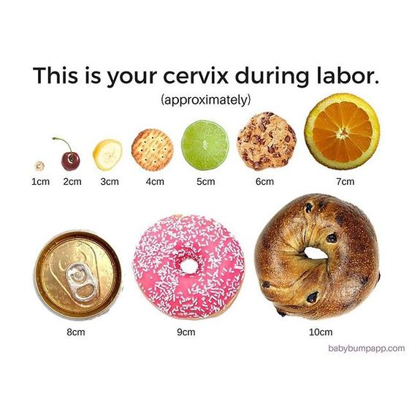
Opening the Cervix
Here are some examples of 1 – 10 centimeters dilation
1 cm = Cheerio
2 cm = Cherry
3 cm = Banana Slice
4 cm = Cracker
5 cm = Lime slice
6 cm = Chocolate Chip Cookie
7 cm = Orange Slice
8 cm = Soda Can
9 cm = Doughnut
10 cm = Bagel
Notes:
The cervix is a short tunnel that connects your uterus to your vagina. You might be dilated 1 -3 centimeters a week or two before labor even starts without feeling a thing.

Slide 9
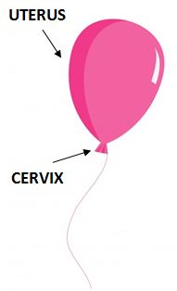
Stage 1
The uterus is like a balloon and the cervix
is the opening.
The purpose of each
contraction is to open the cervix to 10 centimeters over the course of 8-15 hours.

Slide 10
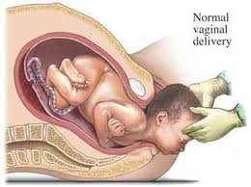
Second Stage: Baby is Born
What Takes Place?
Contractions are stronger, pushing the baby through the birth canal.
How Long Does It Last?
First Child: 1 to 2 hours
Later Children: 15 to 30 minutes
Crowning is when the head of the baby can be seen.

Slide 11
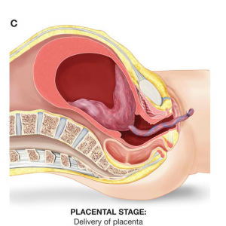
Third Stage of Labor
The third stage of labor is the delivery of the afterbirth:
Placenta
Amniotic sac
Umbilical cord
You will continue to have mild contractions as the uterus shrinks.
The placenta detaches from the uterine wall.
You will give a small push to deliver the placenta.
This takes between 5 – 20 minutes.

Slide 12
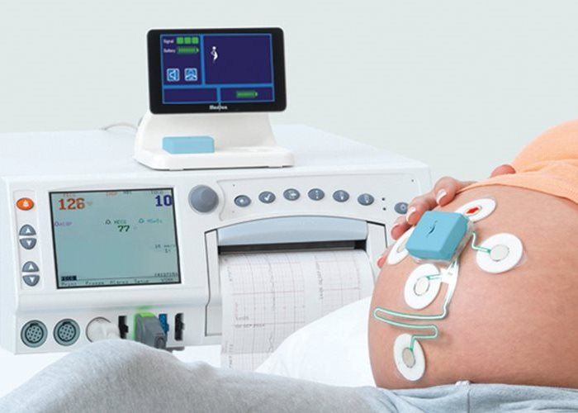
Fetal Monitoring
Watching the unborn baby’s heart rate for indications of stress
Usually done during labor and birth.
Most common method is an ultrasound.

Slide 13
Anesthesia
Most women prefer some kind of anesthesia
Natural (unmedicated) childbirth is becoming more popular because the anesthesia can make the newborn less alert after birth.
An epidural is given in the spinal sheath and numbs the patient from the waist down.
A saddle block numbs the area where you ride a saddle.
A cervical block numbs the cervix.

Slide 14
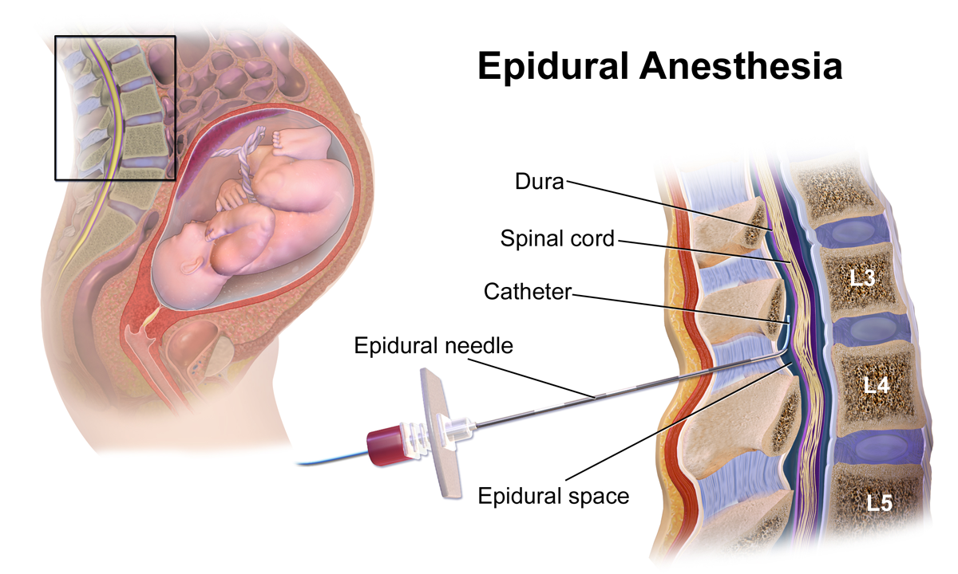
Epidural
Injection in back next to spinal canal.
Numbs the lower half of the body
Given when mother is partially dilated
Usually to about 4 cm
Depends on the anesthesiologist
External/Internal Monitoring

Slide 15
Positions for Giving Birth
Lie on back
Squatting
Lie on side
Sitting
Kneeling
In water

Slide 16
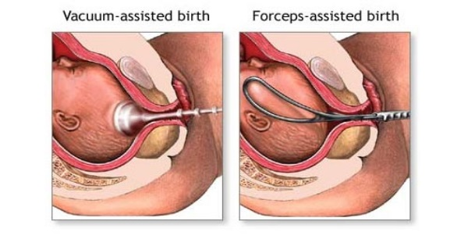
Helping Mom Deliver
Sometimes forceps or a vacuum is used if progress is not being made and the baby is in the birth canal too long.

Slide 17
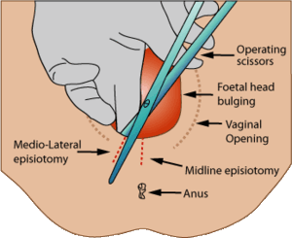
Episiotomy
An episiotomy is a surgical cut in the perineum to enlarge the vaginal opening to make birth easier and prevent tearing.
The cut is stitched back together after delivery.

Slide 18
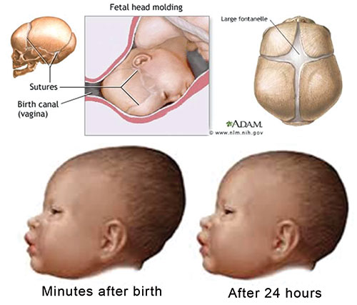
Fontanelle
Fontanelles are the soft spot on the baby’s head.

Slide 19
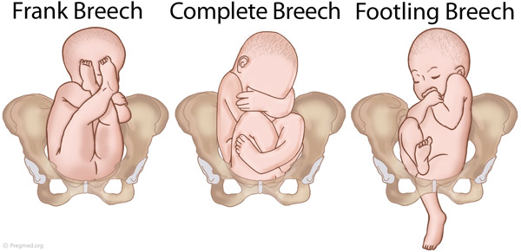
Breech Delivery
A breech delivery is when a baby is born feet or butt first.
Concern because the cord and head must come at the same time pinching off the oxygen supply as the baby descends through the birth canal.
Many breech babies use cesarean delivery.

Slide 20
Premature Labor
Baby is born 37 weeks or less
Warning Signs:
Contractions every 10 minutes or less
Constant, dull backache
Leaking fluid or blood
Sometimes, doctors can give medication to stop premature labor.

Slide 21
Problems of Premature Infants
Low birth weight
Underdeveloped lungs
Infections
Slow development later in life
Little or no sucking reflex

Slide 22
Welcome Little One!

Slide 23
Right after Birth
There will be several medical procedures right after your baby is born.
Suctioning to clear airways
Cord clamped
Identification Band
APGAR Score done at 1 minute and again at 5 minutes. (Breathing effort, heart rate, muscle tone, reflexes, skin color)
Weighed and measured

Slide 24
The Apgar Rating
Apgar Scale- system rating the physical condition of the newborn at 1 and 5 minutes old.
Five Factors:
Heart Rate
Breathing
Muscle Tone
Response to Stimulation (crying)
Skin Color
Rating for each factor 0 to 2
7 or higher indicating a healthy newborn.

Slide 25
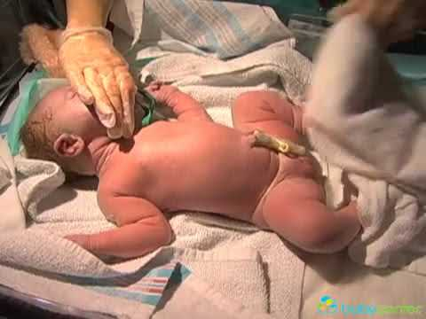

Slide 26
Features of a newborn
You may notice:
The head is large, about one quarter of the total body length
Head may be misshapen, molded in the birth canal
Eyes are dark blue and may seem cross-eyed
Nose is small and flat
Skin is pinkish - purple
Face is puffy and swollen
Both boys and girls have swollen breast and genitals
Mothers can nurse the baby right away if she chooses

Slide 27
The Amazing Uterus
The uterus is an amazing organ with the ability to endure pregnancy and sustain another human being for 40 weeks by building its own life support system. It stretches to a capacity 500 times its original size, contracts with the force of 43 pounds of pressure per inch to dilate the cervix to the size of a large bagel to deliver a beautiful baby!

Slide 28
Uterus Following Birth
During the Next 6 Weeks:
Uterus may cramp the first few days called ‘afterpains’
Uterus will return to its normal size called ‘involution’
Discharge called ‘lochia’ will last 4 – 6 weeks going from red to pink to brown.
Breastfeeding shrinks the uterus and ends lochia faster
Menstrual period will return 6 – 12 weeks after delivery
You CAN get pregnant very easily, even if your period hasn’t returned. Birth control is a must!
Stitches will dissolve in a week or two

Slide 29
Postpartum
Postpartum is the next 6 weeks after delivery.
Breasts secrete colostrum in the first 3-5 days
You will start losing weight right after delivery
Take it easy, if you get a burst of energy and overdo it, the discharge may go back to red.
Eat healthy so you have energy and can heal.
Constipation is normal after birth (eat fiber)
Your body has gone through a lot and you’ll need rest as you recover.
Hormonal changes will cause fatigue, night sweats & mood swings.
Feeling blue is common with fatigue, hormones and being overwhelmed. 50-80% of new moms get baby blues which lasts 1-2 weeks
Some women have postpartum depression
Take time for yourself; continue doing the same relaxation you practiced before labor.
See your OB six weeks after delivery for your postpartum checkup.

Slide 30
Prezi Analysis

Slide 31
Christina Hickman, MA Ed 2019

Slide 32
First phase Early Labor
Cervix dilates to 4cm
Average length is 8 - 10 hours
Longest Stage
Contractions grow stronger, longer, and more frequent
Fetal monitor attached

Slide 33
Helping Mom Begin Labor
Relaxin and Dilation
Dilate- to widen or open
Relaxin is a hormone that allows the connective tissue in mother's pelvis stretch to make it possible for the walls of the vagina to stretch so the baby can pass through safely.
Relaxin allows for dilation.
Induce Labor
A doctor causes labor to begin by injecting pitocin that begins contractions
A doctor ruptures the amniotic sac to begin contractions.

Slide 34
Delivery Options
Vaginal Delivery – Baby is delivered vaginally through the birth canal. Preferred because it helps the baby expel the amniotic fluid and gain strength
Cesarean Section Delivery - - a surgical procedure in which one or more incisions are made through a mother's abdomen and uterus.
Birthing Room – used for regular, vaginal deliveries
Operating room – used for cesarean deliveries

Slide 35
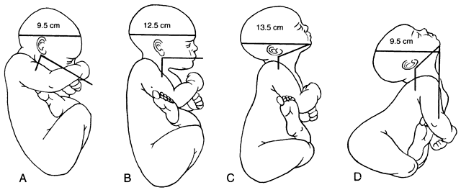
Other Delivery Presentations

Slide 36
Other Reasons for a C- Section
Prolapsed cord
Poor presentation
Mother to small
Baby too big
Placenta abruption
Multiple births
Fetal distress
Mother or baby cannot tolerate labor
STD’s
Previous C-Section
Toxemia
Having a C-Section is considered major surgery as layers of organs are cut through and sutures can become infected.

Slide 37
Investigate your own Birth
What was mom doing when labor began?
Who took mom to the hospital?
Was mom afraid of labor?
Are you the first born?
Who stayed with mom during labor & delivery?
Where were you born, what time of day?
How long was mom in labor?
Did mom have natural childbirth or medication?
What did everyone do the moment you were born?
Did mom hold you right after birth?
1.
How much did you weigh?
Were there any medical issues with you or mom?
How did they come up with your name?
Were you breastfed?
What are some things that are done differently today than when you were born?
Notes:
It might help you feel more empowered to know the details about your own birth. Ask your parents and other family members these questions to refresh their memories:

Slide 38
Second Phase: Active Labor
Contraction are 2 – 5 minutes apart.
Dilate from 5cm - 8cm
You can rely on breathing techniques to get through each contraction.
Have a focal point to look at, keep your eyes open so your mind is on the object not the pain.
Takes 3 – 4 hours

Slide 39
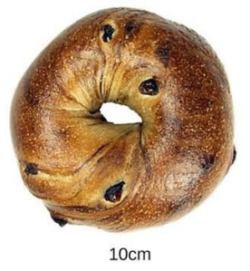
Third Phase: Transition
Cervix dilates to 10 cm in a short amount of time.
Contractions are closer together
Regular, powerful, contractions every two to three minutes
Baby’s head enters birth canal
Contractions are closer together
Cervix dilates to 10
Takes 15 minutes – 1 hour

Slide 40
Zero in on Baby’s Needs
Your baby will be very sleeping for the first few days and will need 20 hours of sleep per day for the next few weeks.
Keep baby inside and away from strangers for the first 2- 3 weeks because the immune system can’t fight germs yet.
Everyone should wash their hands before holding baby, especially before and after changing diaper.
The neck is very weak so support the head at all times.
Care for the umbilical cord until it falls off.
Provide safe sleep by placing your baby on his back.
Remove all pillows, stuffed animals and padding from crib
Always use the car seat facing the rear.
Try to eliminate stress and tension around baby
Comfort your baby by feeding, swaddling, rocking, singing and offering a pacifier.
Never leave your baby unattended.
For a calm baby begin creating a routine for
You can’t spoil a baby with too much love!
So hug and cuddle often!

Slide 41
What are the 3 Stages of Labor?
Contractions open the cervix
Phases:
Early Labor
Active Labor
Transition
The baby is born
The placenta is expelled

Slide 42
Cesarean Delivery Used When:
The labor is long and difficult and the life or the baby or mother is threatened.
The fetal monitor shows a drop in heart rate.
Placenta Previa, placenta is covering the opening to the cervix.
The woman’s bone structure is too small to allow vaginal delivery.
Having a C-Section is considered major surgery as layers of organs are cut through and sutures can become infected.

