Slide 1
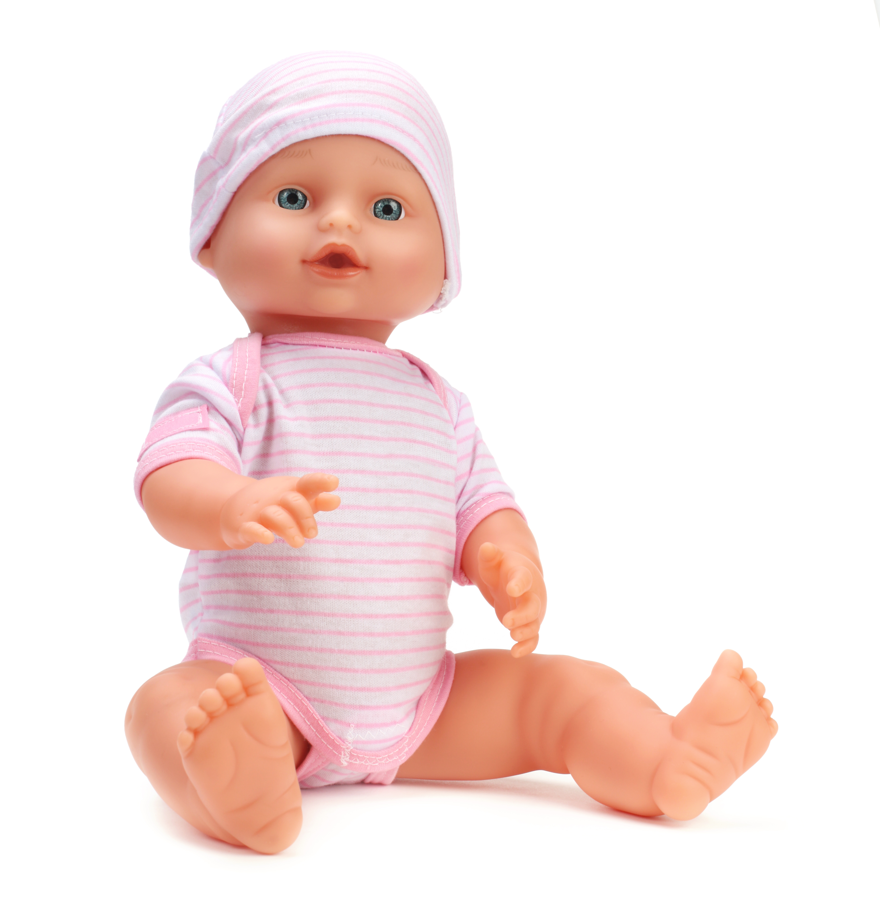
Baby Project

Slide 2
Your teacher will ask for 5 volunteers to be parents each day.
Students will draw for the baby number and weight.

Slide 3
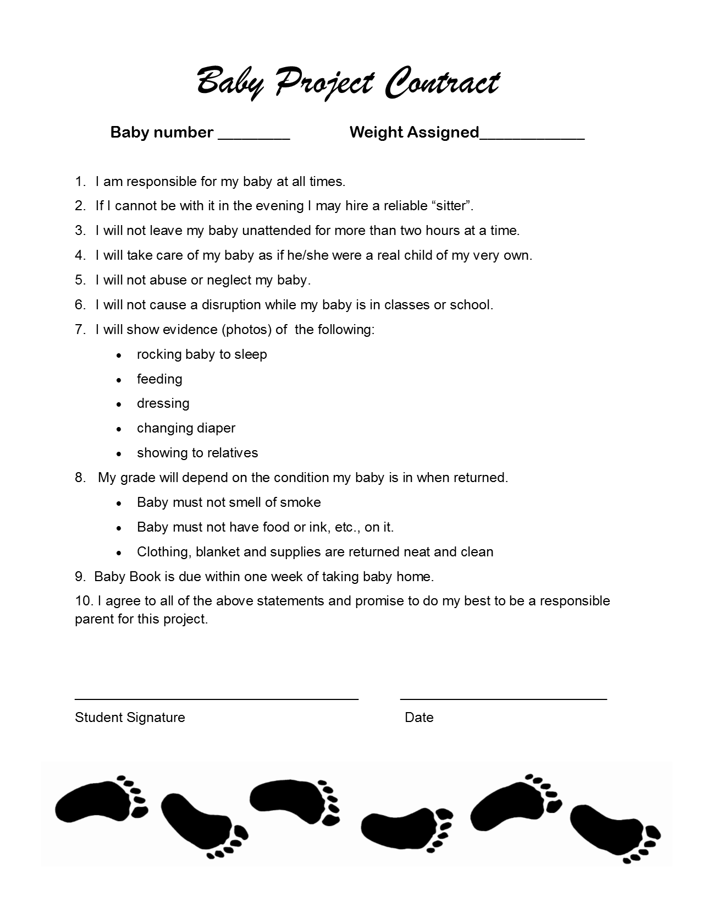
1. Read and sign the contract.
Record your baby number and assigned weight in your Baby Book for reference.

Slide 4
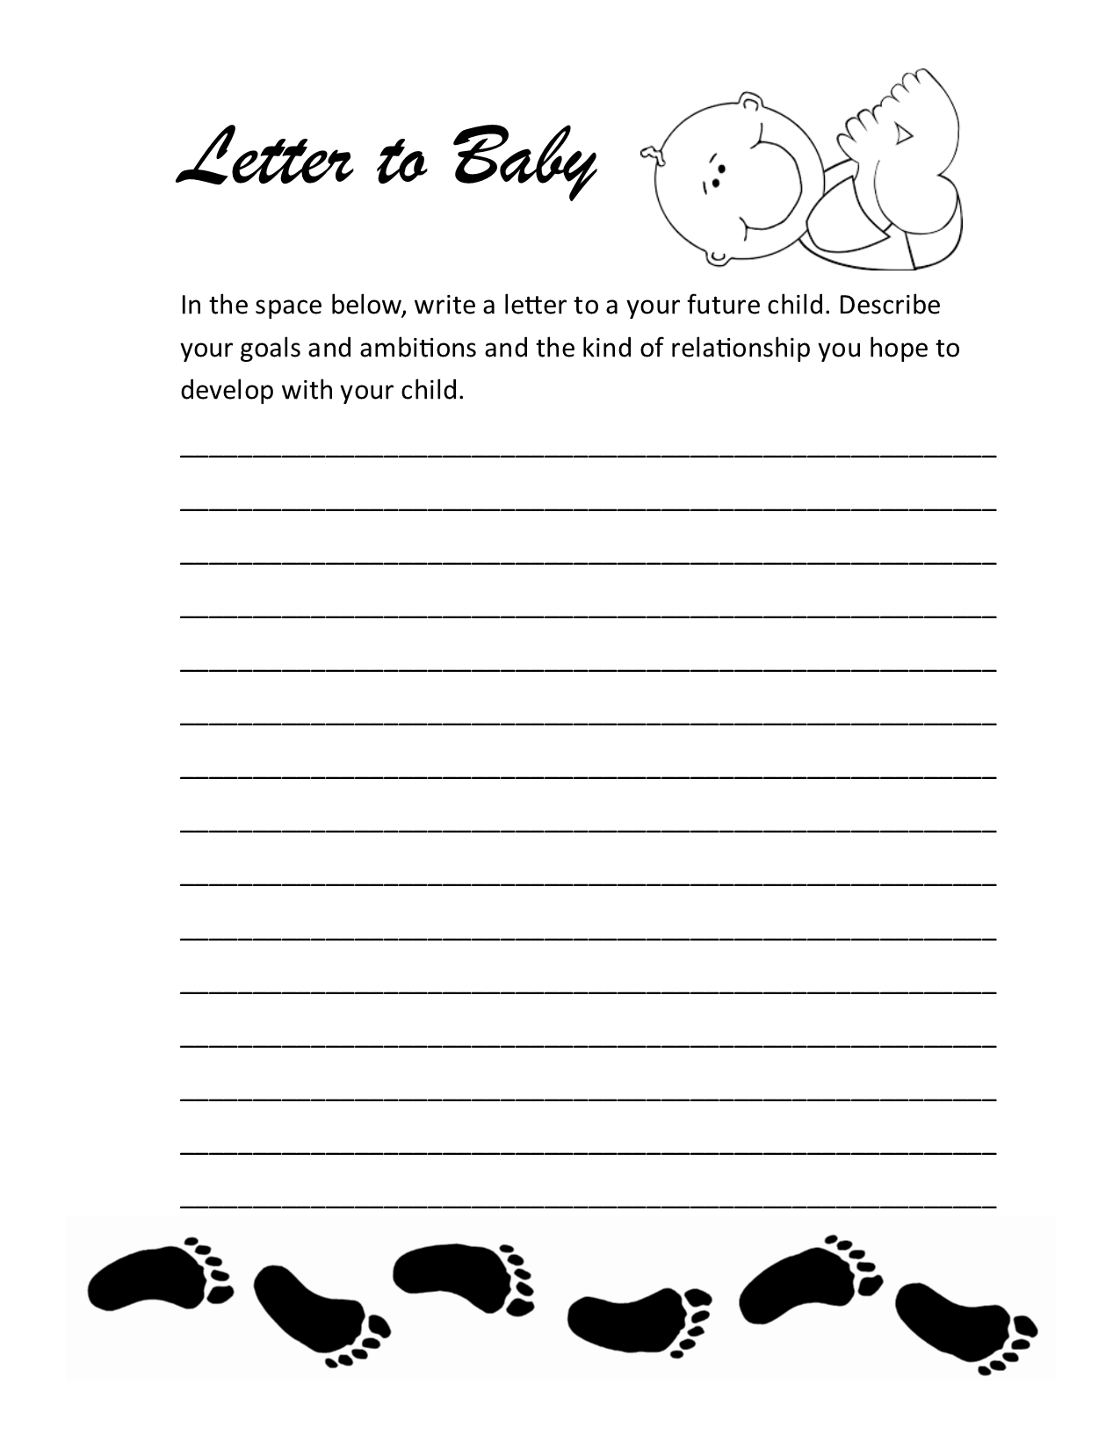
2. Letter to Baby -
write a letter to your future child.

Slide 5
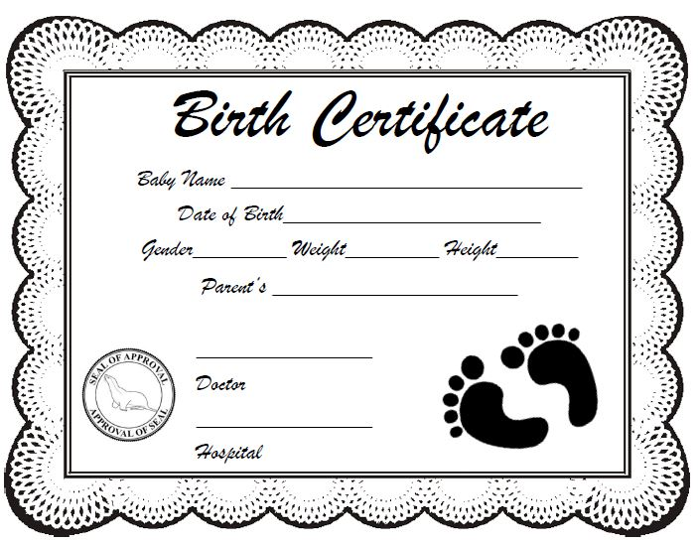
3. Birth Certificate -
complete and get the doctor's signature.

Slide 6
4. First Visitors & Gifts -
introduce your baby and get autographs.
Gifts - list items new parents need.

Slide 7
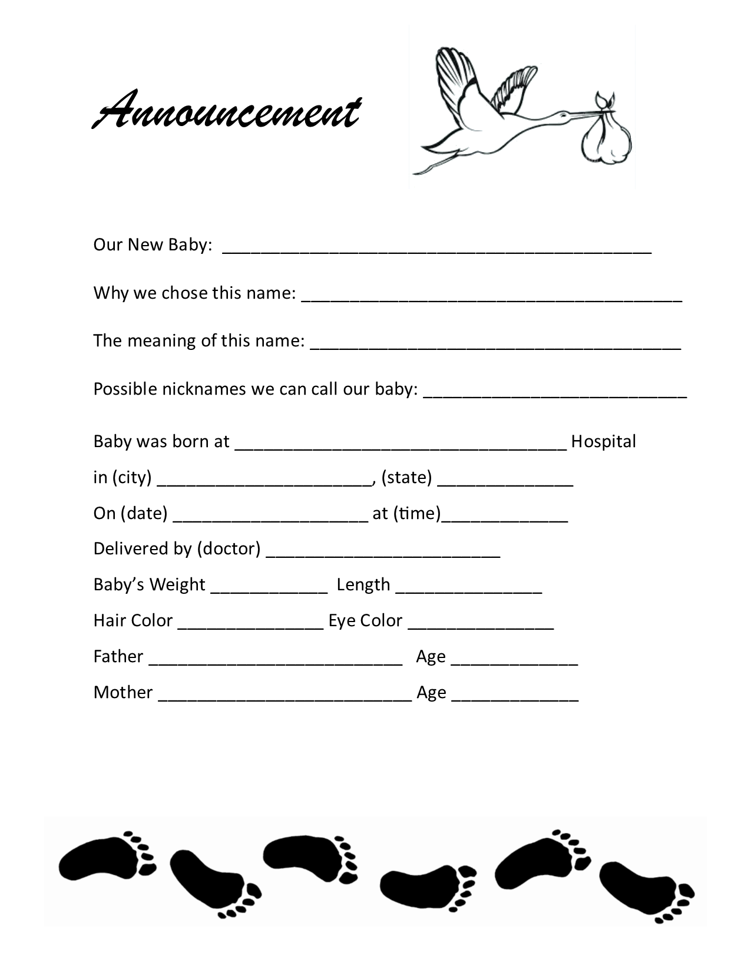
5. Announcement - Complete and research meaning of baby's name.

Slide 8
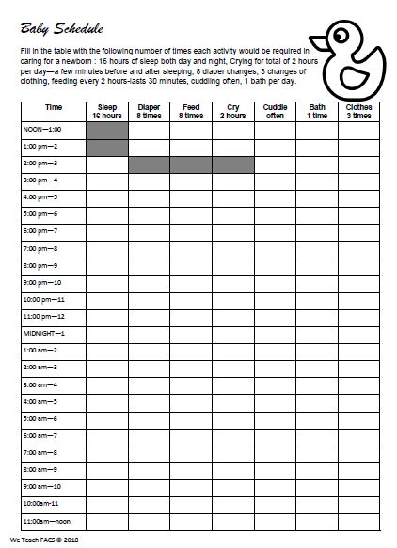
6. Baby Schedule - Complete the table with the number of times a parent would care for baby in 24 hours.
Baby sleeps a total of 16 hrs/day & night for 2 hours at a time.
X from noon - 2
Skip 3 - 4:00 - feed, diaper, calm, rock, bathe or change clothes
X 4 - 6:00 - Sleep, repeat

Slide 9
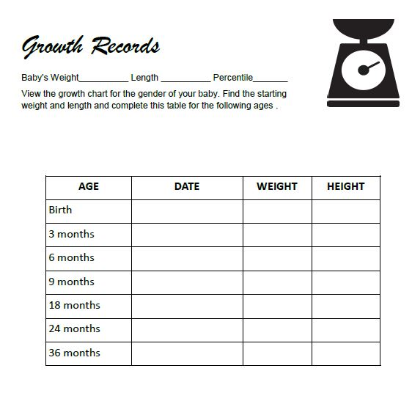
7. Growth Chart - View the Percentile Documents and fill in your child's growth for each age.

Slide 10
Look at the blue boy chart or the pink girl chart and locate the birth weight of your baby.
Follow the line and record what the estimated weight and length will be for your child. What PERCENTILE is your child?

Slide 11
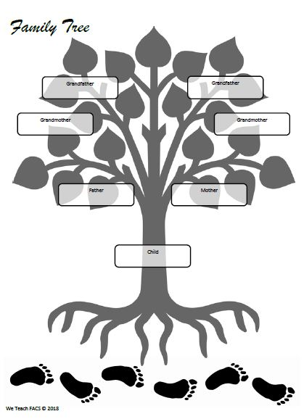
8. Family Tree - Baby's name is in the center. You can pretend the baby has another parent or leave that side blank.

Slide 12
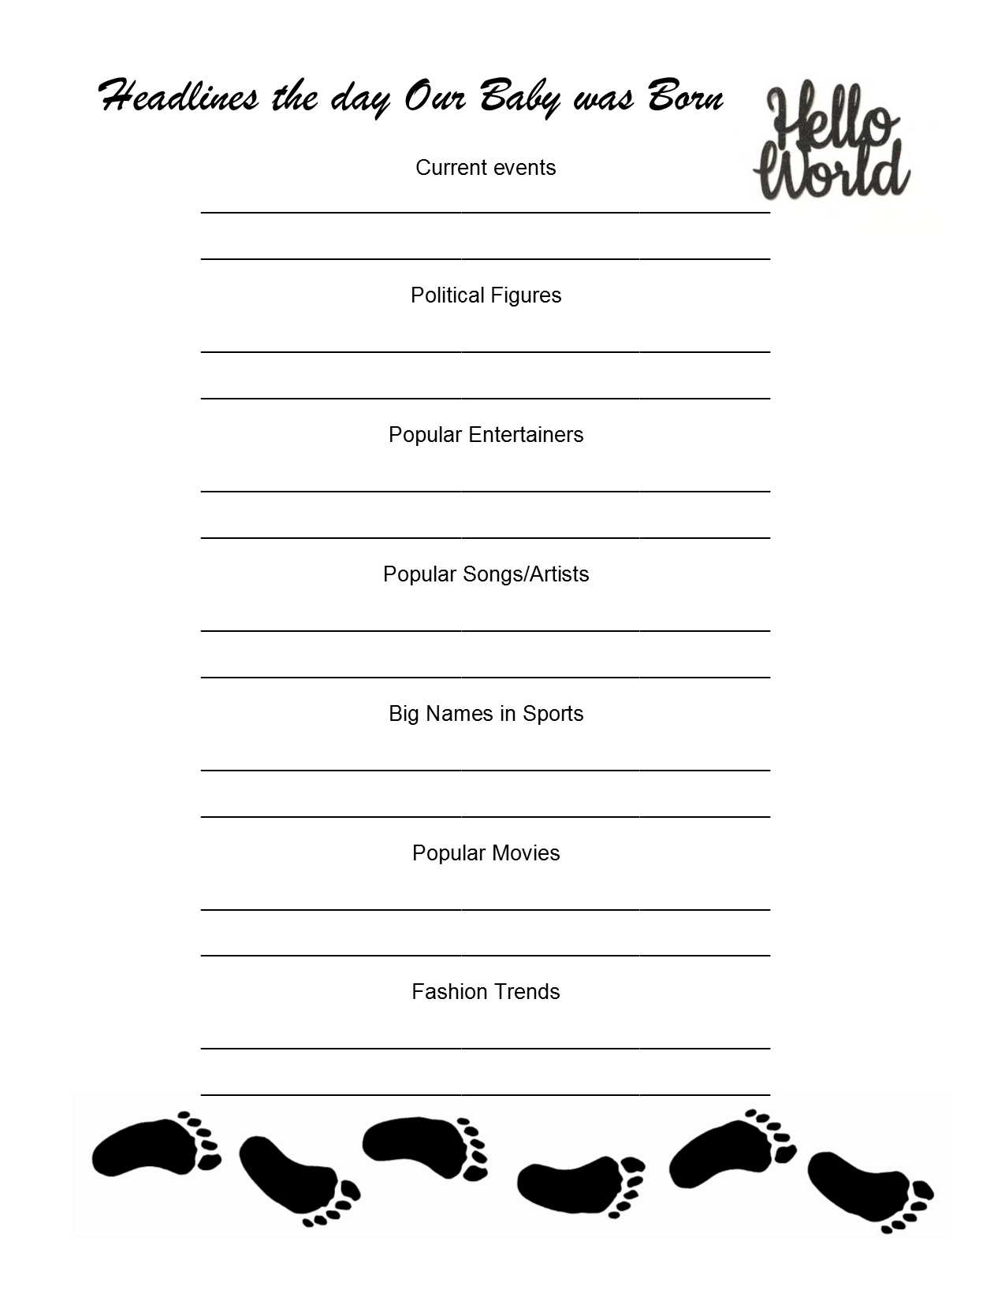
9. Headlines -
Research the headlines the day your baby was born.

Slide 13
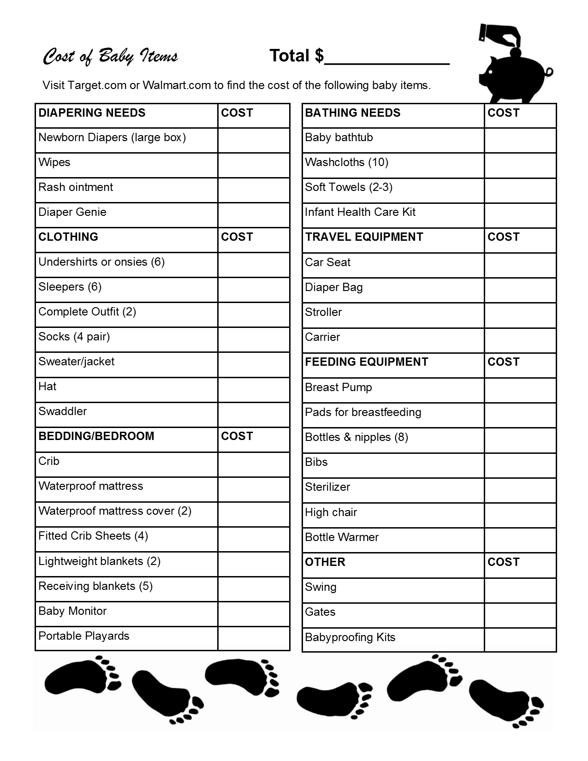
10. Cost of Baby Items - Visit Target or Walmart online and search the cost of items.
Add all items and enter the total at the top of page.

Slide 14
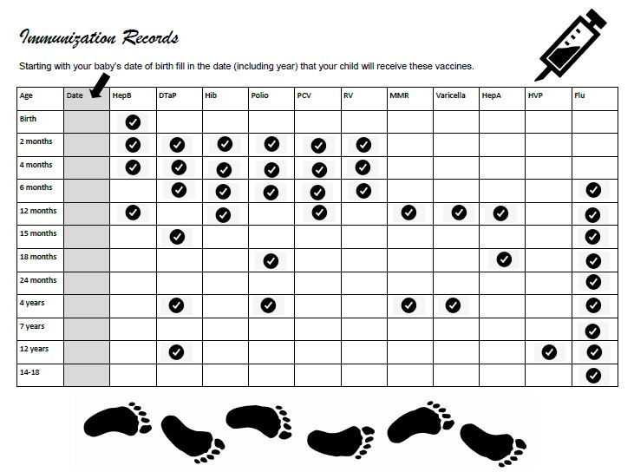
11. Immunization Record - At the top of the second column enter the baby's birthday. Calculate the dates that your child will need appointments for their vaccinations from birth to age 14.
Fill in the dates in the second column including the year.

Slide 15
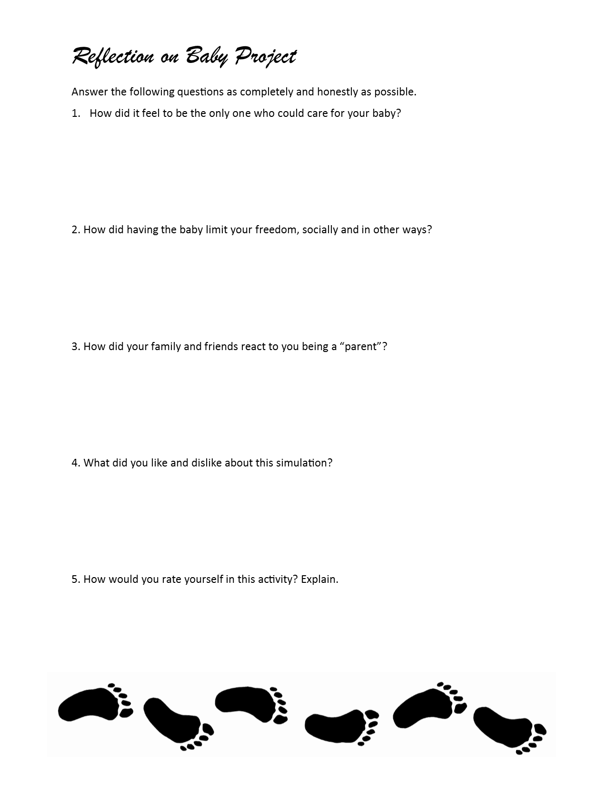
12. Reflection - worth 10
Write about the Baby Project Experience.
Each statement must have at least 3 sentences

Slide 16
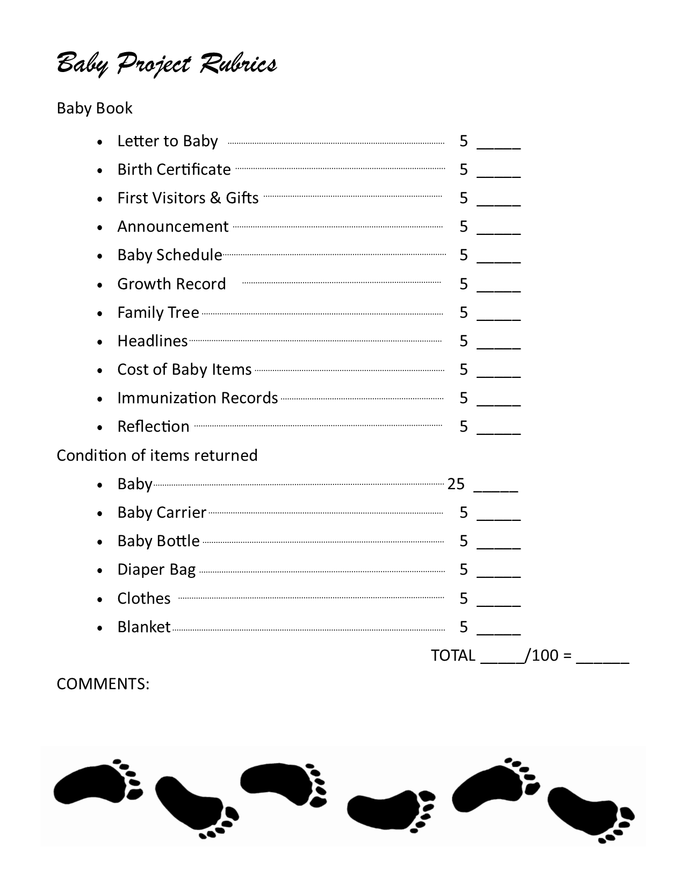
13. Rubrics -
make sure you understand how your project will be graded.

Slide 17
Take Photos - worth 15 points
As part of your grade you must take photos of your time with “Baby” and create slides describing the photos.
Show proof you doing the following:
Rocking
Feeding
Dressing/diapering
Showing to relatives
Going places

Slide 18
Example of the Slides
You must take photos of your time with “Baby” and create slides describing the photos.
Submit the slides to google classroom
Worth 15 points
View the following example of slides

Slide 19
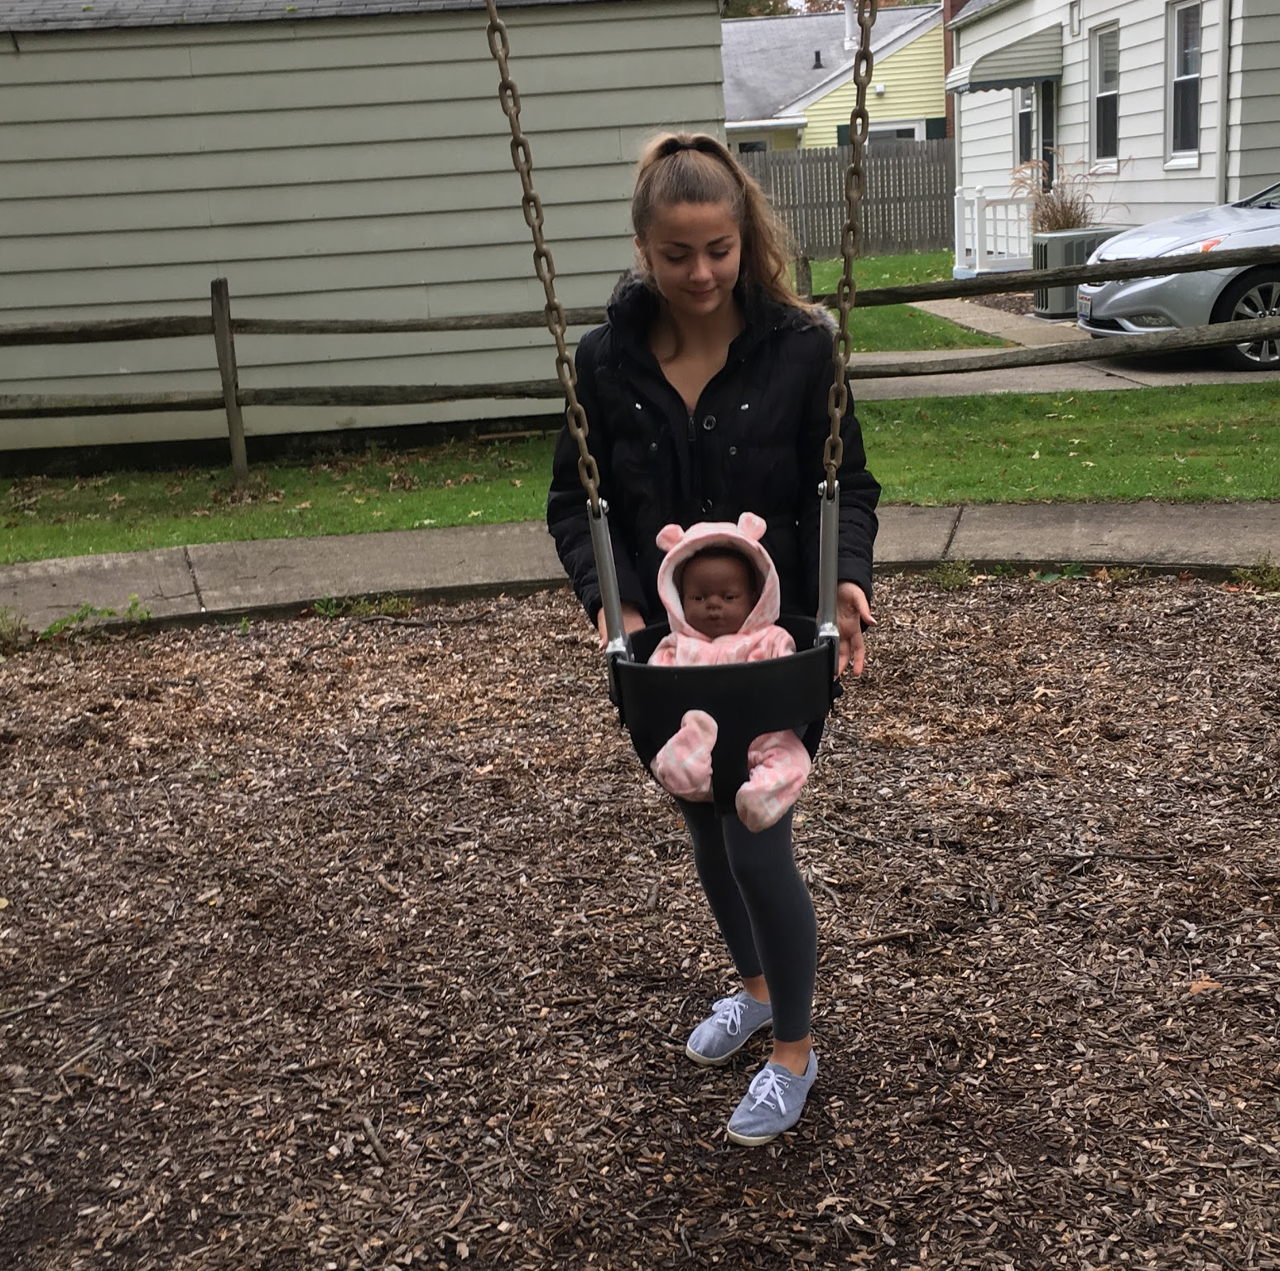
Welcome Little One
By: Amanda

Slide 20
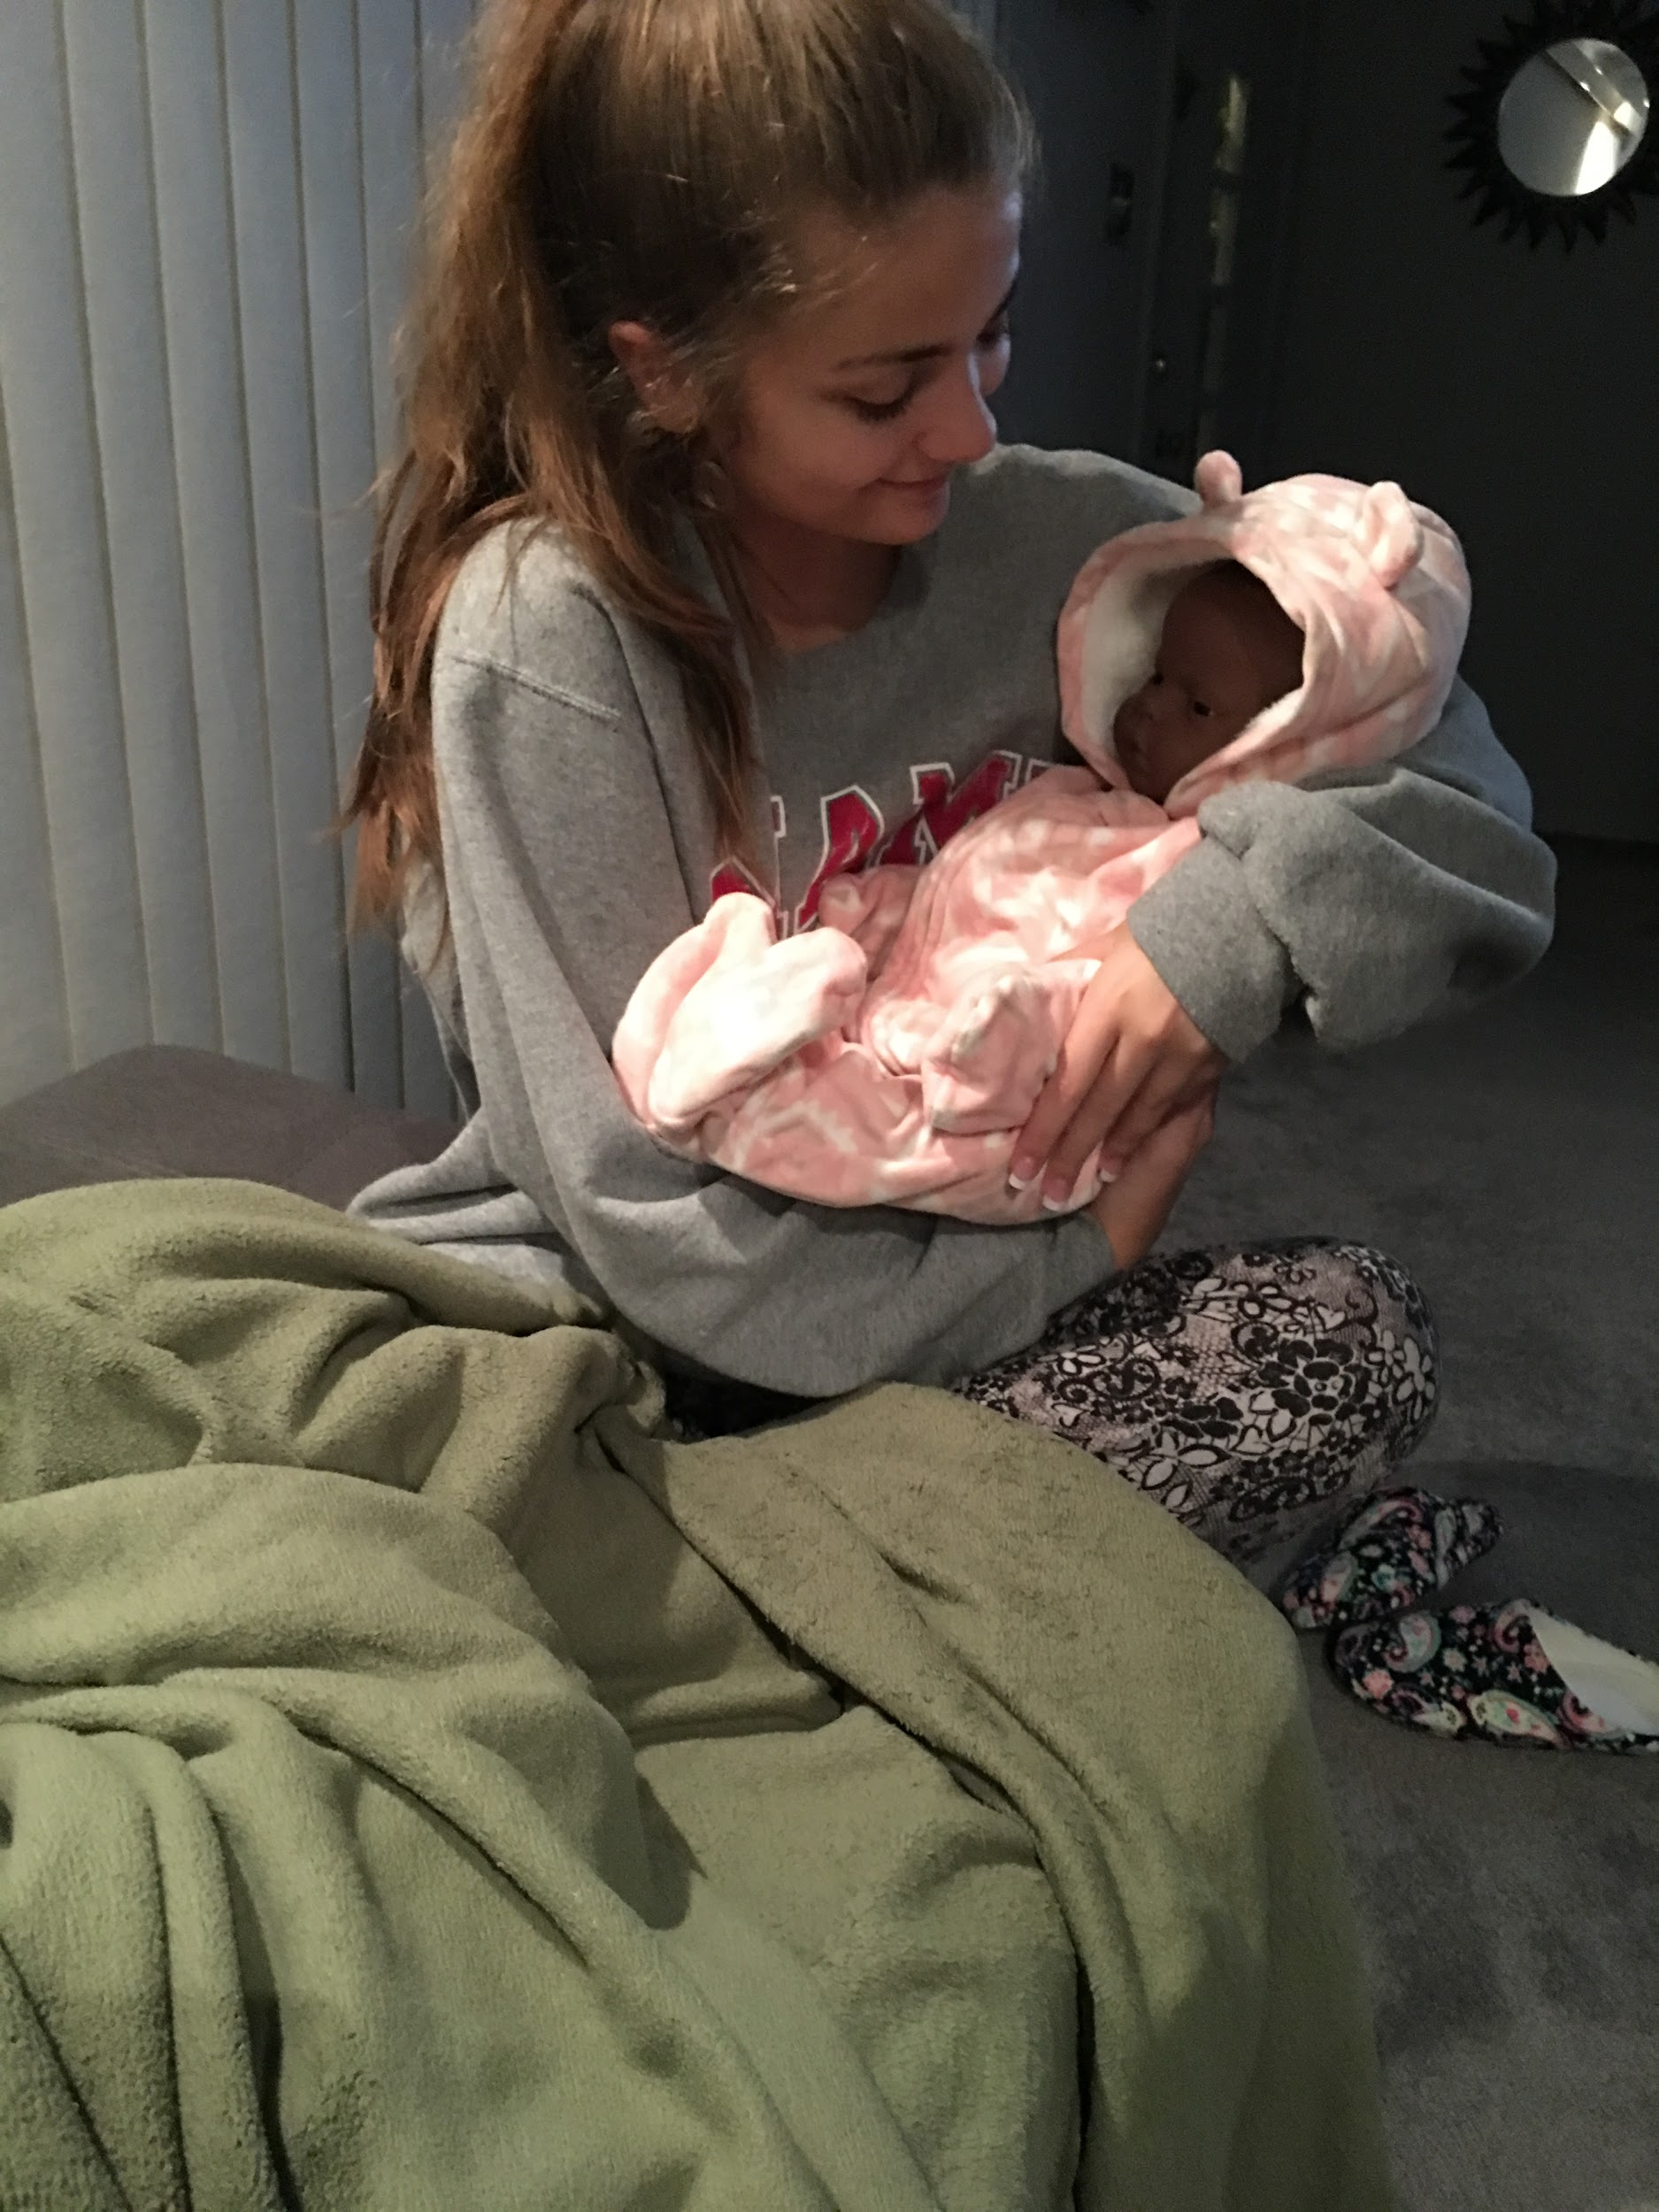
1.) Rocking baby to sleep

Slide 21
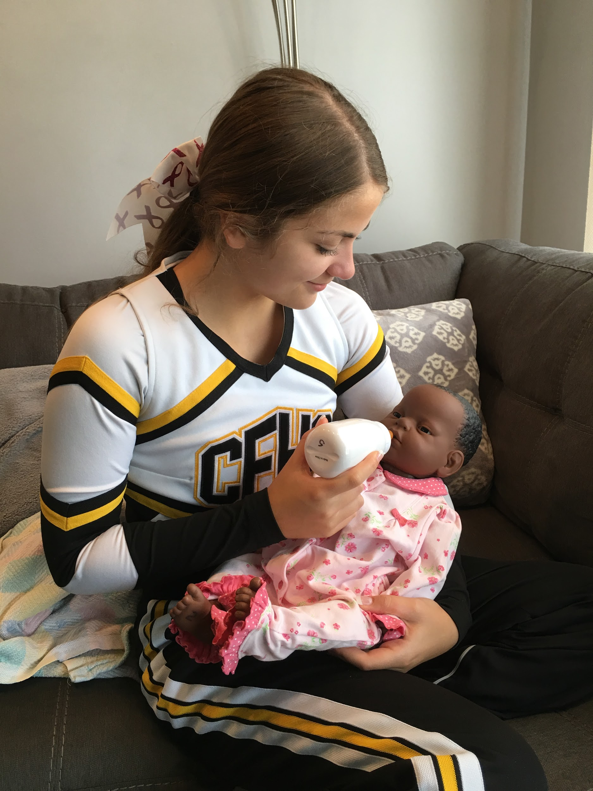
2.) Feeding
Feed Natashia after cheering on the JV football players on Saturday morning.

Slide 22
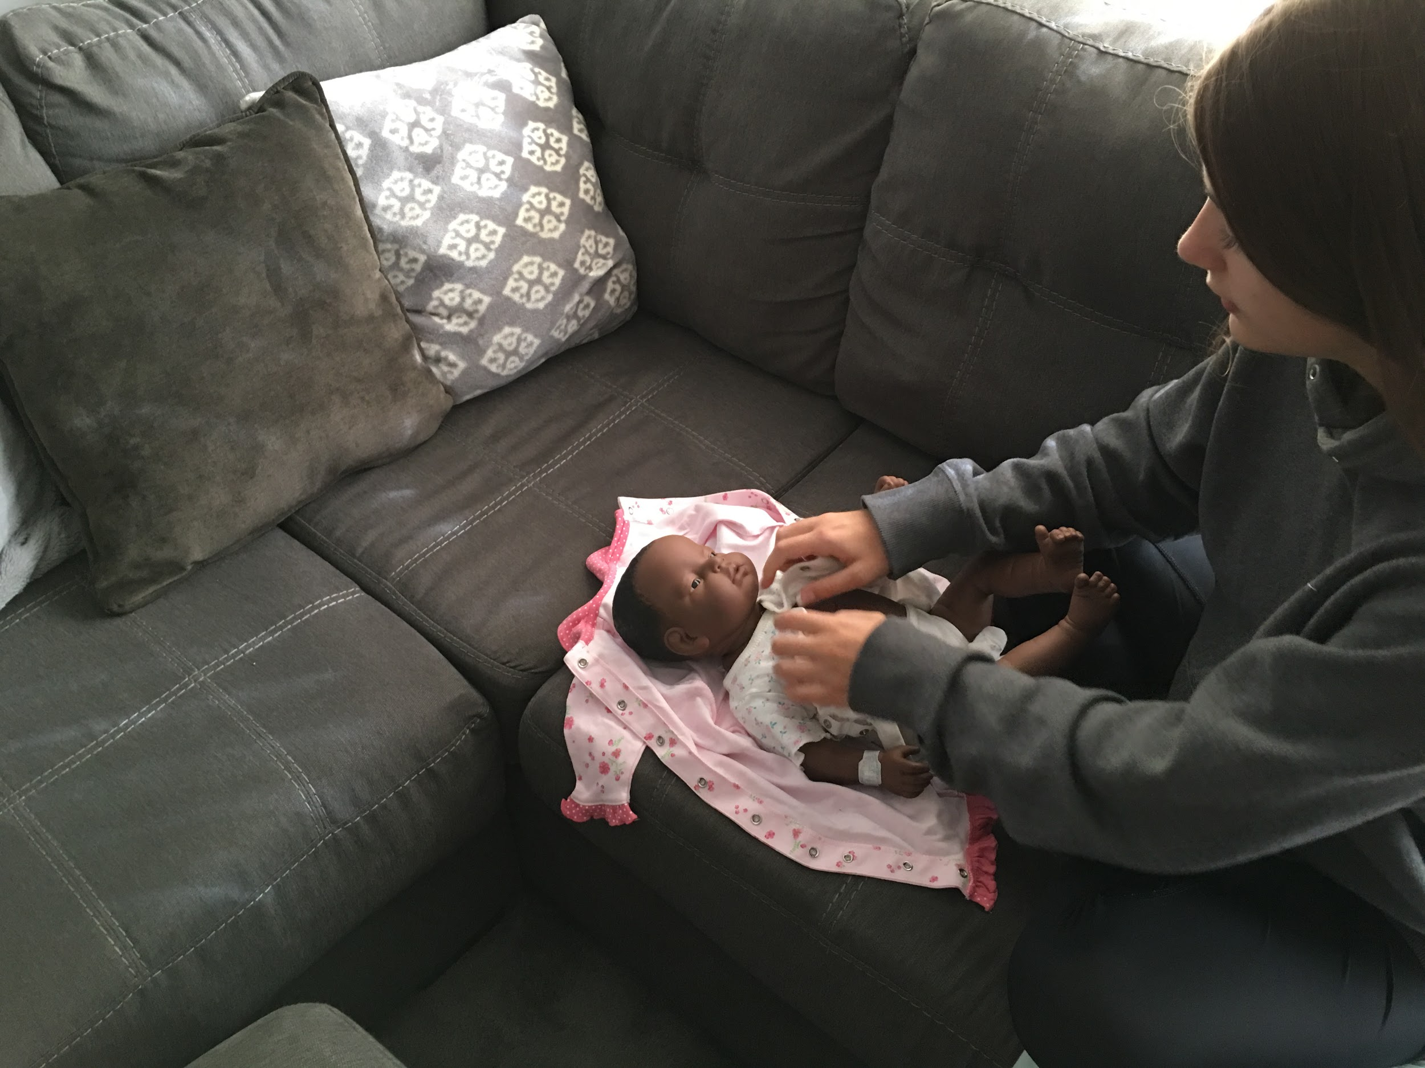
3.) Dressing

Slide 23
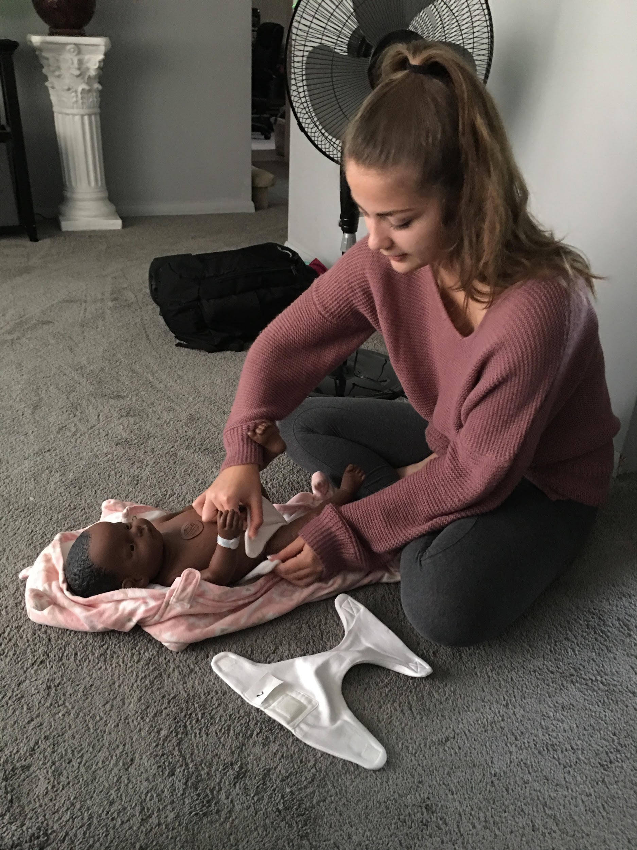
4) Changing diaper

Slide 24
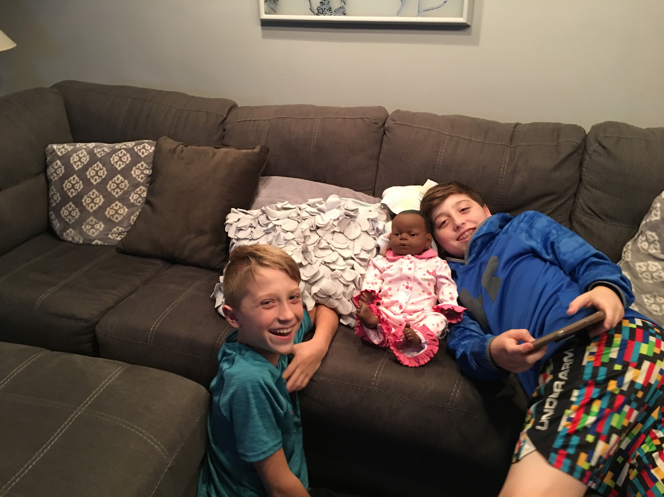
5.) Showing to relatives
My two little cousins, Jaden (right) and Jace (left) stayed the night Saturday and loved spending some time with Natashia

