Slide 1
How Do Contraceptives Work?
Use with worksheets

Slide 3
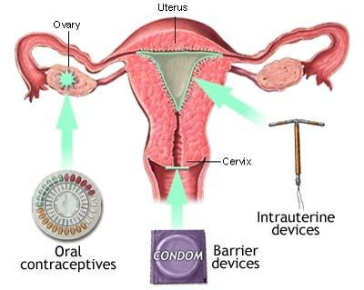
Categories Contraceptives
Hormonal Contraceptive

Slide 4
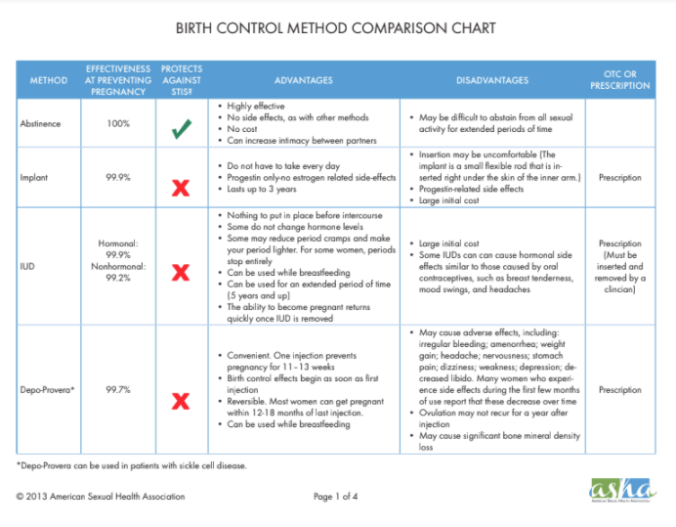
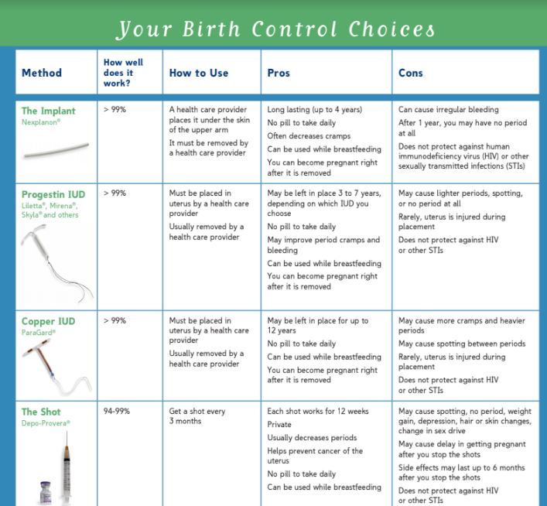
Documents about birth control
Birth Control Comparison Chart
Reproductive Project

Slide 5
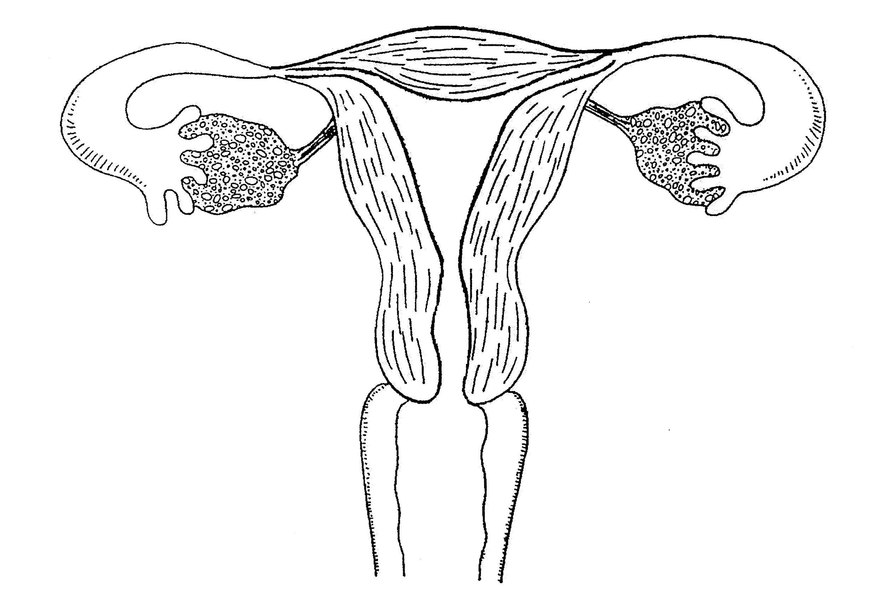
How Do Contraceptives Work?
Worksheet:
Illustrate where each method goes or what protection it offers to the female, using colored pencils.
Right of chart: Identify the effectiveness of each
Left of chart:
the contraceptive category

Slide 6
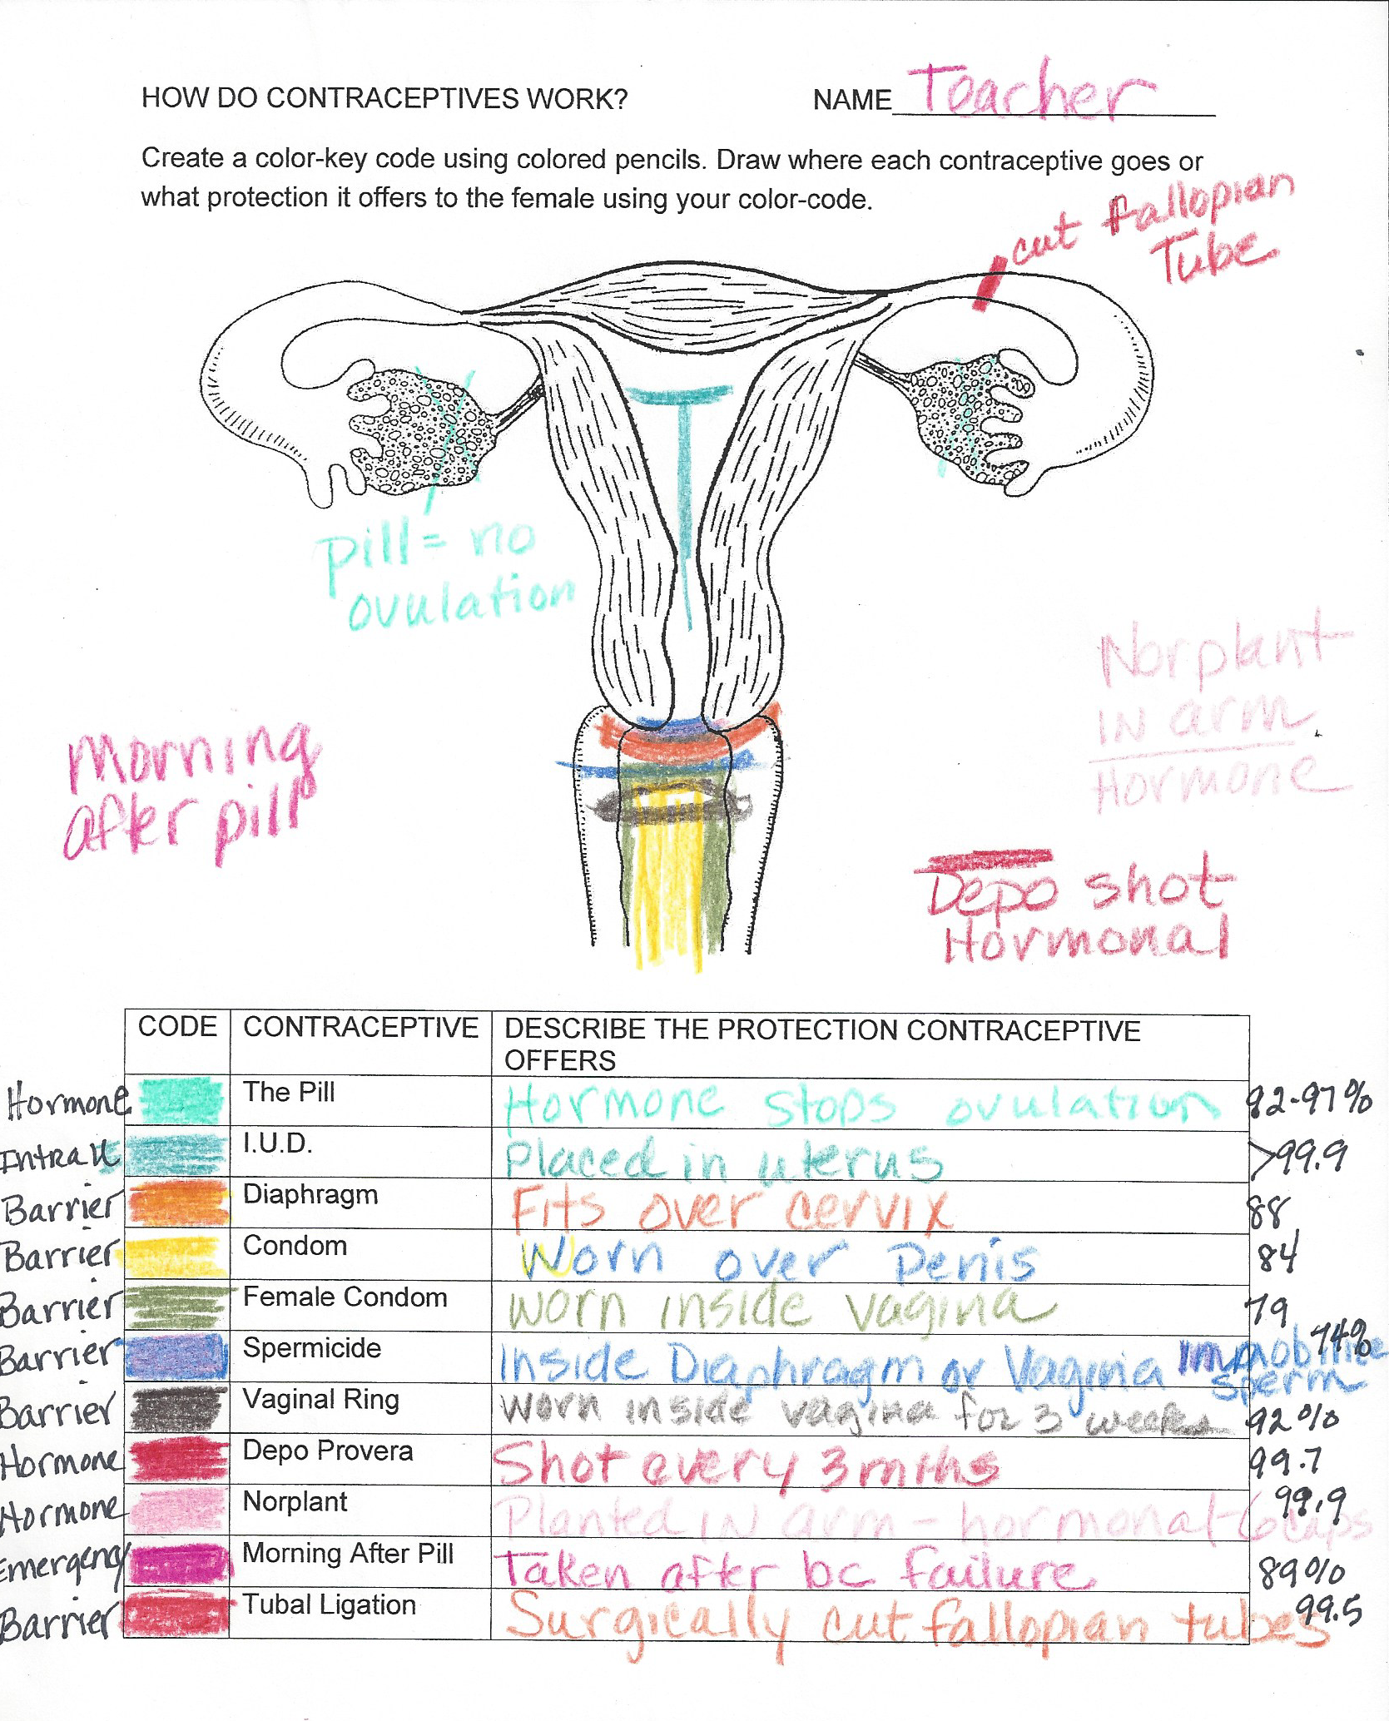
Example:
How Do Contraceptives Work?

