Slide 1
Theories of
Child Development
Putting the pieces together

Slide 2
Theories
What is a theory?
Orderly set of ideas which describe, explain, and predict behavior.
Why are theories important?
To give meaning to what we observe.
As a basis for action -- finding ways to improve the lives and education of children.
Category of theory
Heredity (nature)
Environment (Nurture)
Interactional (Nature & Nurture)

Slide 3
Heredity (nature)
Development is a result of the child’s innate biological makeup. Growth and development becomes a process of waiting and watching as the child follows his/her biological programming.

Slide 4
Environment (nurture)
Development is a result of environmental influences on the child. The child comes into the world waiting for experience to influence what will become him/her.

Slide 5
Interactional (nature & nurture)
Development is influenced both by biological heredity and environment as well as by the dynamic interaction between the two.

Slide 6
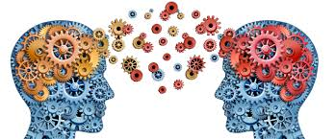
Origins of
Child Development
Theories

Slide 7
6th - 15th centuries Medieval period
Preformationism: children seen as little adults.
Childhood was not a unique phase.
Children were cared for until they could begin caring for themselves, around 7 years old.
Children were treated as adults (e.g. their clothing, worked at adult jobs, could be married, were made into kings, were imprisoned or hanged as adults.)

Slide 8
16th Century Reformation period
Puritan religion influenced how children were viewed.
Believed children were born evil, and must be civilized.
A goal emerged to raise children effectively.
Special books were designed for children.

Slide 9
Child Development Theorist
Theorists have provided:
valuable information about how children learn and develop skills.
insight about how best to nurture and educate children.

Slide 10
John Locke 17th Century Age of Enlightenment
John Locke believed in tabula rasa or blank slate
Children develop in response to nurturing.
Forerunner of behaviorism
www.cooperativeindividualism.org/ locke-john.jpg

Slide 11
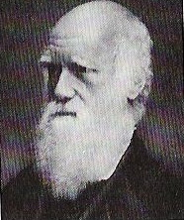
Charles Darwin 19th Century Industrial Revolution
theories of natural selection and survival of the fittest
Darwin made parallels between human prenatal growth and other animals.
Forerunner of ethology

Slide 12
20th Century
Theories about children's development expanded around the world.
Childhood was seen as worthy of special attention.
Laws were passed to protect children,

Slide 13
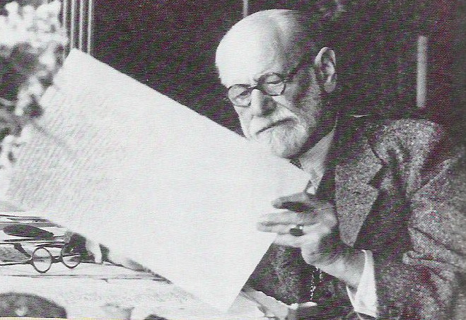
Sigmund Freud 1856-1939
Psychosexual Theory
He emphasized that a child's personality is formed by the ways which his parents managed his sexual and aggressive drives.
Childhood is much more important than previously thought and its effects are longer lasting.

Slide 14
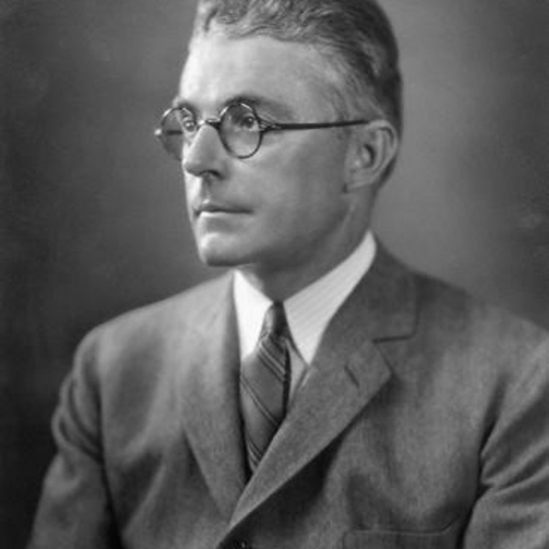
John Watson 1878-1958
Behaviorism Theory
Early 20th century, "Father of American Behaviorist theory.”
Based his work on Pavlov's experiments on the digestive system of dogs.
Researched classical conditioning
Children are passive beings who can be molded by controlling the stimulus-response associations.

Slide 15
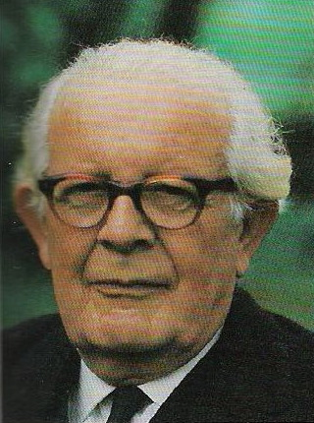
Jean Piaget 1896-1980
Cognitive development theory
The first to study children scientifically
Focused on how children learned
Believed they go through four stages of learning and must be given learning tasks appropriate to their level of development

Slide 16
Piaget’s Cognitive Development Stages
Sensorimotor
Ages birth - 2: the infant uses his senses and motor abilities to understand the world
Preoperation
Ages 2-7: the child uses metal representations of objects and is able to use symbolic thought and language
Concrete operations
Ages 7-11; the child uses logical operations or principles when solving problems
Formal operations
Ages 12 up; the use of logical operations in a systematic fashion and with the ability to use abstractions

Slide 17
Lev Vygotsky 1896-1934
Socio-Cultural Theory
Agreed that children are active learners, but their knowledge is socially constructed.
Cultural values and customs dictate what is important to learn.
Social contact is essential to intellectual development
Children should be given the opportunity for frequent social interaction

Slide 18
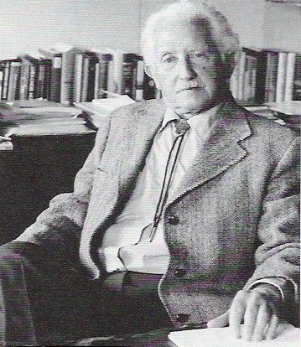
Erik Erikson 1902-1994
Psychosocial Theory
Expanded on Freud's theories.
Believed that development is lifelong.
Caregivers must be aware of children’s needs at each stage of development and support them through crisis.
Emphasized that at each stage, the child acquires attitudes and skills resulting from solving a crisis in a positive way.
Identified 8 stages:
Basic trust vs mistrust (birth - 1 year)
Autonomy vs shame and doubt (ages 1-3)
Initiative vs guilt (ages 3-6)
Industry vs inferiority (ages 6-11)
Identity vs identity confusion (adolescence)
Intimacy vs isolation (young adulthood)
Generativity vs stagnation (middle adulthood)
Integrity vs despair (the elderly)

Slide 19
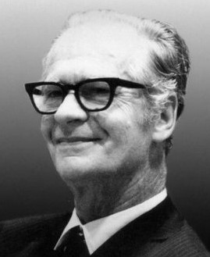
B. F. Skinner 1904-1990
Argued that when a child’s actions have positive results they will repeat action. Negative results will cause action to stop.
Believed that learning could be broken down into smaller tasks, and that offering immediate rewards for accomplishments would stimulate further learning.

Slide 20
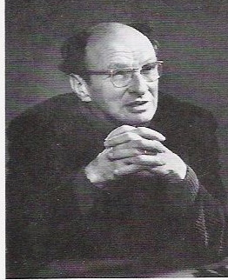
Urie Bronfenbrenner 1917-2005
Ecological Systems Theory
Outlined layers of environment that affect a child’s development such as the child’s own biology, family, community, environment, and society.
Both the environment and biology influence the child's development.
The environment affects the child and the child influences the environment.
Caregiver needs to be stable, loving and lasting

Slide 21
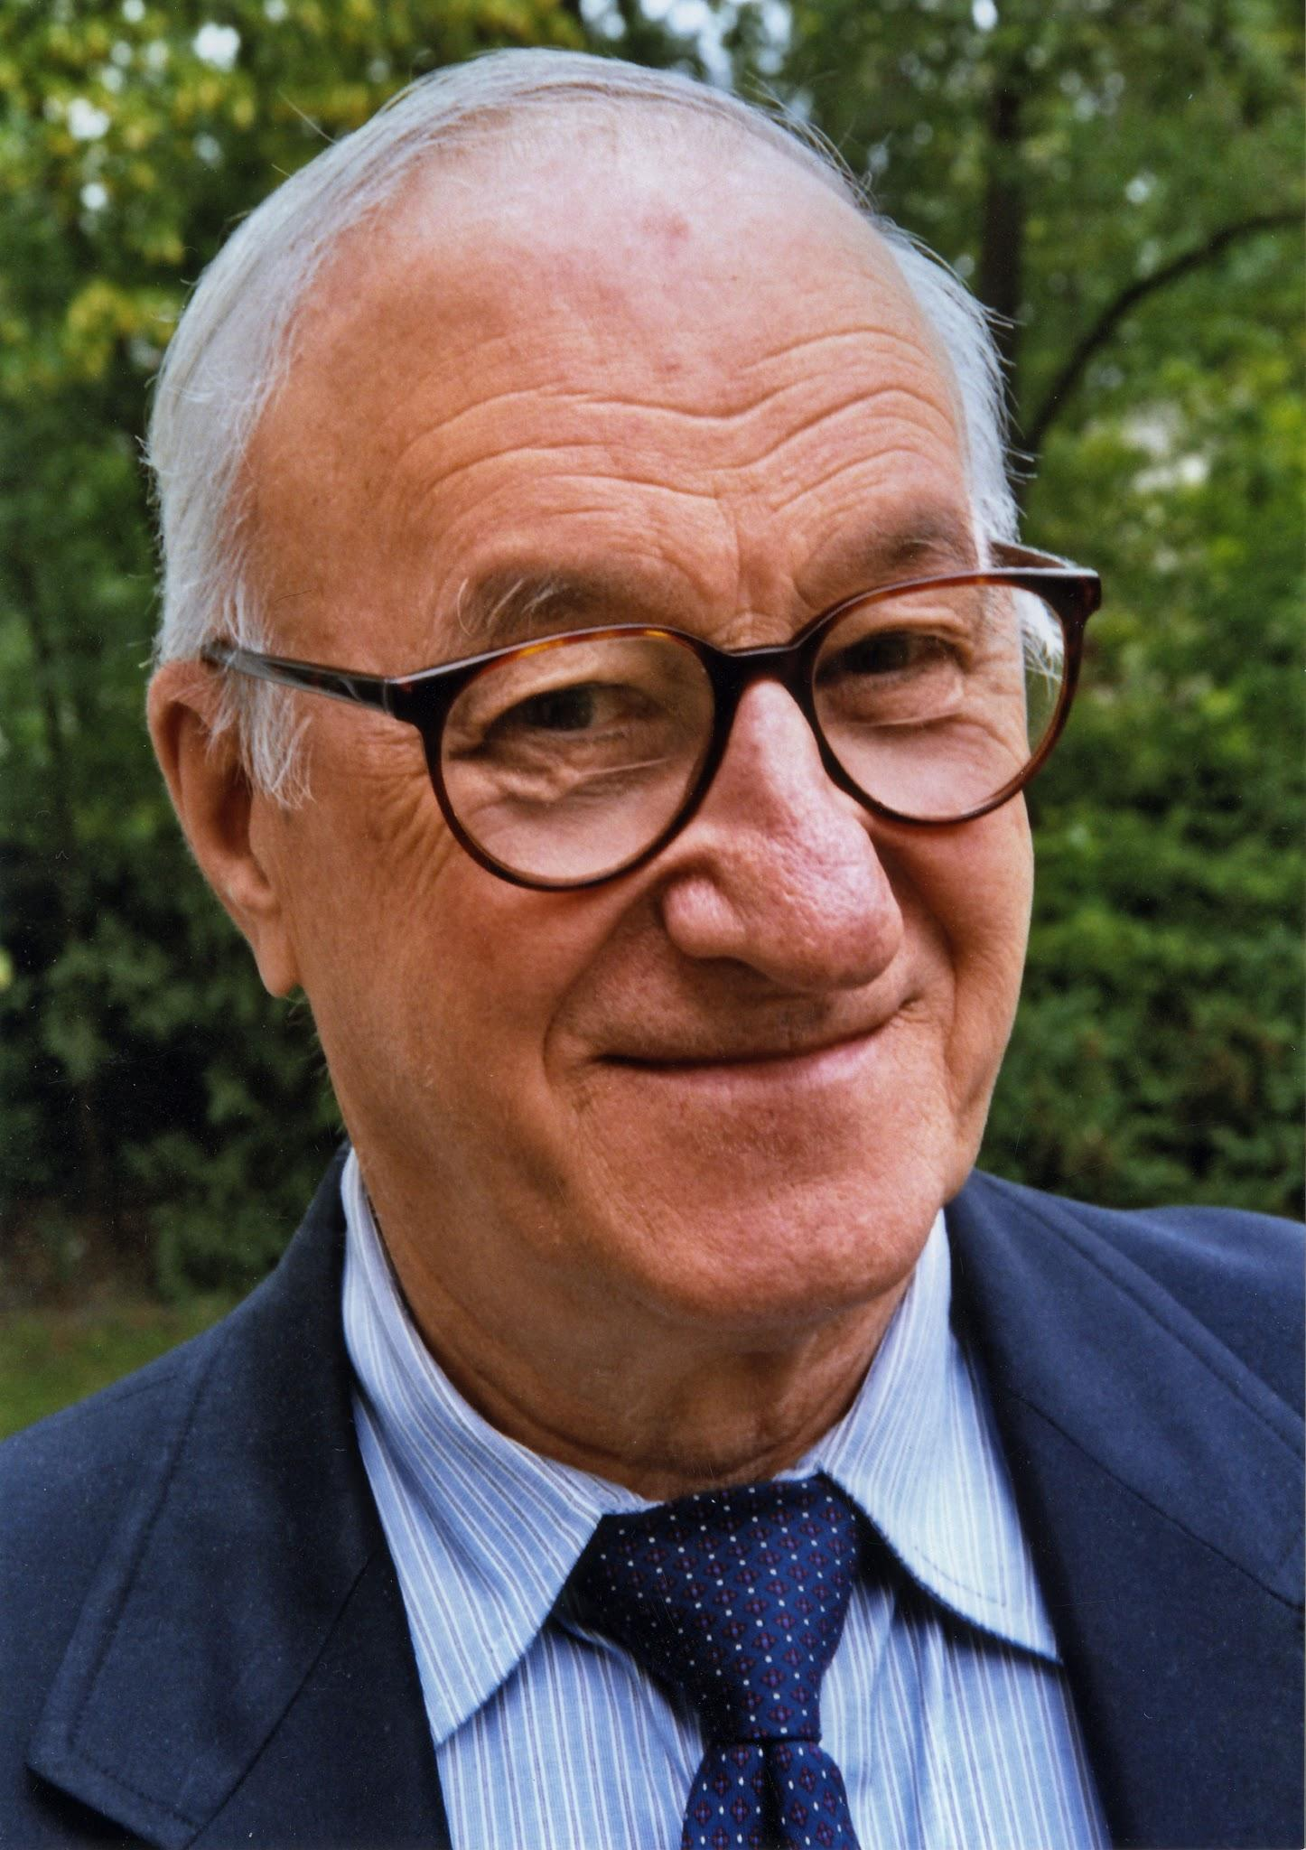
Albert Bandura 1925 -
Social Learning Theory
Stressed how children learn by observation and imitation.
Believed that children gradually become more selective in what they imitate.

Slide 22
Eclectic theoretical orientation:
Selects features from other theories
No one theory has all the answers
Each theory can make a contribution to understanding life-span development

