Slide 1
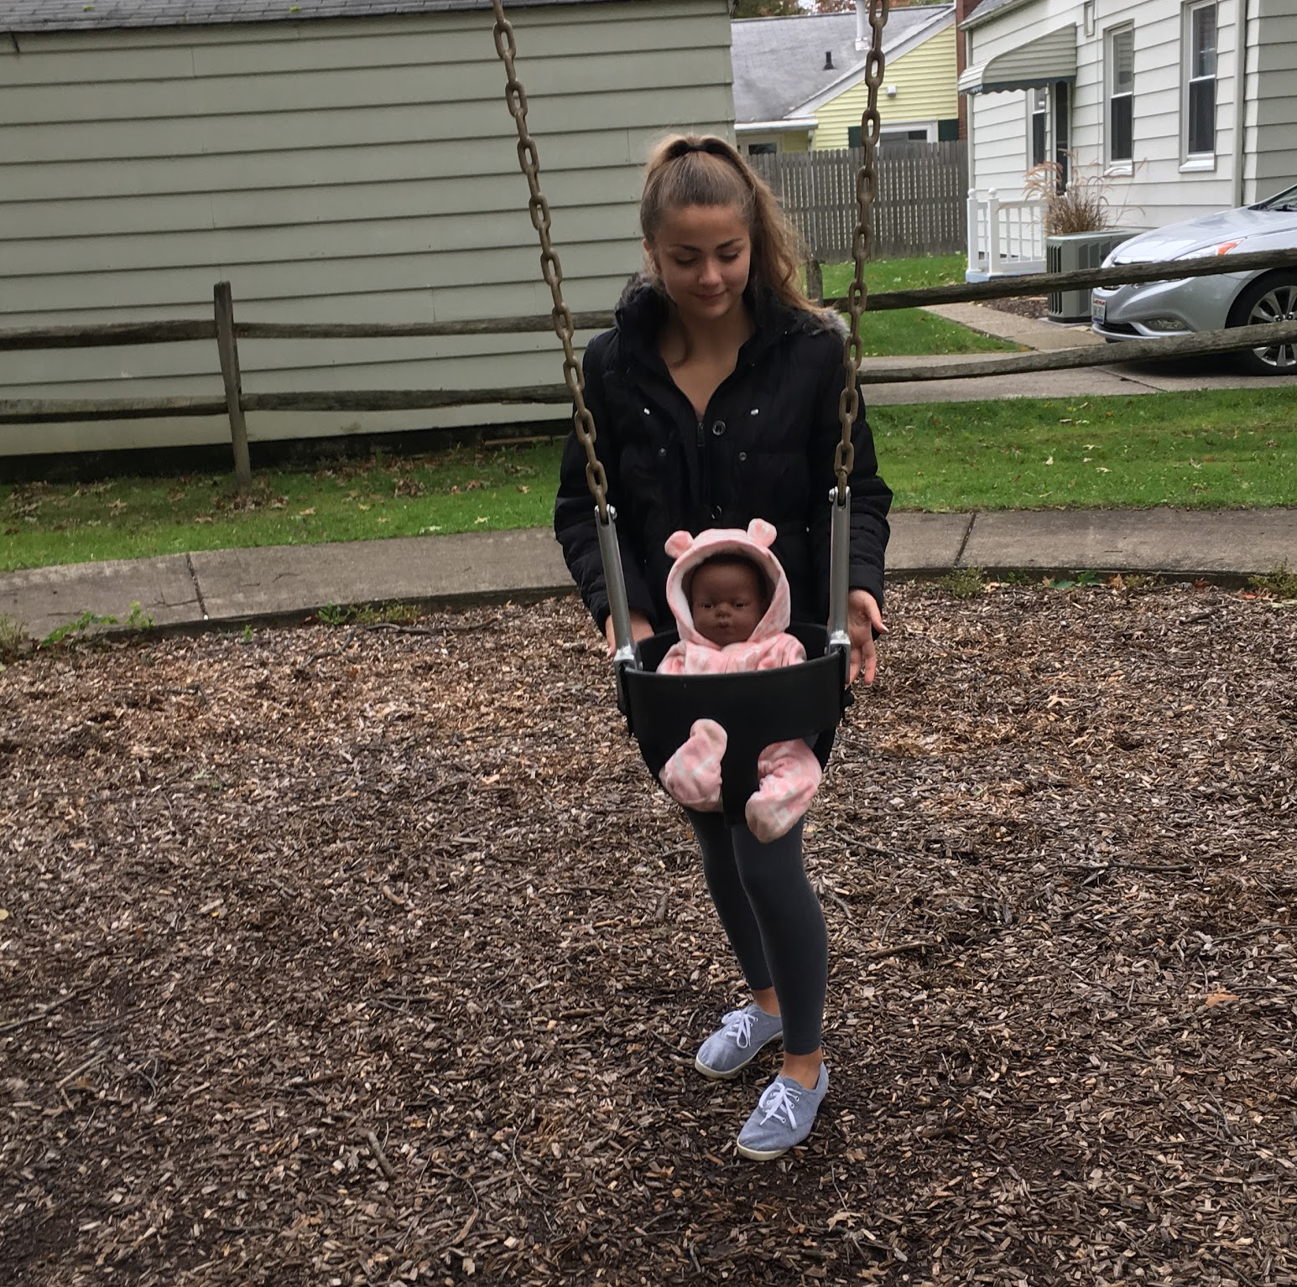
Welcome Little One
By: Amanda Forester

Slide 2
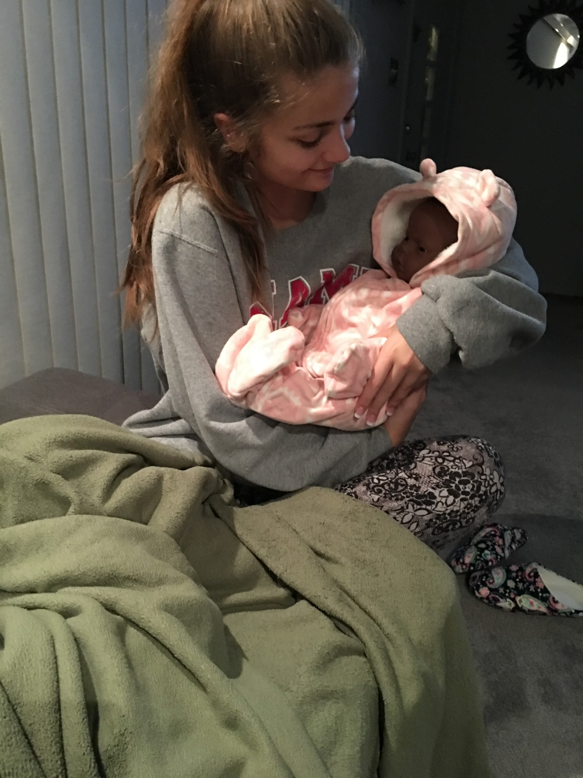
1.) Rocking baby to sleep

Slide 3
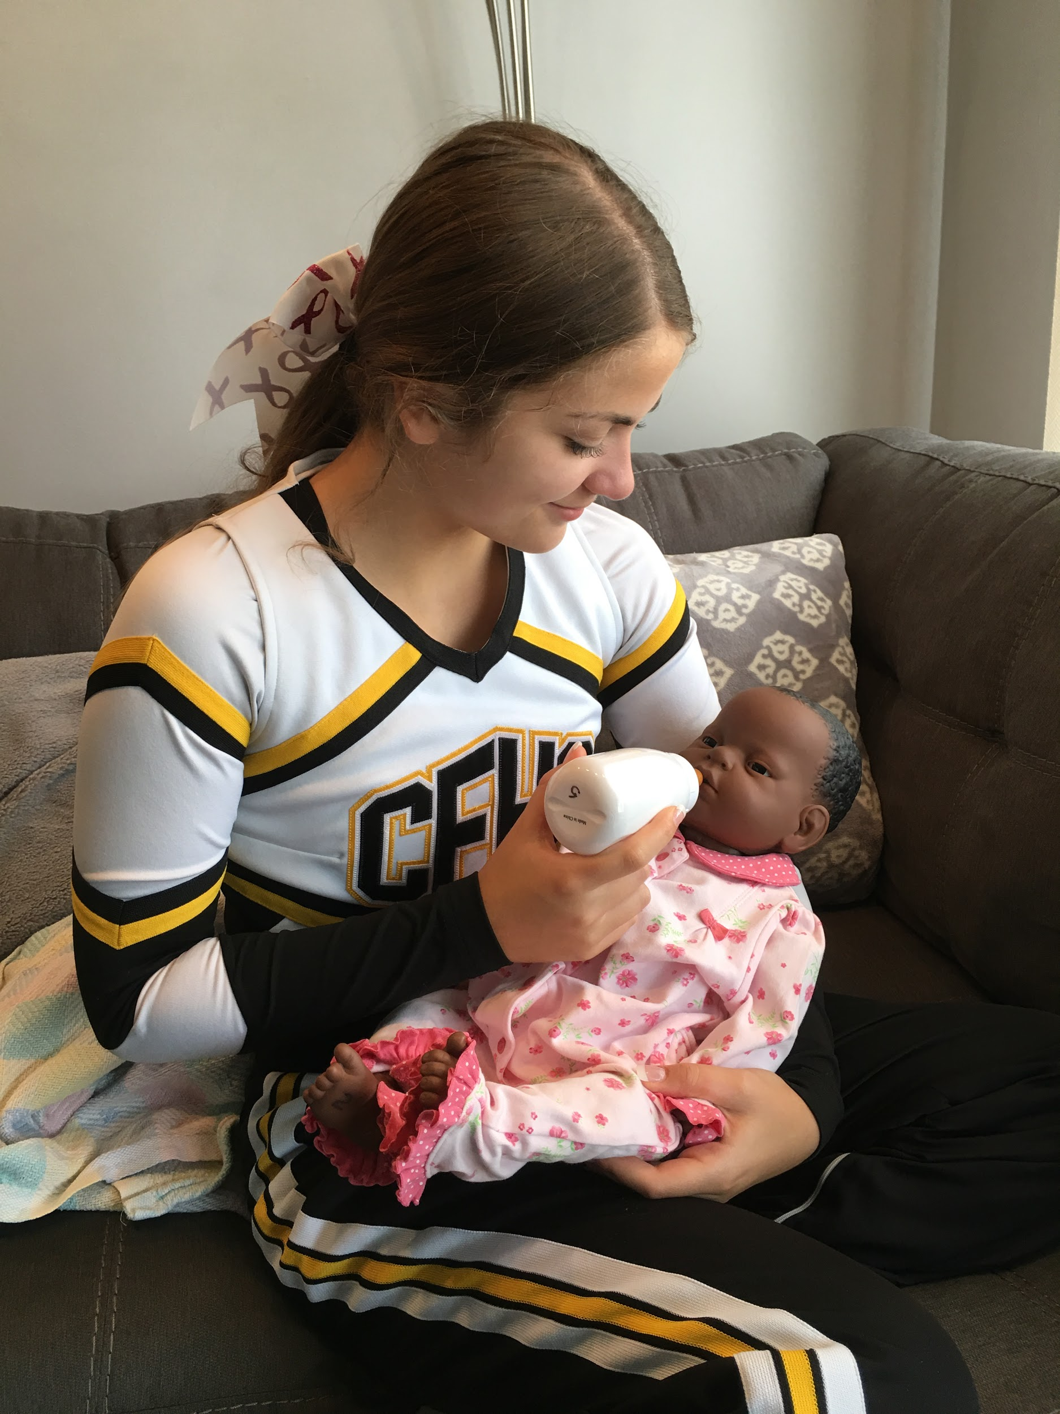
2.) Feeding
Feed Natashia after cheering on the JV football players on Saturday morning.

Slide 4
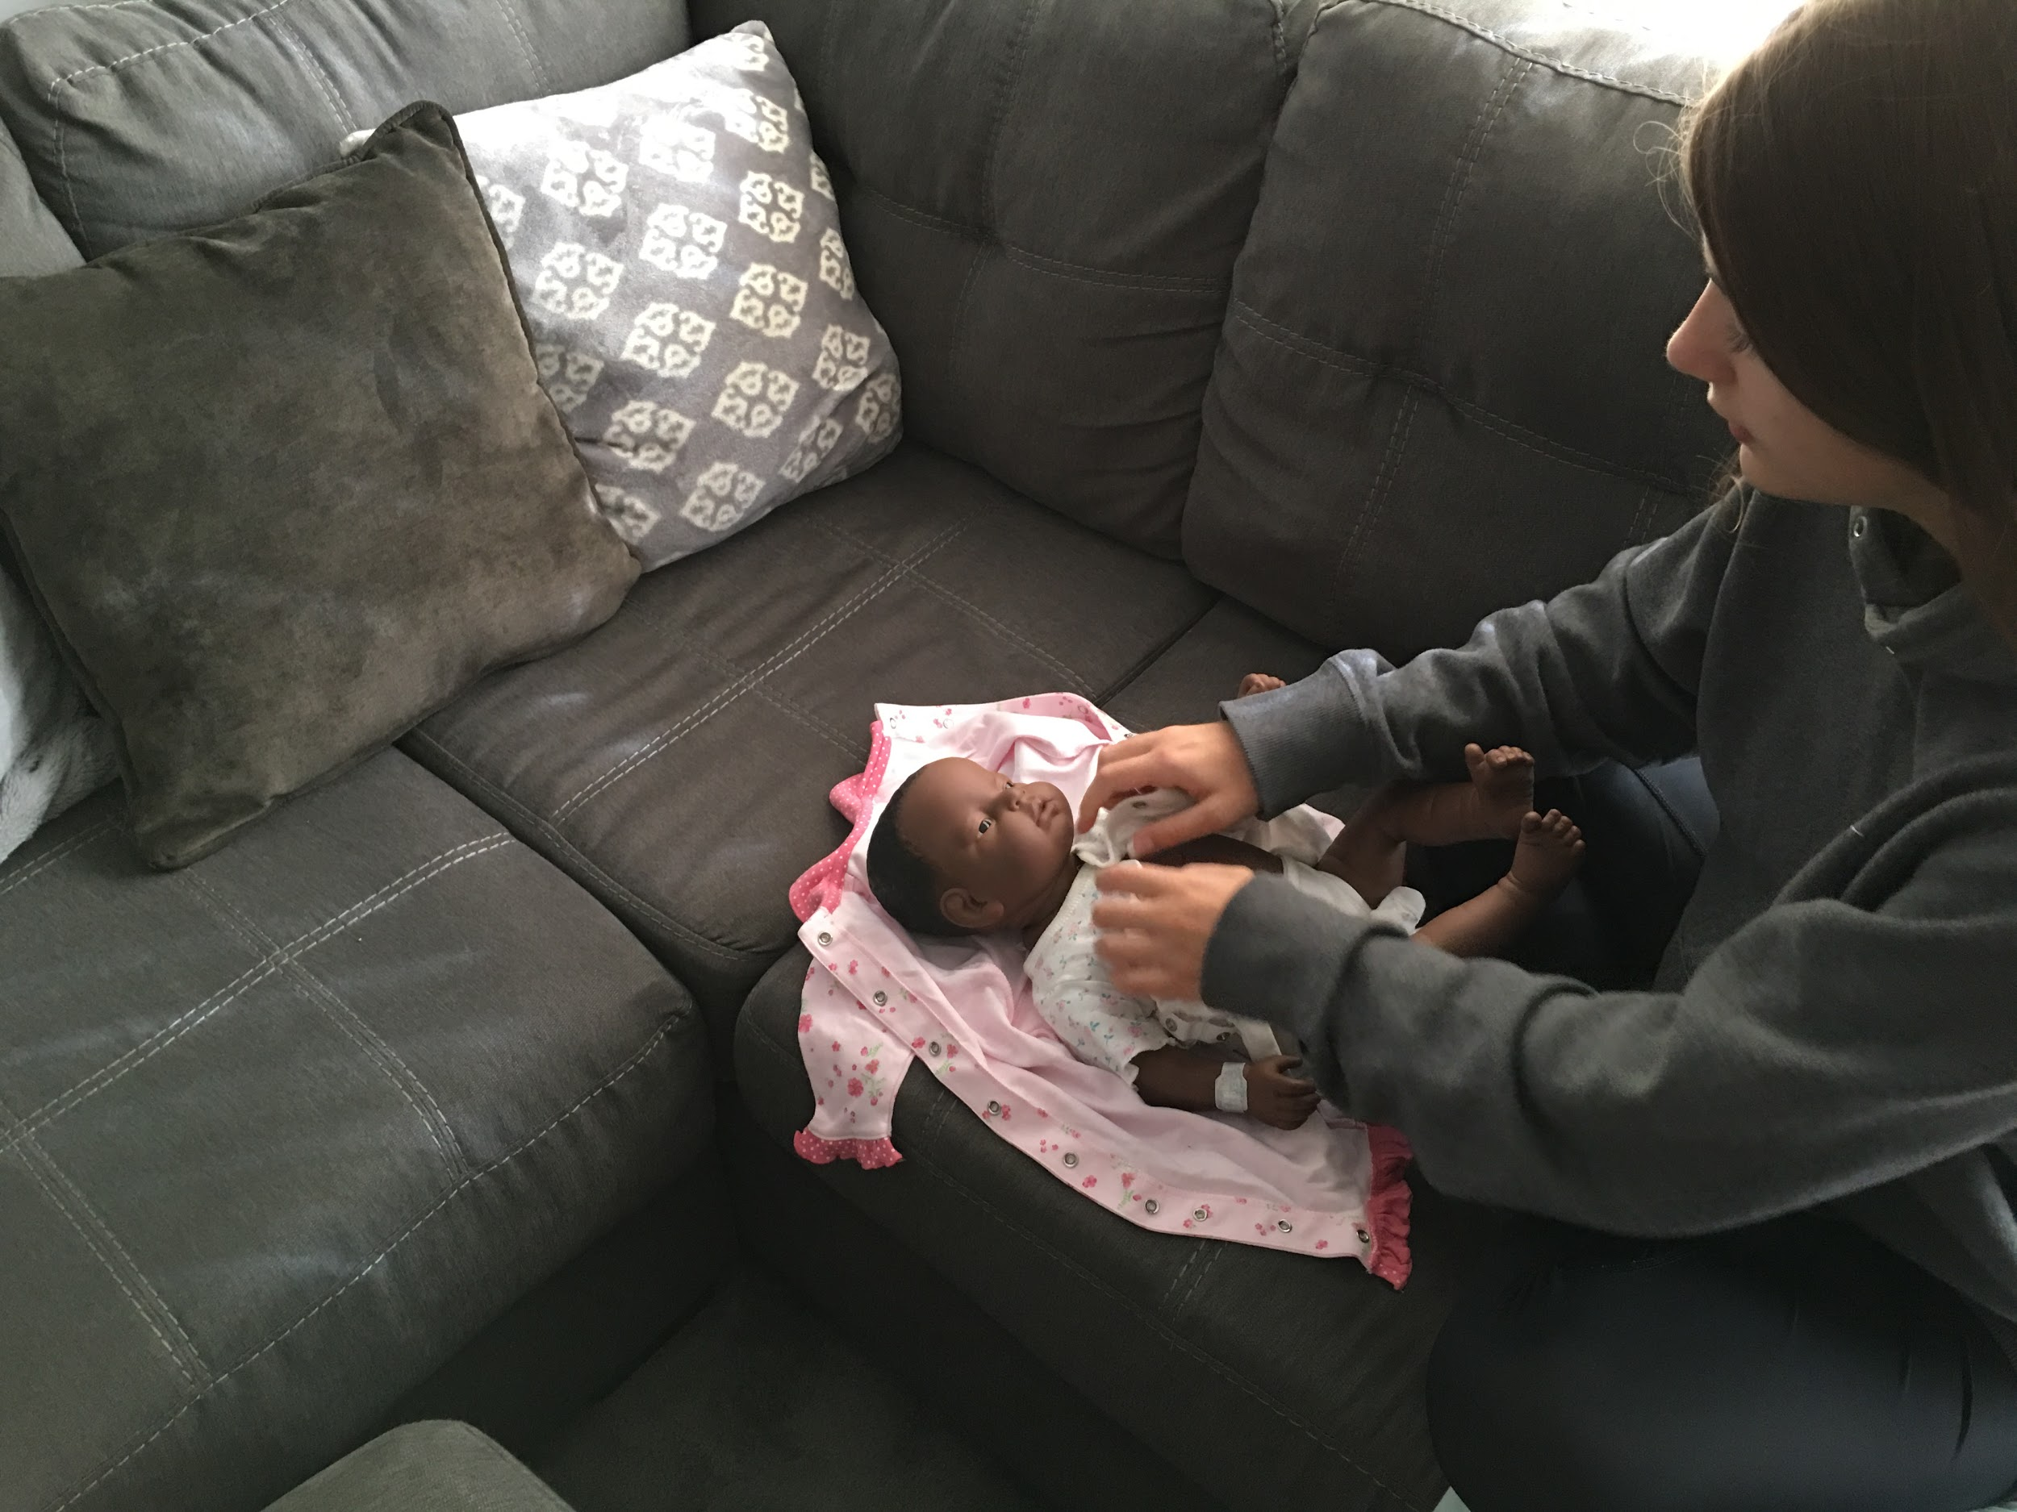
3.) Dressing

Slide 5
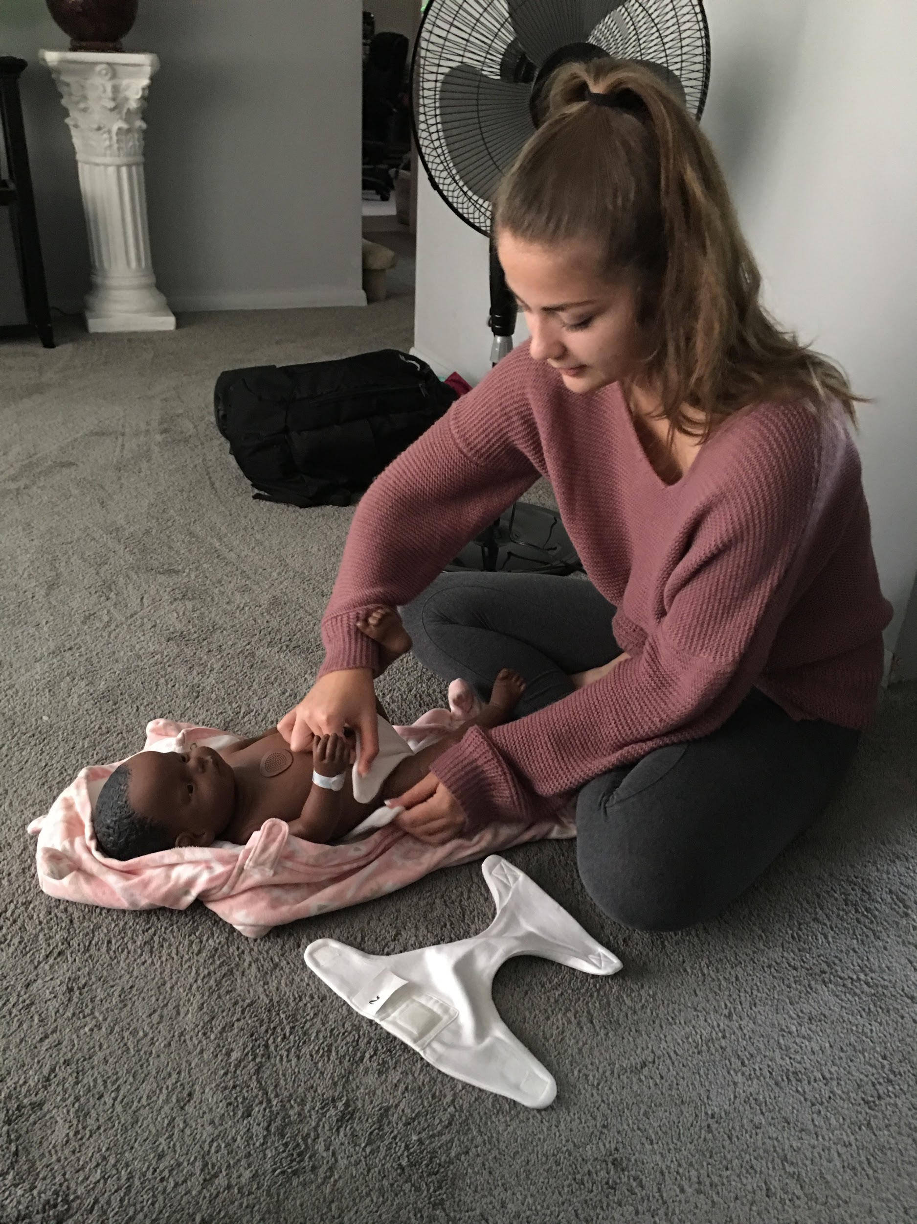
4) Changing diaper

Slide 6
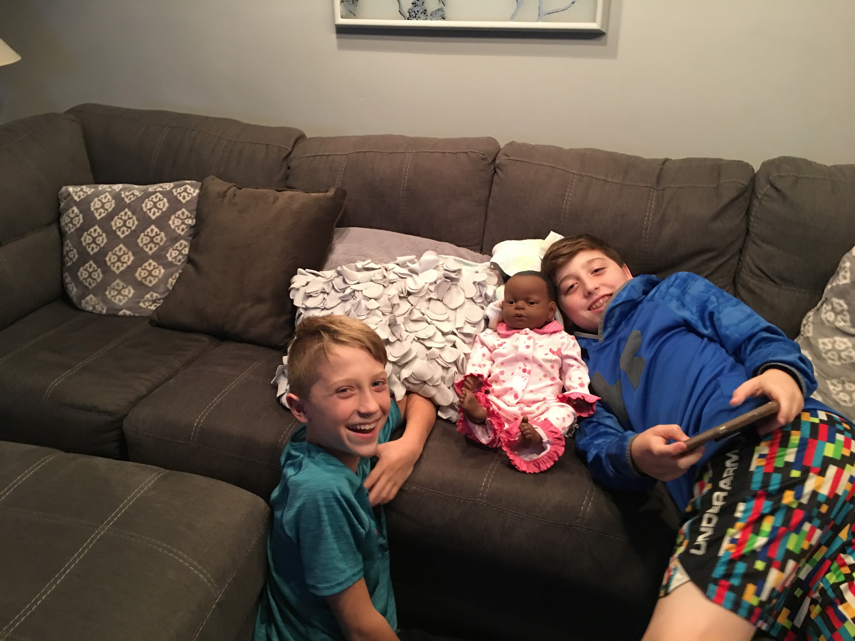
5.) Showing to relatives
My two little cousins, Jaden (right) and Jace (left) stayed the night Saturday and loved spending some time with Natashia

