Slide 1
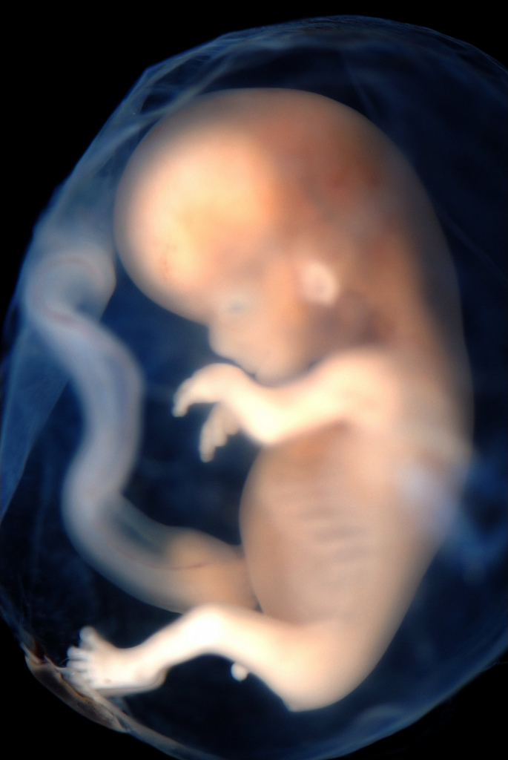
Fetal Development
The Developing Baby

Slide 2
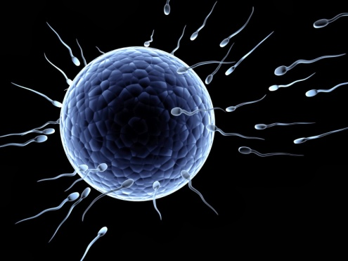
Process of Conception
Summarize the process of conception using the following terms:
Fallopian tube
Ovum
Ovulation
Sperm
Uterus

Slide 3
Conception Overview
During Ovulation,the mature ovum is released and starts its journey through the fallopian tube where it can be fertilized within 24 hours
Ovum NOT Fertilized = menstrual period
Fertilized Ovum = Baby
Sperm → uterus → fallopian tube → fertilize ovum
3 to 4 day window when conception can occur after intercourse

Slide 4
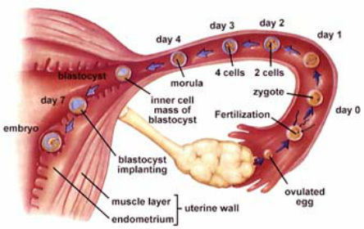
Conception
Journey of the Ovum (egg cell)
Ovary → Fallopian Tube → Uterus
Fallopian Tube- tube that connects the ovary to the uterus
The Journey takes 2 to 3 days.

Slide 5
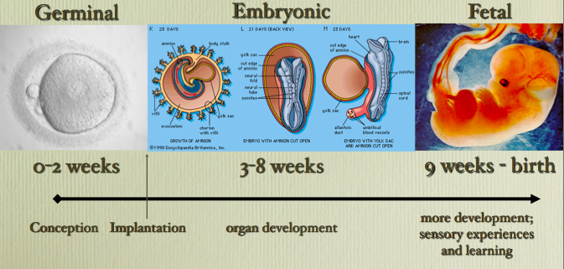
3 Stages of Pregnancy
Grouped in 3 stages
The Germinal
Embryonic
Fetal

Slide 6
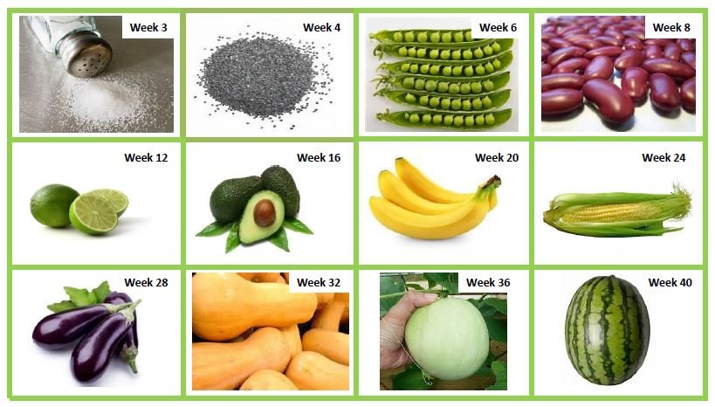
Understanding Development

Slide 7
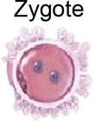
The Germinal Stage
1st stage in the baby's development
Formation of the zygote
The fertilized egg
Last about 2 weeks
Key steps in establishing pregnancy

Slide 8
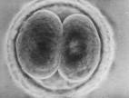
The Germinal Stage
Cell Division- the cell begins to grow in the fallopian tube.
In 4 days the zygote reaches the uterus.
Implantation- the lining of the uterus has now thicken enough for the zygote to attach itself and grow.
Size of a pinhead in 2 weeks

Slide 9
The Embryonic Stage
2nd Stage
3rd week to the 8th week
Embryo grows rapidly
Embryo- developing baby
Face, eyes, ears, limbs, & bones
Organs and Body Systems develop
6 weeks the brain and spinal cord connect

Slide 10
The Fetal Stage
3rd stage
Longest stage: 8th or 9th week to birth
Baby develops into a Fetus
Vocal cords develop
Digestive system and kidneys begin working
4th or 5th month kicks and other movements
By the 7th month the baby can live outside of the uterus with medical help.
Common length of pregnancy is 40 weeks or 280 day

Slide 11
The Embryonic Stage
Amniotic Sac- a sac filled with fluid (amniotic fluid) that surrounds and protects the embryo in the uterus
Placenta- tissue that connects the embryo to the uterus. Brings Oxygen and nourishment from the mother.
Umbilical Cord- long tube that connects the baby to the placenta. Take waste away.

Slide 13
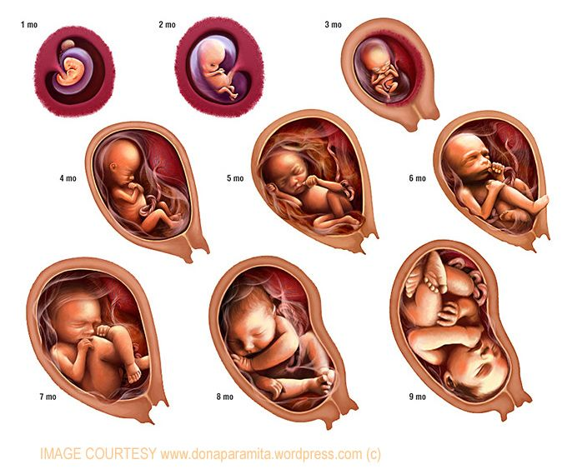

Slide 14
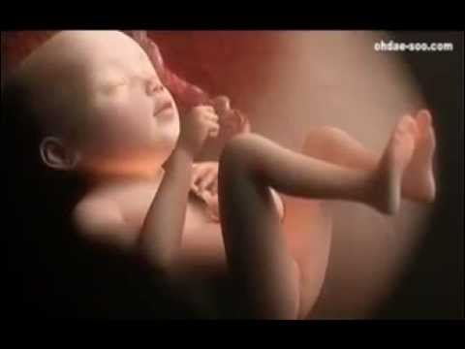
0 - 9 Month Journey in the Womb

Slide 15
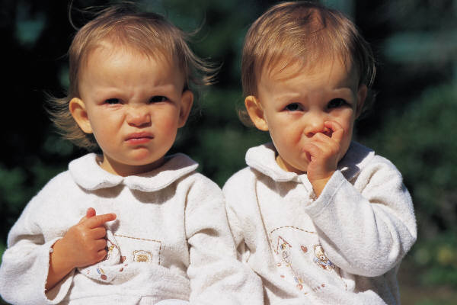
Multiple Births
Most common is twins
2 types:
Identical- when the cell mass split in half
Fraternal- 2 eggs fertilized by 2 sperm
3 out of 100 births will be twins
Fraternal twins are more common

Slide 16
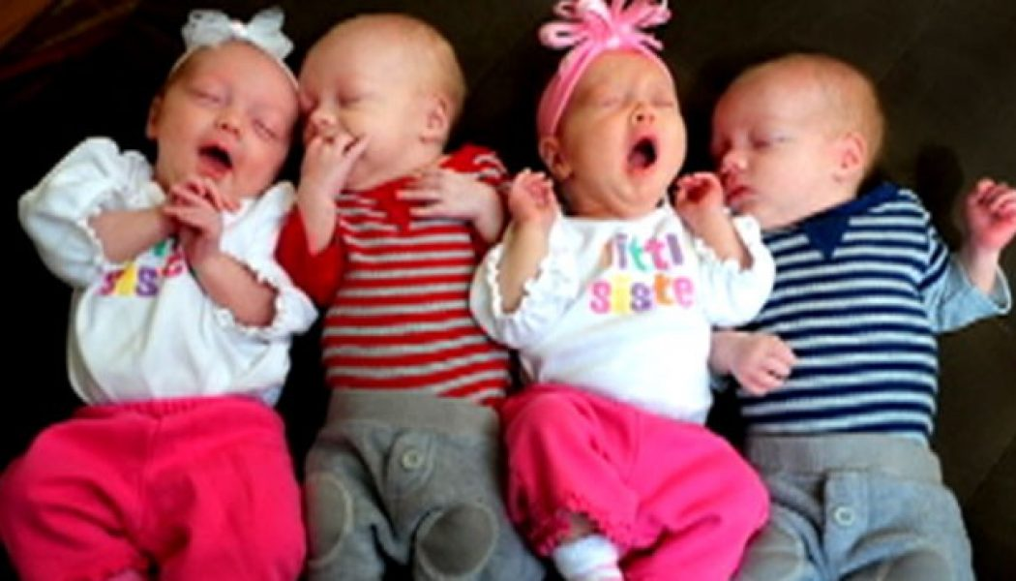
Multiple Births
Three or more babies
Very rare
Increase chances, if using treatment to help with fertility.
More than one egg is released at a time

Slide 17
Heredity
Heredity- the passing on of characteristics
Examples:
Physical Traits- hair, skin, eyes
Talents- musical, athletic ability
Medical Conditions

Slide 18
Dominant vs. Recessive Gene
Inherited Characteristic
2 copies of a gene; 1 from mom, 1 from dad
If both genes are the same, then the child automatically has the characteristic.
Many cases this does not happen
Dominant Gene- a stronger gene, controls the characteristics
Recessive Gene- weaker gene, only expressed if both parents give it.

Slide 19
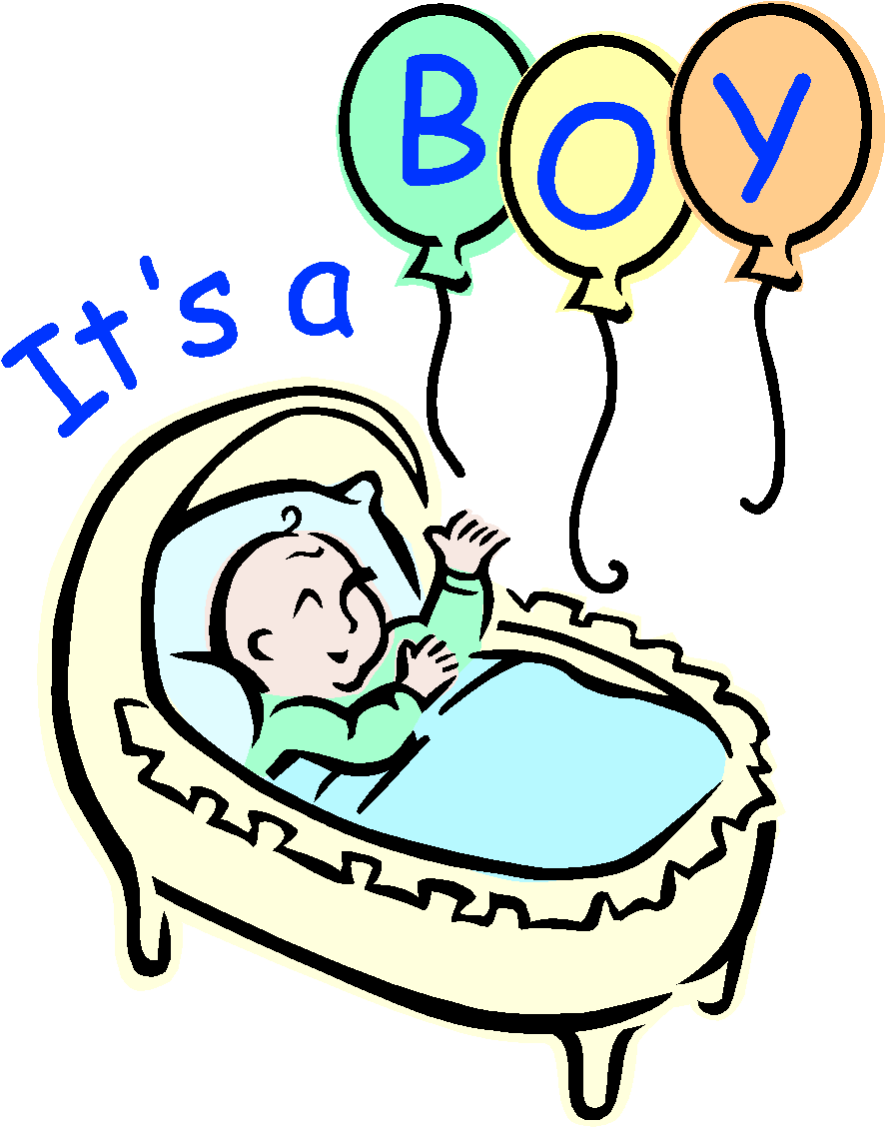
Gender Determination
Sex Chromosomes X and Y
Women (ovum) carry only X
Male (sperm) carry X or Y
Children
Girl = XX
Boy = XY

Slide 20
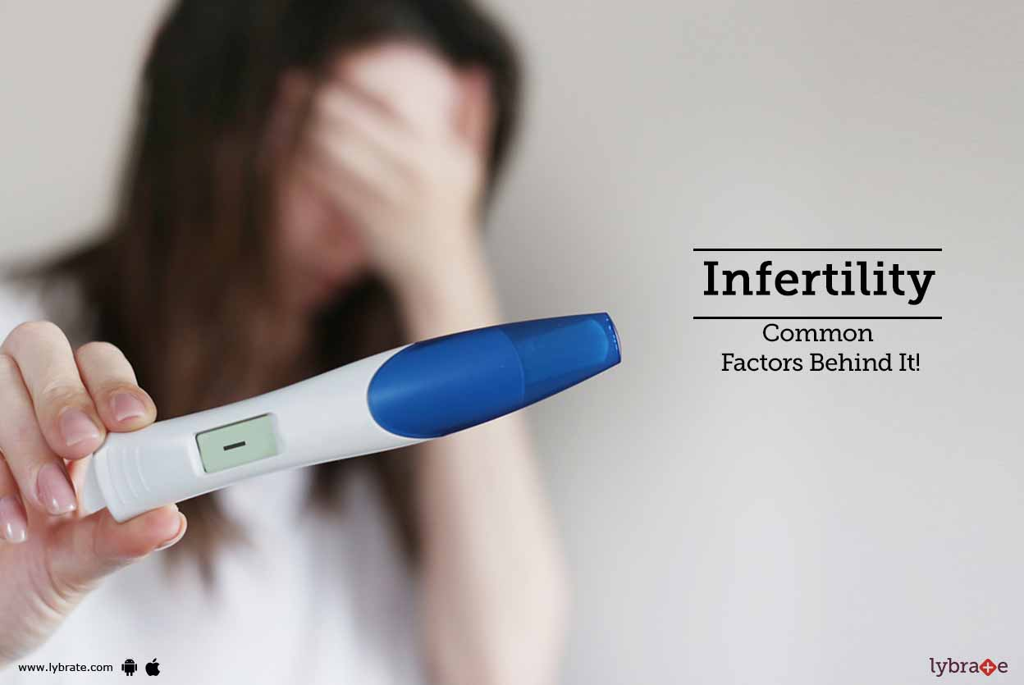
Infertility
Inability to conceive a child
40% women infertility; 40% men infertility; 20% unknown causes or linked to both partners.
Example- A Woman's ovary does not release an ovum each month.

Slide 21
Infertility Options
Medication- Fertility Drugs
Adoption- legally takes on all responsibilities and rights for raising, loving, and caring for a child in need of a permanent home.
Ovum Transfer- similar to In Vitro. Another woman donates an ovum.
Surrogate Mother- a woman who becomes pregnant for another woman. (legal arrangements)

Slide 22
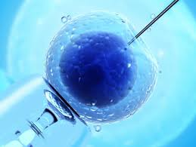
Infertility Options
Artificial Insemination- sperm injected in uterus.
In Vitro Fertilization-
doctor combines sperm and ovum. If fertilized, then placed in the uterus.

Slide 23
Not Using Infertility Options
Expensive
Controversial
Morals
New technology and knowledge

Slide 24
Critical Stages of Human Development

Slide 25
The end
of study guide

Slide 26
Genetics
At the moment of Conception
Baby receives 46 chromosomes.
Chromosome- a tiny threadlike structure in the nucleus of every cell.
Chromosomes come in 23 pairs
Each chromosomes has 100s to 1,000s genes

Slide 27
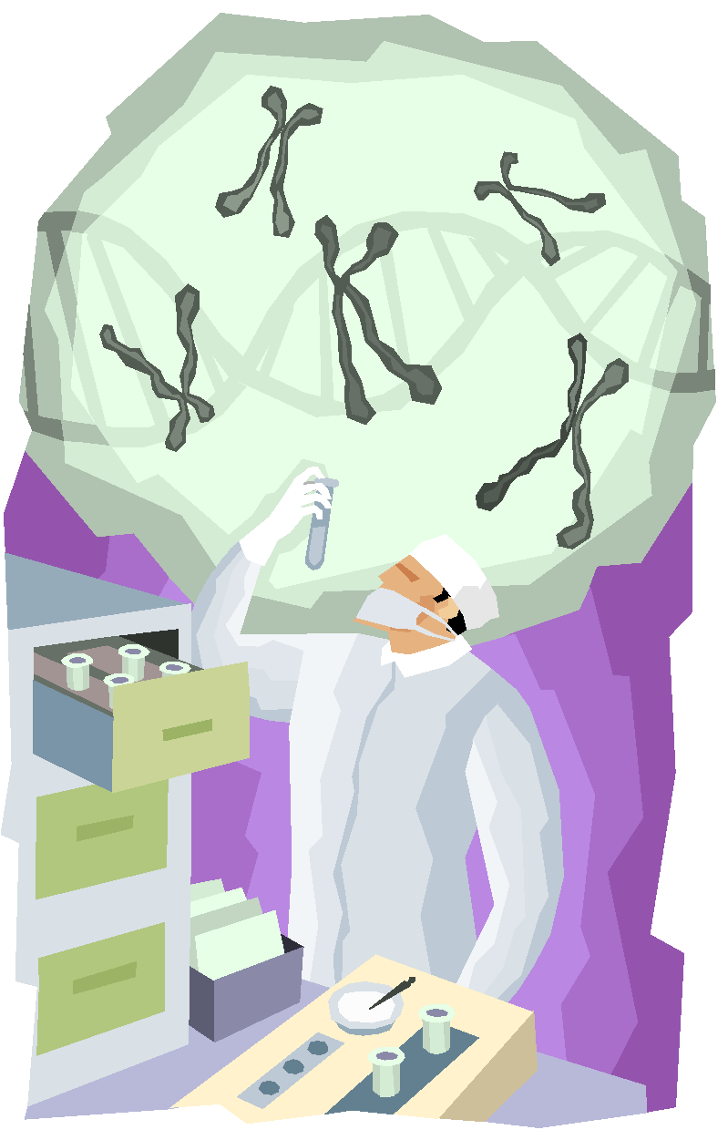
Genetics
Chromosomes
Chromosomes come in 23 pairs
Each chromosomes has 100s to 1,000s genes
Father’s sperm and mother’s ovum each contribute one chromosome to each pair.

Slide 28
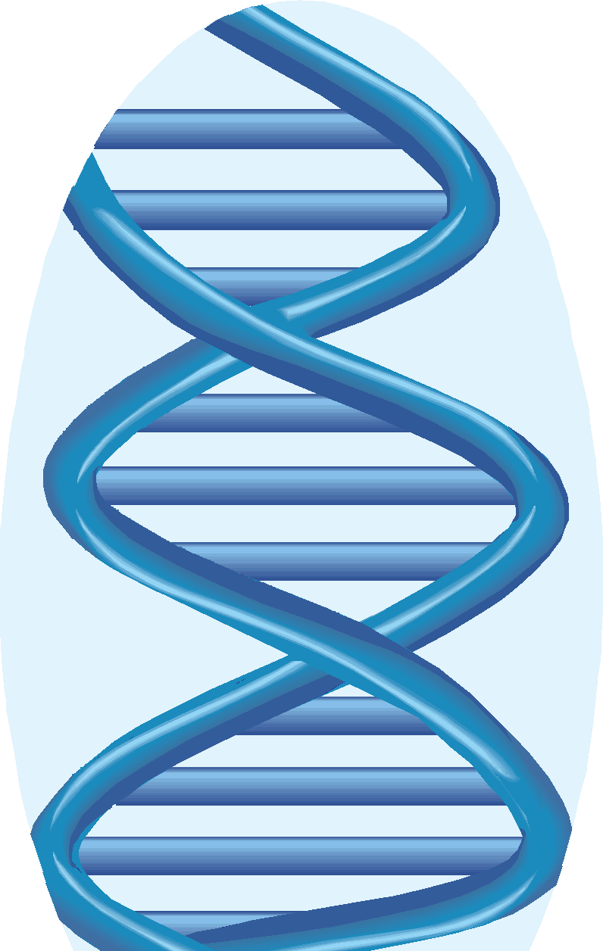
Genetics
Gene- a unit that determines a human’s inherited characteristics.
Genome- complete blueprint for the creation of a person.
DNA- the complex molecules that make up genes

Slide 29
Reflection Journal
Why is it important to eat healthfully during all stages of life?
Why is exercise important to help keep a body fit?
Where can you learn how to develop an exercise routine that is right for you?

Slide 30
Lightening
Happens in the 9th month
1st child- days to weeks before birth
2nd + child- right before birth
Fetus drops into the pelvis
Pressure on upper abdomen is reduced and breathing becomes easier

