Slide 1
Contraceptives
The history and mystery explained

Slide 2
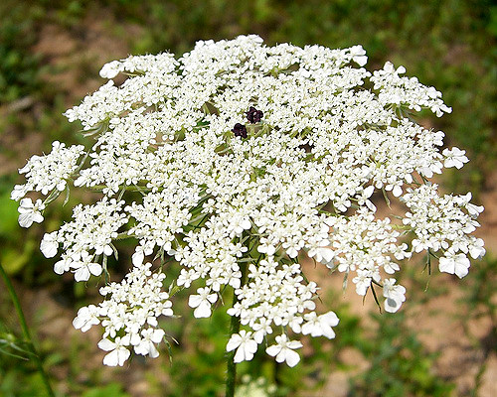
History of Birth Control
2,500 years ago ancient Greek physicians prescribed Queen Anne’s Lace as a “morning after birth control”
1850 BC recipes for contraceptives were found in Egypt

Slide 3
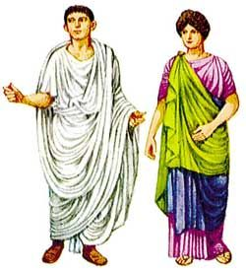
History of Birth Control
150 AD Ancient Romans used douche of oil to cleanse the vagina after intercourse
1600’s condoms were made of animal gut or membrane

Slide 4
History of Birth Control
1800”s physicians inserted collar buttons or wishbones as IUD’s
1880 the diaphragm was introduced
1955 the birth control pill was released

Slide 5
Definitions
BIRTH CONTROL
Control over pregnancy
Limit pregnancy
To space pregnancy
To end pregnancy
CONTRACEPTIVES
Methods used to keep females from getting pregnant
PROPHYLACTIC
Means to “guard against disease such as a condom
ABSTAIN
to hold oneself back voluntarily

Slide 6
Prefix and Suffix
Brainstorm words with the prefix and suffix
CONTRA = against or in opposition
CEPTION = beginning or start
STERILE = the opposite of fertile
CIDE = to kill, act of killing
INTRA = inside

Slide 8
Contraceptive Categories
Hormonal - hormones control ovulation
pill, patch, vaginal ring, injection, implant
Barriers - block sperm from entering the cervix
Condoms, spermicides, diaphragm, cervical cap, sterilization
Intrauterine Device - device inside the uterus
IUD
Natural Methods - no hormones or barriers
Abstinence, Fertility awareness, withdrawal
Emergency Contraception - to prevent a pregnancy
Plan B, morning after pill

Slide 9
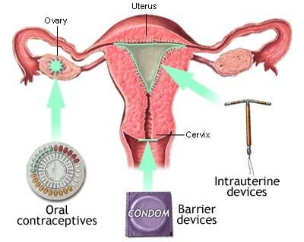
Categories Contraceptives
Hormonal Contraceptive

Slide 10
Christina Hickman, MA Edu, 2018

